Slide 1
Standardization Roadmap for U.S. Electric Vehicle Deployment
Jim McCabe
Senior Director, Standards Facilitation
American National Standards Institute
NHTSA EV Safety Technical Symposium
May 18, 2012

Slide 2
ANSI EVSP
American National Standards Institute’s Electric Vehicles Standards Panel (ANSI EVSP)
  80 private and public sector organizations involved from automotive, utility, electrotechnical industries, standards developing organizations (SDOs), government agencies
  Strictly a coordinating body; it does not develop standards
Mission: To foster coordination and collaboration on standardization matters among public and private sector stakeholders to enable the safe, mass deployment of electric vehicles and associated infrastructure in the U.S. with international coordination, adaptability and engagement
ANSI EVSP Roadmap | NHTSA Symposium
Slide 2

Slide 3
Roadmap Released – April 2012
Standardization Roadmap for Electric Vehicles, Version 1.0
  Free Download at www.ansi.org/evsp
Identifies standards, codes, and regulations that exist or that are in development, gaps where new or revised standards are needed, related conformance and training programs, and harmonization efforts
Includes prioritized timelines for when standardization should occur and identifies SDOs that may be able to do the work
Focus is on-road plug-in EVs, both battery electric and plug-in hybrids, charging systems and associated support services for U.S. market
ANSI EVSP Standards Compendium, a searchable spreadsheet of standards related to issues identified in the roadmap
Slide 3
ANSI EVSP Roadmap | NHTSA Symposium
Notes:
Notes:

Slide 4
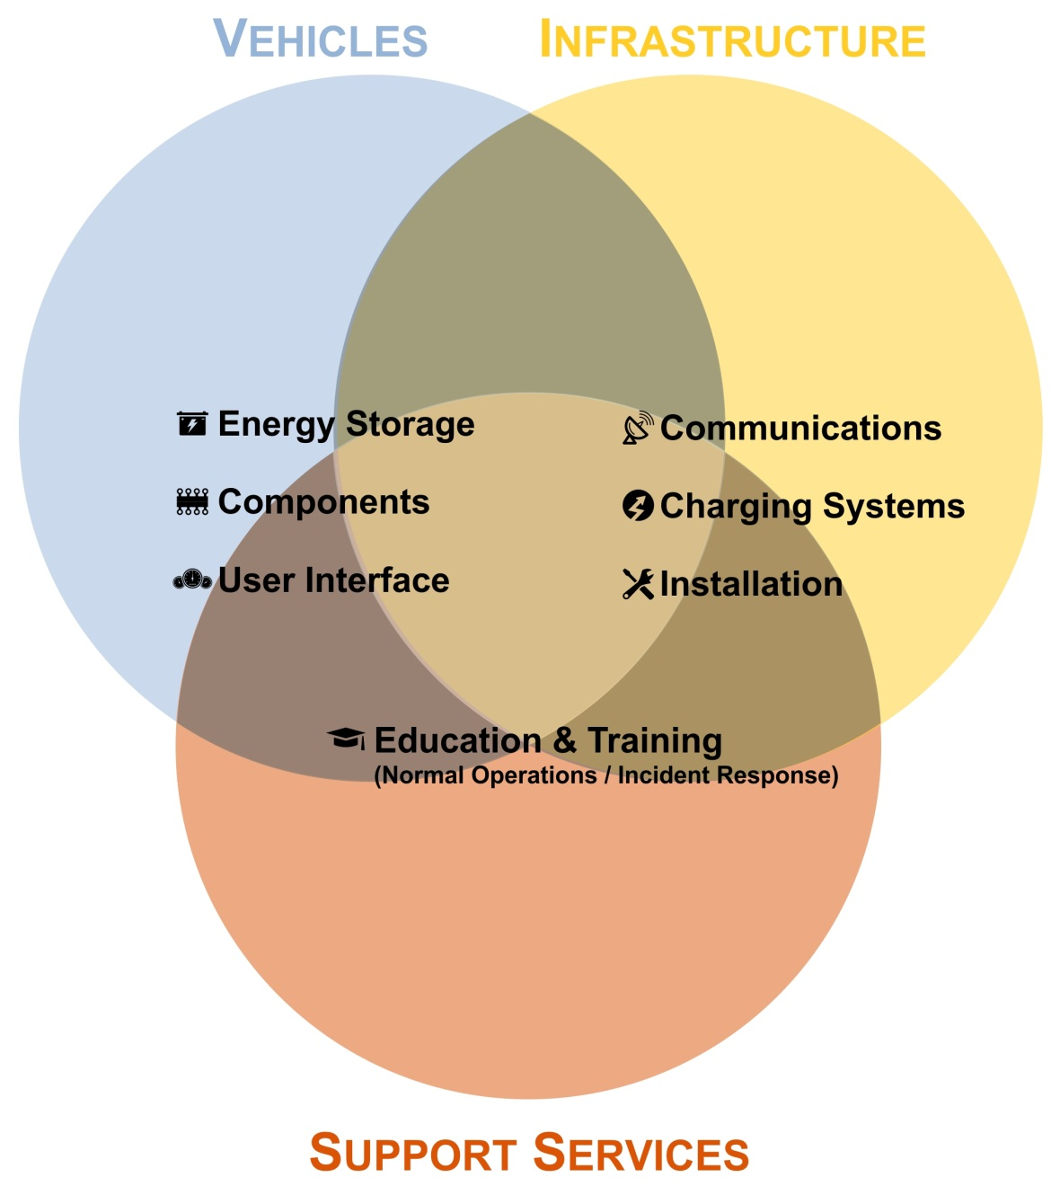
Structure
ANSI EVSP Roadmap | NHTSA Symposium
Slide 4

Slide 5
Conclusions
36 gaps or partial gaps identified
  22 are near-term priorities (0-2 years)
  12 are mid-term priorities (2-5 years)
  2 are long-term priorities (5+ years)
16 issues where no gap identified
Many SDOs (both U.S. based and non-U.S. based) produce globally relevant standards following an open, consensus-based process
  SAE, UL, NFPA, IEEE, ISO, IEC et al.
365 standards identified from 34 organizations
  Some of the existing / needed standards relating to EVs, batteries, EV charging and harmonization listed on next slides
ANSI EVSP Roadmap | NHTSA Symposium
Slide 5

Slide 6
EV Standards
Terminology
ISO 8713:2005, Electric road vehicles – Vocabulary
SAE J1715:2008, Hybrid Electric Vehicle (HEV) & Electric Vehicle (EV) Terminology; being split into two parts between SAE Hybrid and Battery Committees. Mid-term gap: Revise J1715.
Power Rating Methods (in development)
SAE J2907, test method/conditions for rating performance of electric propulsion motors in hybrid electric and battery electric vehicles
SAE J2908, test method/conditions for rating performance of hybrid-electric and battery electric vehicle propulsion systems reflecting thermal and battery capabilities and limitations
Mid-term gap: Complete J2907 and J2908.
ANSI EVSP Roadmap | NHTSA Symposium
Slide 6

Slide 7
EV Standards (contd.)
Crash Tests / Safety
NHTSA FMVSS 305, Electric Powered Vehicles: Electrolyte Spillage and Electrical Shock Protection. Last revised 2011. No gap.
High Voltage Cables, On-Board Wiring, Component Ratings and Charging Accessories: IEC, SAE and UL standards exist. No gap.
Vehicle Diagnostics – Emissions: Covered by California Air Resources Board on-board diagnostic system regulations. No gap.
Audible Warning Systems
NHTSA safety standard in development, incorporating portions of SAEJ2889-1, Countermeasure Performance Evaluation & Test Procedure. SAE standard is basis of ISO/NP 16254 (in development).
UNECE WP.29 looking at global technical regulation (GTR)
Near-term partial gap: Address EV sound emission / measurement
ANSI EVSP Roadmap | NHTSA Symposium
Slide 7

Slide 8
EV Standards (contd.)
Graphical Symbols
Some general IEC standards including IEC TR 60784:1984, Instrumentation For Electric Road Vehicles
NHTSA FMVSS 101, Controls and Displays. Last published 2008.
Near-term gap: Develop EV graphical symbols standards for parts under hood and to communicate information to driver. Develop SAE j2936, Vehicle Battery Labeling Guidelines
Telematics – Driver Distraction
Auto Alliance Driver Focus Telematics Guidelines; NHTSA Proposed Driver Distraction Guidelines; NHTSA FMVSS 101
No gap.
Fuel Efficiency, Emissions and Labeling: July 2011 EPA / NHTSA Final Rule references several SAE standards. No gap.
ANSI EVSP Roadmap | NHTSA Symposium
Slide 8

Slide 9
Battery Safety
IEC 62660-2:2010, Secondary batteries for the propulsion of electric road vehicles – Part 2: Reliability and abuse testing for lithium-ion cells
ISO 6469-1:2009, Electric road vehicles – Safety specifications – Part 1: On-board rechargeable energy storage system (RESS)
ISO 6469-3:2001, Electrically propelled road vehicles – Safety specification – Part 3: Protection of persons against electric shock
ISO 12405-1:2011, Electrically propelled road vehicles – Test spec for lithium-ion traction battery packs and systems – Part 1: High-power applications
ISO 12405-2, Electrically propelled road vehicles – Test spec for lithium-ion traction battery packs and systems – Part 2: High-energy applications (in development)
ISO 12405-3, Electrically propelled road vehicles – Test spec for lithium-ion traction battery packs and systems – Part 3: Safety (in development)
ANSI EVSP Roadmap | NHTSA Symposium
Slide 9

Slide 10
Battery Safety (contd.)
SAE J1766:2005, Recommended Practice for Electric and Hybrid Electric Vehicle Battery Systems Crash Integrity Testing (under revision)
SAE J2464:2009, Electric and Hybrid Electric Vehicle Rechargeable Energy Storage System (RESS) Safety and Abuse Testing
SAE J2929:2011, Electric and Hybrid Vehicle Propulsion Battery System Safety Standard Lithium‐based Rechargeable Cells (under revision)
  Near-term gap: Address delayed battery overheating events in J2929
  Mid-term gap: Address loss of control / dual mode failure in J2929
ANSI/UL 2580:2011, Batteries for Use in Electric Vehicles
NHTSA FMVSS 305, Electric Powered Vehicles: Electrolyte Spillage and Electrical Shock Protection. Last revised 2011.
Movement underway by WP.29 to develop GTR on EVs w/batteries a subset
ANSI EVSP Roadmap | NHTSA Symposium
Slide 10

Slide 11
Battery Performance and Durability
Testing etc.
IEC standards for cell level performance testing
ISO 12405-1 and -2 for pack level performance testing
SAE J1798, Recommended Practice for Performance Rating of Electric Vehicle Battery Modules (in development)
  Mid-term gap: Complete J1798; if possible, harmonize with ISO 12405-2.
UL has defined requirements and testing / certification services for batteries
Long-term gaps: Standards needed for battery recycling / battery secondary uses
ANSI EVSP Roadmap | NHTSA Symposium
Slide 11

Slide 12
Battery Storage, Packaging, Transport and Handling
Near-term gap: No standards address safe storage of lithium-ion batteries specifically, whether at warehouses, repair garages, recovered vehicle storage lots, auto salvage yards, or battery exchange locations
Develop a standard on safe storage practices for both new and waste EV batteries including when battery separated from host vehicle. Potential Developers: SAE, NFPA, ICC, IEC/TC 69.
Near-term gap: Current standards / regulations do not adequately cover transportation of waste batteries (damaged, aged, sent for repair, end-of-life)
Develop a harmonized approach toward communication, labeling, packaging restrictions, criteria for when a battery is waste. Potential Developers: ISO/TC 22/SC21, SAE or UL.
ANSI EVSP Roadmap | NHTSA Symposium
Slide 12

Slide 13
EV Charging Standards
Wireless Charging. Near-term gap: Complete work on SAE J2954 and UL 2750.
Battery Swapping. Near-term gap: Define minimum requirements for safe operation of battery swapping stations, as well as interoperability standards. Potential Developer: IEC/TC 69.
Electric Vehicle Supply Equipment (EVSE)
SAE J2894, Power Quality Requirements for Plug-in Electric Vehicle Chargers. Part 1 requirements published Dec 2011. Near-term gap: Complete work on SAE J2894, Part 2, test procedures.
EVSE Charging Levels
SAE J1772TM, Recommended Practice for Electric Vehicle and Plug-in Hybrid Electric Vehicle Conductive Charge Coupler. Defacto U.S. standard.
IEC 61851 addresses levels (modes) and safety; IEC 62196 addresses connectors
Near-term partial gap: Complete work to establish DC charging levels in J1772
ANSI EVSP Roadmap | NHTSA Symposium
Slide 13

Slide 14
EV Charging Standards (contd.)
Off-Board Chargers and Supply Equipment
Near-term partial gap: Finish harmonization of safety requirements for off-board charging stations and portable EV cord sets, with respect to risk of fire, shock and injury to persons, within North America, based on UL 2594, Standard for EVSE
Mid-term partial gap: Harmonize safety requirements for off-board chargers within North America, based on UL 2202, Standard for EV Charging Equipment
Mid-term partial gap: Work to harmonize IEC 61851 series of standards and the North American standards to address safety of off-board chargers, off-board charging stations, and portable EV cord sets
Slide 14
ANSI EVSP Roadmap | NHTSA Symposium
Notes:
Notes:

Slide 15
EV Charging Standards (contd.)
EV Couplers
Near-term partial gap: Finish harmonization of EV coupler safety standards within North America, based on UL 2251, Standard for Plugs, Receptacles and Couplers for EVs
Near-term partial gap: Work to harmonize the IEC 62196 series of standards and the North American EV coupler safety standards
Near-term partial gap: Work to harmonize EV coupler configurations internationally, in particular with respect to DC charging
Near-term gap: Complete work on SAE J2953, PEV Interoperability with EVSE. Establish conformance programs for EV / EVSE interoperability within the U.S. market, based on SAE J1772TM, J2953 and a UL verification program under development.
ANSI EVSP Roadmap | NHTSA Symposium
Slide 15

