Slide 1

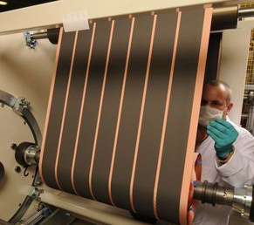
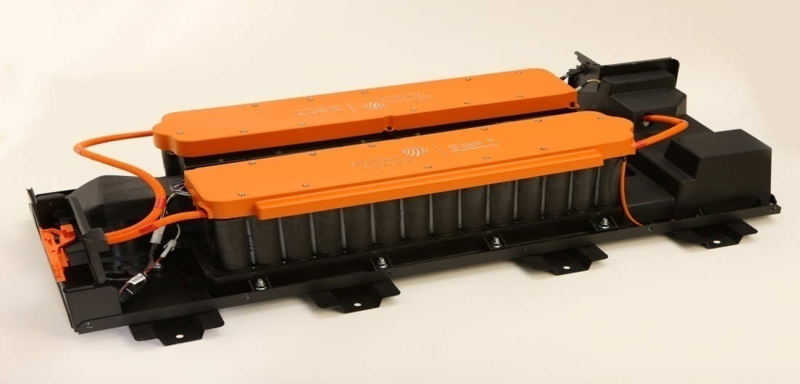
U.S. DOE Perspective on Lithium-ion Battery Safety
David Howell
US Department of Energy
Washington, DC
Technical Symposium: Safety Considerations for EVs powered by Li-ion Batteries
The National Highway Traffic Safety Administration
May 18, 2011

Slide 2
Outline
Program Overview
Safety and Abuse Tolerance Activities
DOE Safety/Abuse Testing
Battery Design & Modeling
Materials R&D
Vehicle Testing
Collaborations
Summary & DOE Perspectives

Slide 3
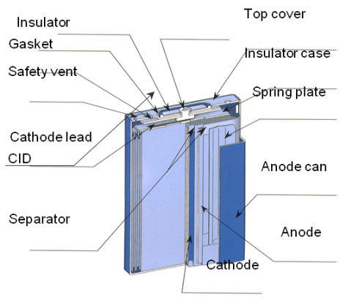
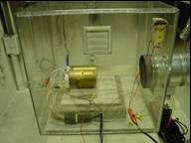

Programmatic Structure
MISSION: Advance the development of batteries to enable a large market penetration of hybrid and electric vehicles to achieve large national benefits..
Energy Storage R&D
$93 M
Battery Development
45%
Applied Battery Research
20%
Testing, Analysis & Design
10%
Exploratory Materials Research
25%
e⁻
e⁻
Anode
Cathode
e⁻
Separator
Cu Current Collector
Li⁺
Al Current Collector
New Materials Research
Diagnostics & Modeling
Electrochemistry Optimization
Power & Capacity
Life, Improvement
Next Generation Cell Development
Performance & Cost Reduction
Standardized Testing
Life Projections
Design Tools
3 | Energy Efficiency and Renewable Energy

Slide 4
Major Technical Challenges and Barriers
Barrier/Challenge | Potential Solutions
Reduce Cost | Improve material and cell durability Improve energy density of active materials Improved manufacturing processes Improved design tools/design optimization
Significantly Increase Energy Density (3rd generation lithium-ion, lithium-sulfur, lithium-air) | Develop ceramic, polymer, and hybrid structures with high conductivity, low impedance, and structural stability Select improved electrolyte/separator combinations to reduce dendrite growth
Improve Abuse Tolerance (High energy density, reactive materials, flammable electrolytes) | Implement battery cell and pack level innovations (e.g., improved sensing, monitoring, and thermal management systems) Implement battery materials innovations (e.g., non-flammable electrolytes, high-temperature melt integrity separators, additives & coatings)
Cost
Specific Energy/
Energy Density
Safety
4 | Energy Efficiency and Renewable Energy

Slide 5
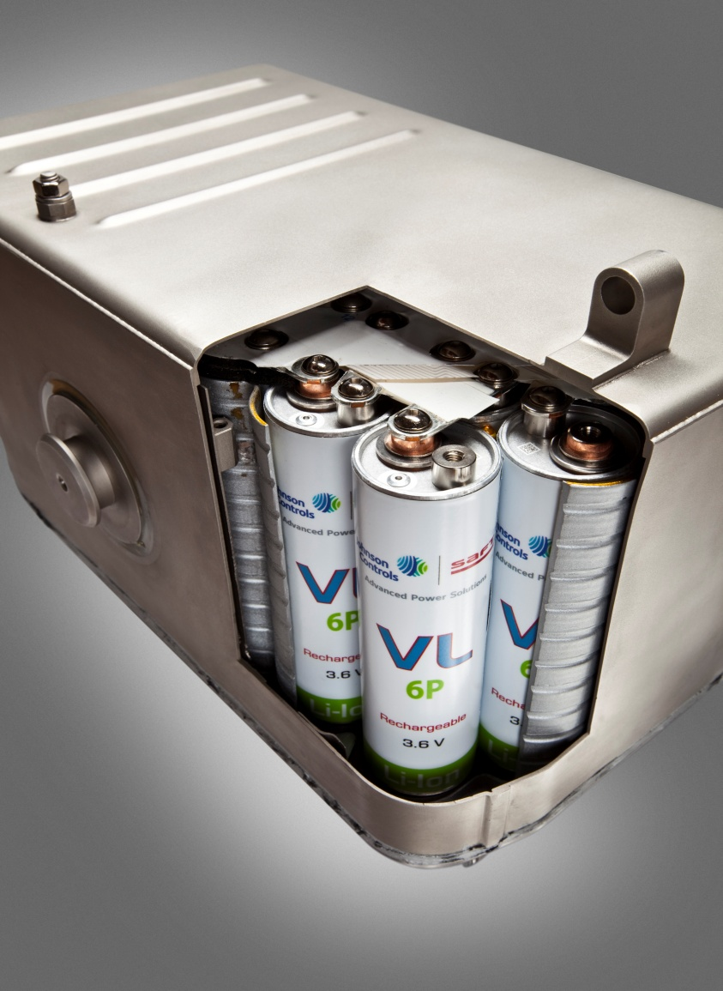
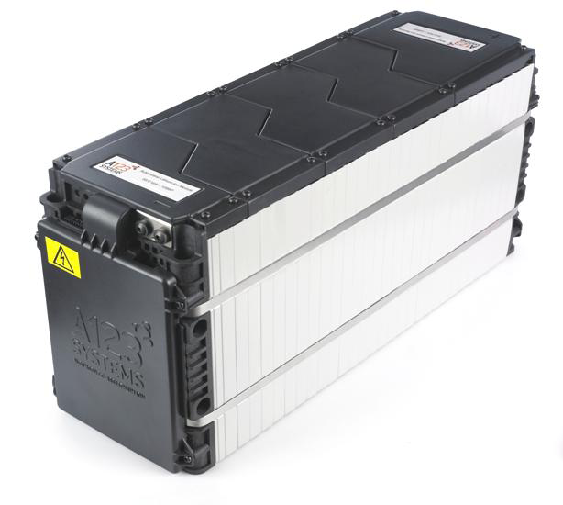
Battery Cell Form Factors
Battery Pack with Prismatic Cells
Battery Pack with Cylindrical Cells
Courtesy: A123Systems
Courtesy: Johnson Controls Inc.
5 | Energy Efficiency and Renewable Energy

Slide 6
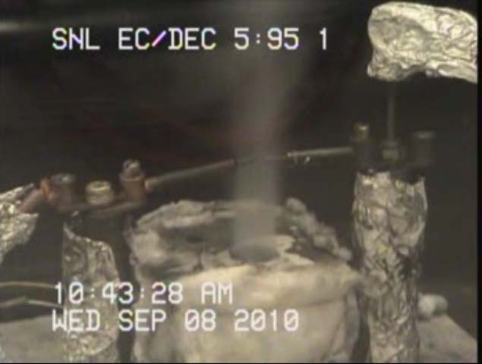
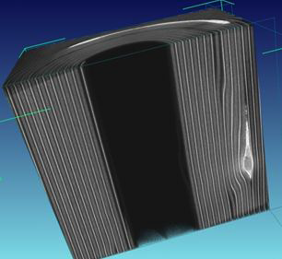
Safety/Abuse Tolerance Testing
Abusive Conditions
  Mechanical (crush, penetration, shock)
  Electrical (short circuit, overcharge, over discharge)
  Thermal (overheating from external/internal sources)
  Abuse Testing Methodology
  SAE Abuse Test Manual J2464
  Several members of the VTP Team participated on the committee to develop the new SAE Abuse Test Manual
Facilities: Sandia National Laboratories was awarded funding through the American Reinvestment and Recovery Act (ARRA) for facility upgrades to the Battery Abuse Testing Laboratory.
  Improving the safety engineering controls and systems required to accommodate abuse testing PHEV and EV sized batteries,
  Updating laboratory equipment and systems to facilitate the growing demand for safety testing.
CT image of an 18650 Li-ion cell with a large defect in the roll

Slide 7
Test Methods Development
“On Demand” Internal Short Circuit Test Development
Many field failures are caused by internal shorts resulting from manufacturing defects or foreign particles inadvertently incorporated in the cell during manufacture.
  The internal short could lead to thermal runaway and severe reactions.
DOE has funded multiple projects to develop techniques to mimic internal shorts on demand.
  The purpose of the work is to develop a tool or technique that will be used to develop methods to detect and mitigate internal shorts.
  Techniques under development include
    Low-melting point metal alloys used to trigger ISCs at relatively low temperatures (SNL and NREL)
    Pinch test using spherical balls (ORNL)
    Proprietary method (TIAX)
Preliminary experimental demonstration of differences in ISC severity based on short type (current collector-current collector, current collector-active material)
Experimental data will be incorporated in thermal models developed by NREL and TIAX.
Reproducibility needs to improve for all methods
Notes:
Internal short circuits plagued the Li ion consumer battery market 5 years ago, leading to massive and costly recalls. Our national labs are trying to develop a repeatable internal short circuit test, which is proving to be much more difficult that we envisioned. We’ve tried low melting point alloys, pinch tests, heater wire insertion, etc. All have major issues.

Slide 8
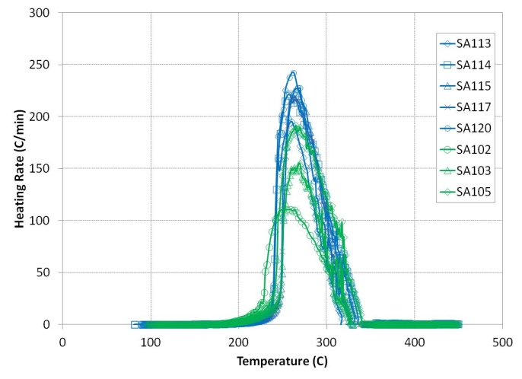
Aged Cell Testing
Impact of Cell Age on Abuse Response
Accelerating Rate Calorimetry (ARC)
ARC profiles plotted as heating rate as a function of temperature for the fresh cell (in blue) and 20% faded aged cell (in green) populations.
Notes:
For some time we’ve wondered how cells’ abusive characteristics change as they age. Here we find that the abuse response is somewhat mitigated in a cell that as undergone 20% capacity fade.

Slide 9
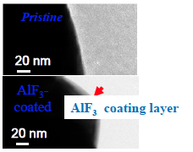
Battery Development Efforts to Improve Safety
United States Advanced Battery Consortium (USABC)
The United States Advanced Battery Consortium (USABC) is a collaborative effort among Ford, GM, Chrysler and DOE to develop advanced automotive batteries.
Abuse tolerance is among the barriers being addressed.
The cell materials technologies being developed are:
  Safety reinforced separators
  Ceramic filled separators
  High temperature melt integrity separators
  Coatings on high voltage cathodes
  Cathode additives to improve abuse
  Electrolyte additives to mitigate overcharge
  Heat resistant layers on anode and cathode electrodes
AlF₃ coating layer for cathodes
Notes:
Development of physics based models is being used to elucidate the causes of cell abuse failures, such as dendrite formation and growth, cathode breakdown, and eventually, SEI breakdown.

Slide 10
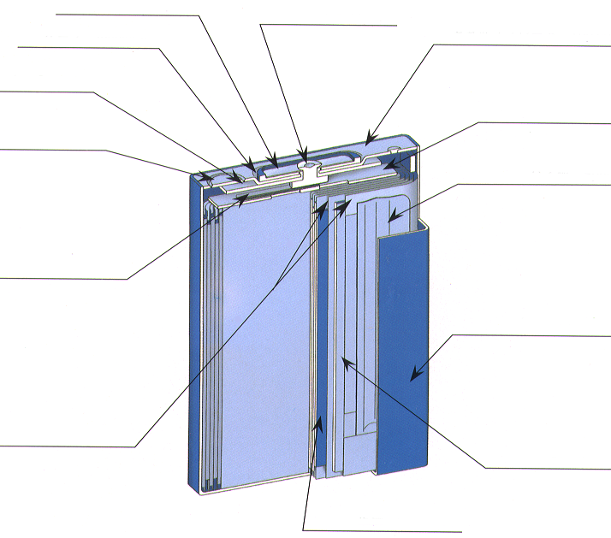
Battery Development Efforts to Improve Safety
USABC Cell and Abuse Tolerance Improvement Efforts
Work at cell & pack level also includes improving abuse tolerance.
Technologies being developed:
  Charge interrupt devices
  Cell vent designs to release electrolyte gasses prior to thermal runaway
  System designs that manage vented gasses away from passenger areas
  Liquid and gas, active and passive, thermal management systems
  Simulations to evaluate abuse tolerance mitigation technologies at the cell and system level
Schematic of Prismatic Cell
Terminal plate
Cathode pin
Insulator
Top cover
Gasket
Insulator case
Safety vent
Spring plate
Cathode lead
CID
Anode can
Separator
Anode
Cathode
Wound or Stacked Electrodes
Notes:
Development of physics based models is being used to elucidate the causes of cell abuse failures, such as dendrite formation and growth, cathode breakdown, and eventually, SEI breakdown.

Slide 11
Battery Design & Modeling
Computer-aided Engineering of Batteries (CAEBAT)
Develop computer-aided engineering (CAE) tools for the design and development of battery systems for electric drive vehicles
Develop and incorporate existing and new models into a battery design suite to reduce battery development time and cost while improving safety and performance
Include CAE tools to predict and improve safety of cells and battery packs
Battery design suite must address multi-scale physics interactions, be flexible, expandable, and validated
CAEBAT Overall Program
Element 4: Open Architecture Software
Element 1
Component
Level Models
Element 2
Cell
Level Models
Element 3
Battery Pack
Level Models
Notes:
Development of physics based models is being used to elucidate the causes of cell abuse failures, such as dendrite formation and growth, cathode breakdown, and eventually, SEI breakdown.

Slide 12
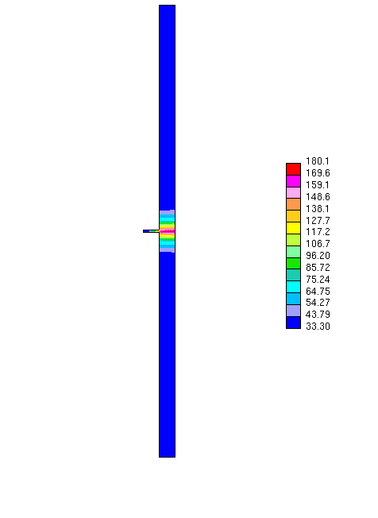
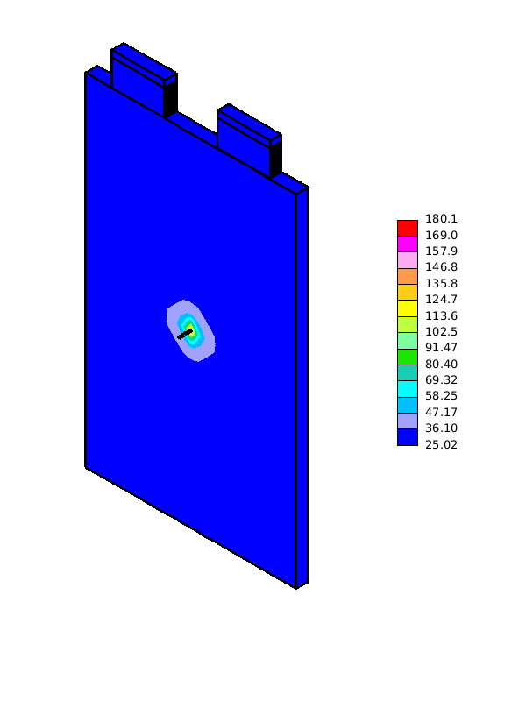
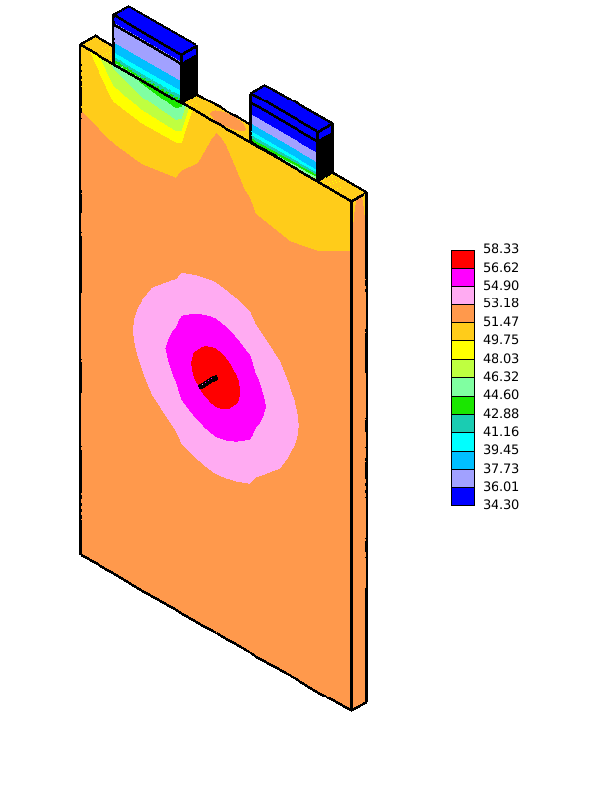
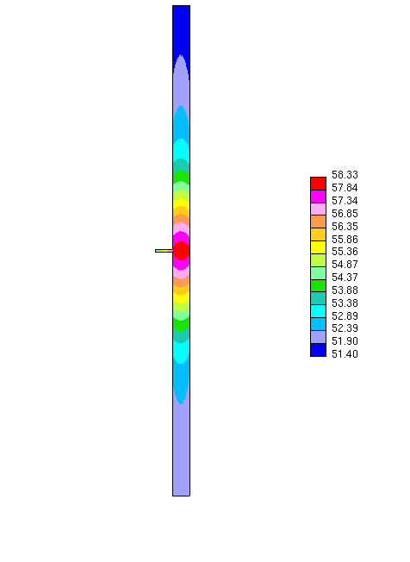
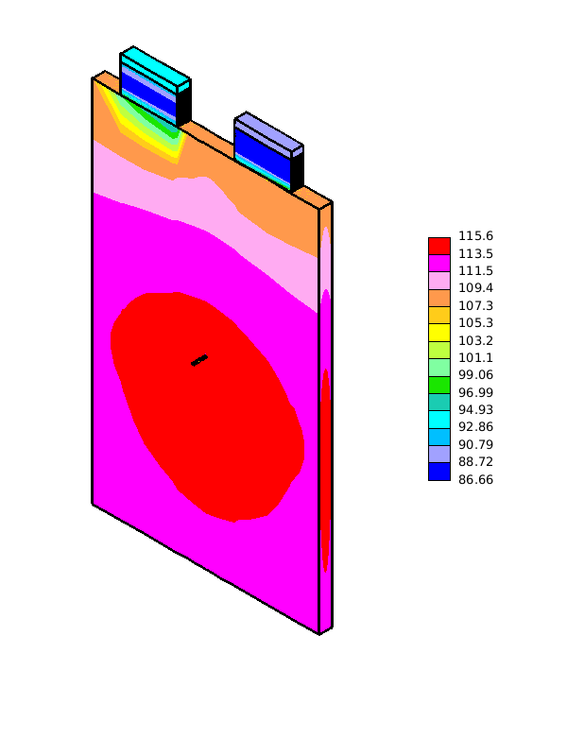
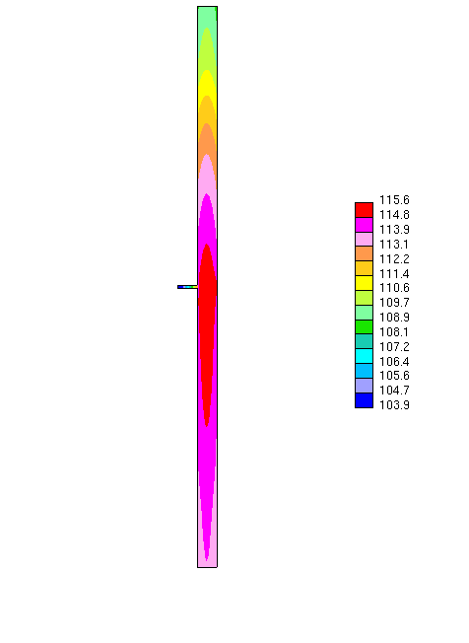
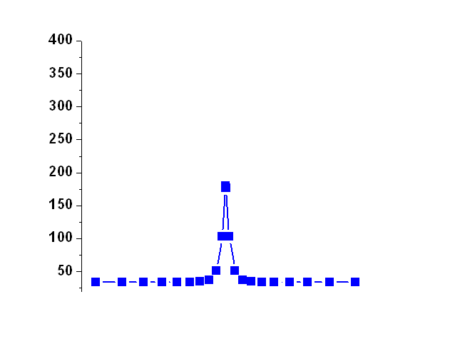

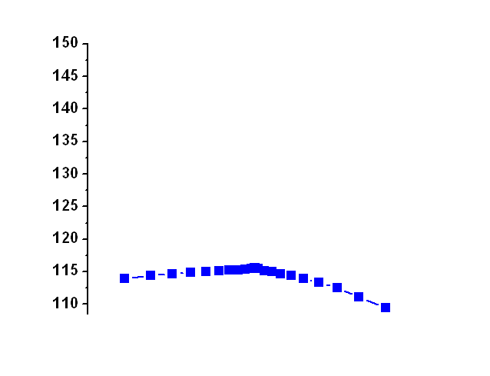
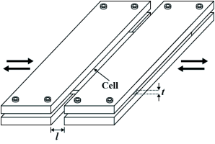
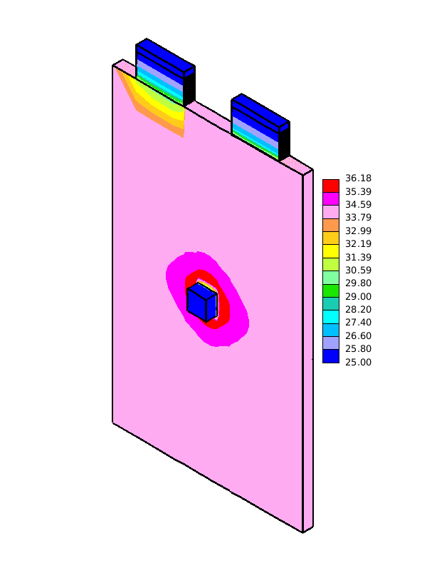
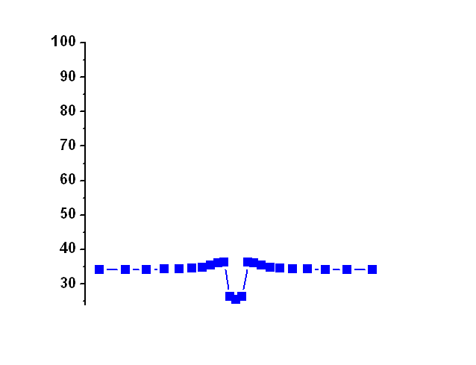
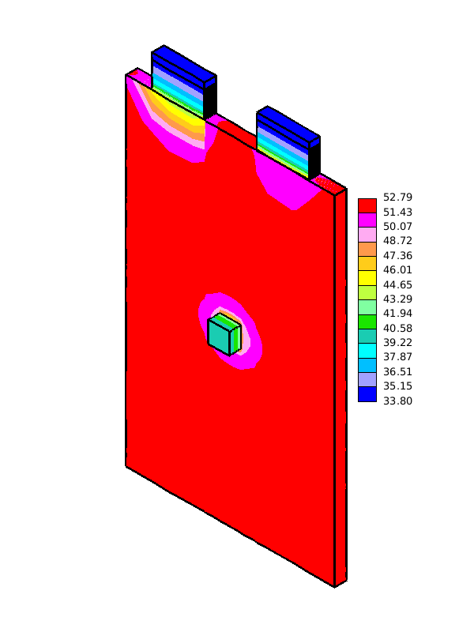

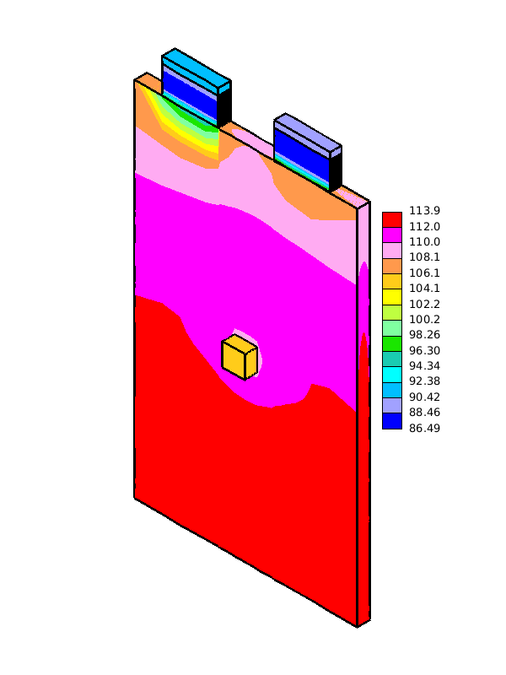

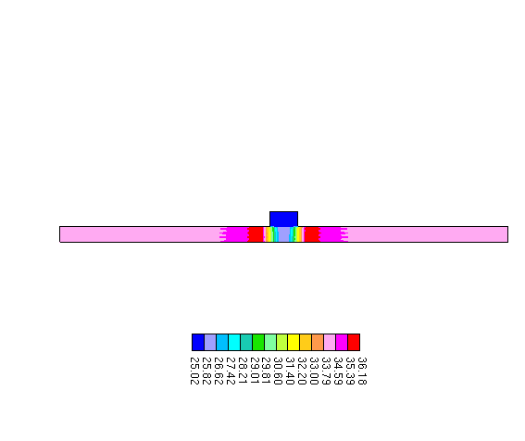
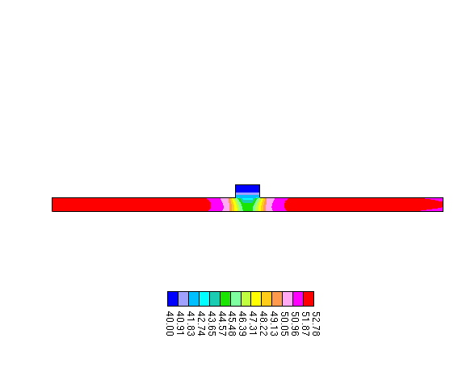
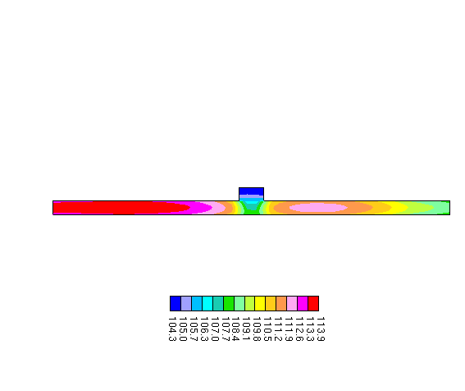

Battery Safety Abuse Modeling
Thermal Response and Short Circuit Modeling
  EC-Power : thermal response, full and partial nail penetration, shorting by metal particle
  NREL , Tiax: thermal response, and internal short circuit models
Structural Crash Models
  University of Michigan (USCAR funding) developing a mechanical constitutive analytical model and a numerical simulation model.
  Sandia National Labs (DOE funding) validating the models
Future R&D to develop safety modeling that combines electrochemical-thermal coupled models with mechanical material models.
Full Penetration
Diameter = 0.5 mm
T_{max}=180ºC
T_{avg}= 34ºC
T_{max}-T_{avg}=146ºC
T_{max}=58ºC
T_{avg}= 53ºC
T_{max}-T_{avg}=5ºC
T_{max}=116ºC
T_{avg}= 113ºC
T_{max}-T_{avg}=3ºC
0.5s
10s
100s
Diameter = 8 mm
T_{max}=36ºC
T_{avg}= 34ºC
T_{max}-T_{avg}=2ºC
T_{max}=52.8ºC
T_{avg}= 52.3ºC
T_{max}-T_{avg}=0.5ºC
T_{max}=114ºC
T_{avg}= 112ºC
T_{max}-T_{avg}=2ºC
0.5s
10s
100s
Notes:
A 10 Ah prismatic cell case study shown on the right demonstrates the temperature change effect due to a 0.5mm or 8mm diameter full nail penetration. This analysis is possible due to 3-D electrochemical-thermal coupled modeling.

Slide 13
Materials R&D
Cathodes with Improved Stability
Accelerating Rate Calorimetry (ARC)
EC:PC:DMC
1.2M LiPF₆
Increased thermal-runaway-temperature and reduced peak-heating-rate for full cells
Decreased cathode reactions associated with decreasing oxygen release
Notes:
One of the advantage of our independent testing is that we can provide unbiased assessments of materials and cells. The results here are expected, we’ve know for some time which cathodes are more reactive at high states of charge. This graph, along with the recent GM fire involving an A123 system with LFP cathode, also emphasizes the importance of electrolyte flammability to battery safety.

Slide 14
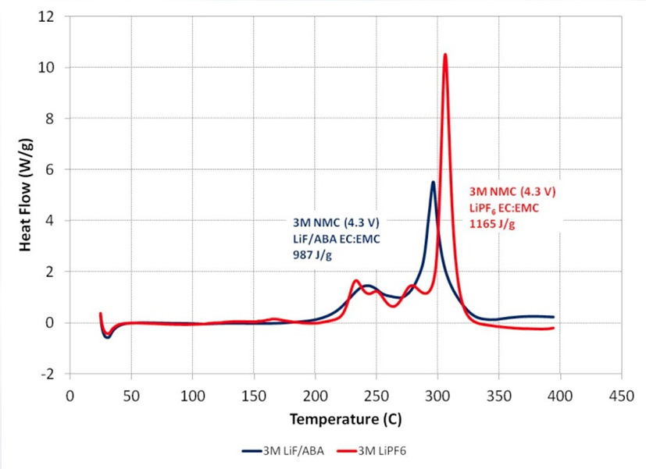
Materials R&D (cont’d)
Cathode coatings and novel electrolytes
Anion Boron Receptor Electrolyte
Thermal Response of AlF₃-coated Gen3 cathode in 18650 cells by ARC
AlF₃-coating improves the thermal stability of NMC materials by 20°C
Improves thermal response during cell runaway
50% reduction in total heat output of NMC 433 with LiF/ABA electrolyte compared to standard electrolyte,
Reduce gas generation and decomposition products
Notes:
Coatings are being investigated in an attempt to slow down highly energetic reactions. Here it is found that AlF3 coatings do more than slow the reaction down, and delays its onset by about 20°C, which would give the BMS more time to shut the entire system down.

Slide 15
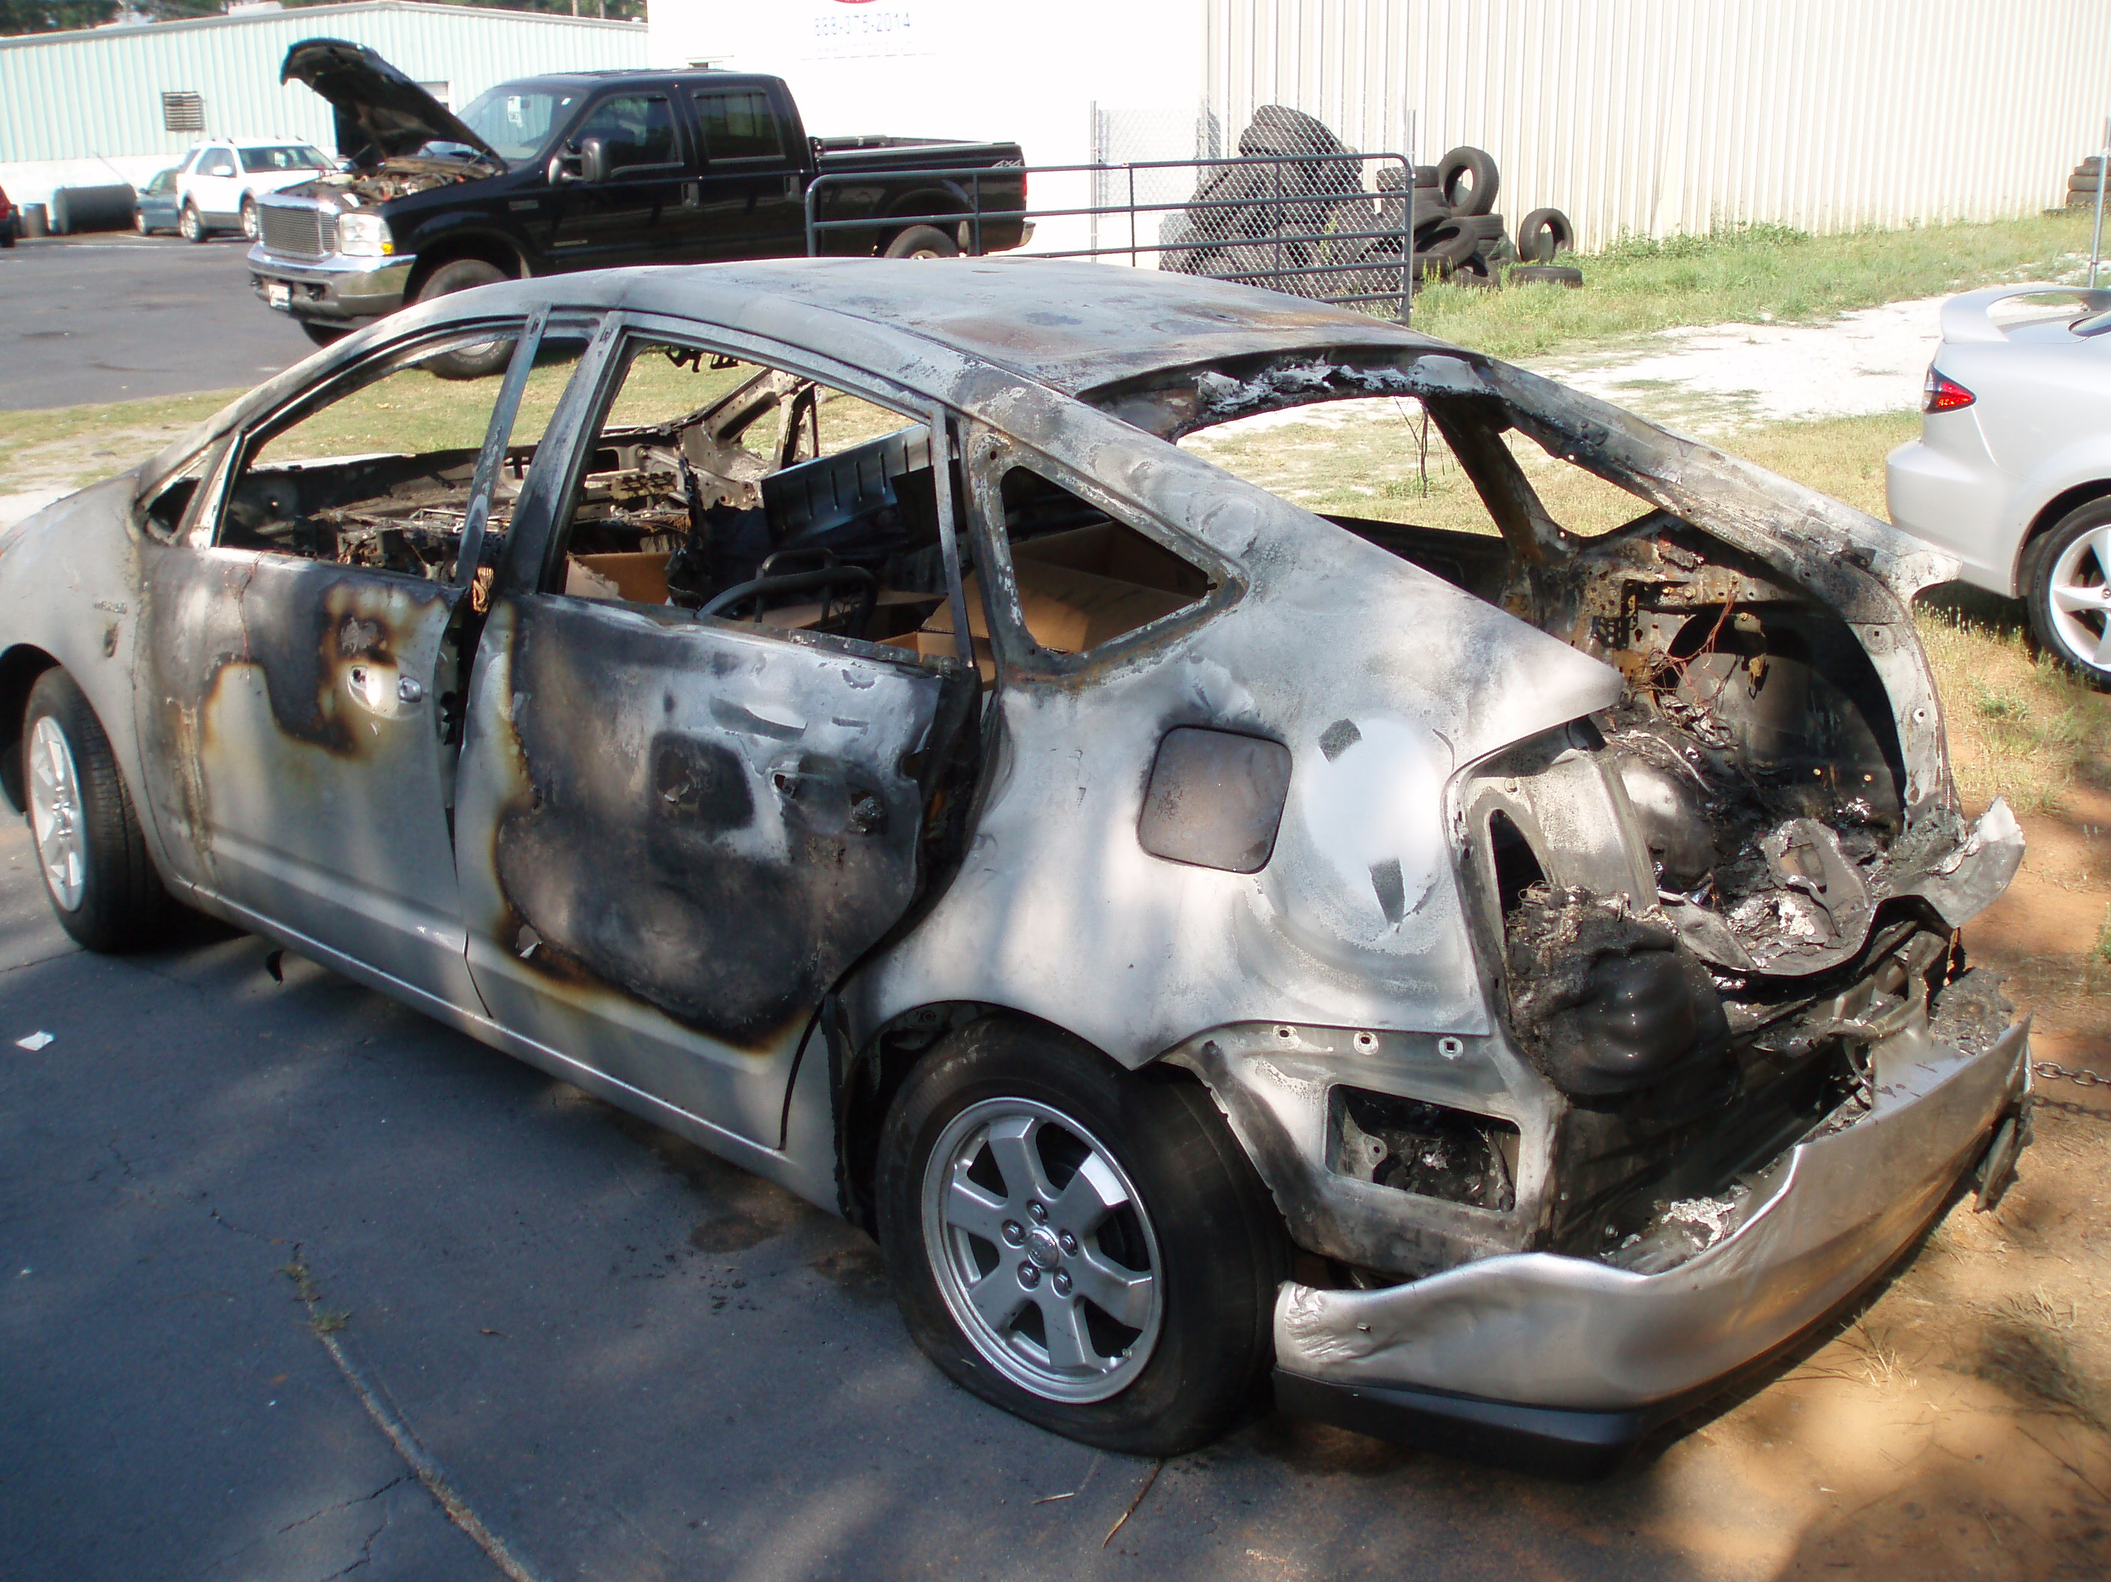
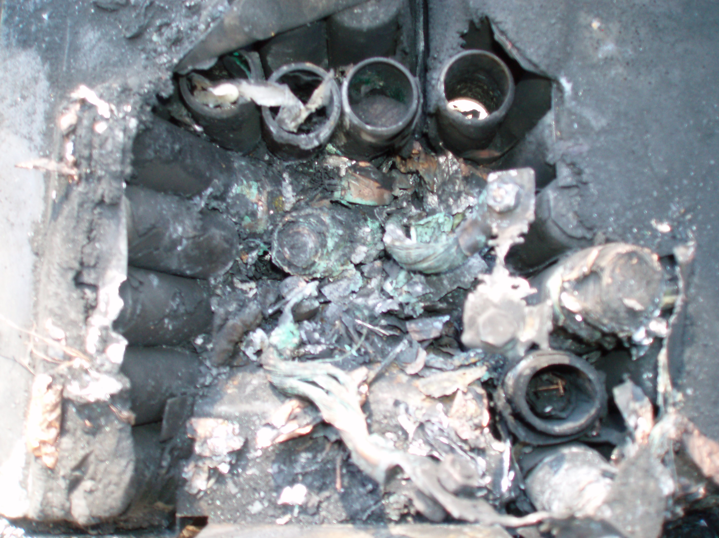
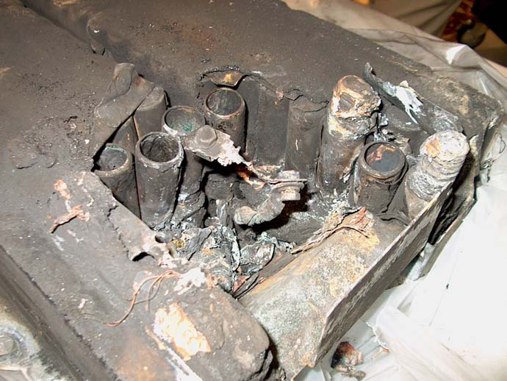
DOE Fleet Testing Safety Experience
DOE’s Advanced Vehicle Testing Activity tests and collects data on electric drive vehicles (EDVs) using conversion, prototype, and production vehicles, some with Li-ion batteries.
In 2011, data was collected for 6,500 vehicles over trips covering more than 26 million miles in EDVs with almost no adverse events.
Three thermal events have occurred in non-production vehicles in recent years.

Slide 16
DOE Fleet Testing Safety Experience
 | Vehicle 1 | Vehicle 2 | Vehicle 3
Type | HEV converted into a PHEV by adding a 12 kWh Li-ion pack | HEV converted into a PHEV : NiMH pack with a 5kWh Li-ion pack | PHEV with a 12kWh pack
Event | Battery received 13.5kWh overcharge Significant smoke, heat, but no flame evidence Battery cells remained in place Components (pouch bag, solvents, separator) with low melting points were missing | Vehicle fire Converter design deviated from battery manufacturer design guidelines The first responders had easy access to the battery, significant damage occurred to the pack and the vehicle before they arrived | Significant smoke, heat, but no flame evidence The first responders sprayed significant volumes of water into the vehicle to extinguish the melting seat and carpeting Pack resumed smoking and significant heat rise. Testing indicated one module had high voltage Load bank was used to discharge the high voltage module and stabilize battery.
Cause | Likely a faulty charger or BMS | Likely caused by improper assembly of bolted joints with electric lugs | Most likely cause of the failure was faulty wiring design.

Slide 17
DOE Fleet Testing Safety Experience
Summary
Damage can be limited if responders have good access to the battery pack
Full battery discharge/thermal event can continue over multiple days
Issues to consider with PHEV battery and vehicle design
  Lack of common disconnect locations
  Responders unaware of hazards
    Electrical safety personal protection equipment (PPE) and breathing apparatus should be worn by first responders
Access to battery pack is critical IF an event occurs

Slide 18

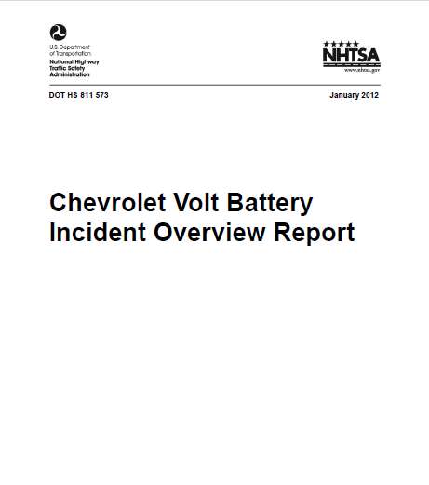
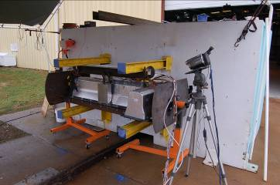
Intra Government Collaborations
DOT/NHTSA
  Technical support for Regulations for battery transportation
  Collaboration on Battery Safety tests with NHTSA and NSWC
  DOE/DOT/INL is working with the National Fire Prevention Association to develop PPE needs and first responder training aids. We are filming multiple lithium battery test burns with multiple suppression methods utilized
  Joint studies, working groups
Volt battery pack being prepared for test
Notes:
Department of Transportation/NHTSA
Joint Interdepartment EV Working Group
Joint program with NHTSA: NFPA study
Collaboration: NHTSA – Chevrolet Volt fire
Regulations: transportation of Li batteries
U.S. Army Tank Automotive Research, Development and Engineering Center (TARDEC)
Cooperative Agreement: TARDEC & VTP
Collaboration: CAE-BAT
Pilot Line Facility for the Production of Advanced Battery Materials at ANL
U.S. Army Research Laboratory
Advanced electrolytes & cathodes
U.S. Naval Surface Warfare Center/Carderock
Develop high energy density lithium-ion asymmetric electrochemical capacitors
Identify advanced materials to meet cold start, power assist & regenerative braking
Investigate electrochemical performance and thermal behavior of prototype cells
Collaboration: PC Test, U of MA-Boston, FMC Corp., Hunter College of CUNY
Develop technology associated with assessing the safety of advanced batteries
Participate in NHTSA testing of Volt batteries
Assess flammability and heat release of Li-ion electrolytes
Collaboration: Oak Ridge on internal short circuit technique

Slide 19
DOE Perspective Regarding Lithium-ion Battery Safety
Safety of Batteries is of Central Importance
Safety is a key barrier to introduction of rechargeable batteries into vehicles.
  Vehicle environment is challenging (temperature, vibration, etc.)
  Large cells and large capacity batteries for vehicle traction present additional challenges
Safety is a systems issue, with many inputs and factors.
  Even “safe” cells and batteries can prove unsafe in some applications due to poor engineering implementation or an incomplete understanding of system interactions.
Standardized tests are crucial to obtain a fair comparison of different technologies and to gauge improvements.

