Slide 1
EV Vehicle Safety
Manuel Bartolo
Automotive Safety Office, Ford Motor Company
Electric Vehicle Safety Technical Symposium
May 18, 2012

Slide 2

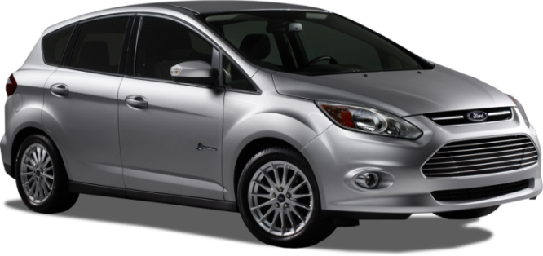
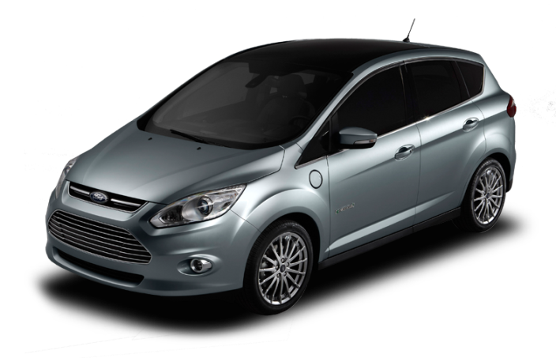

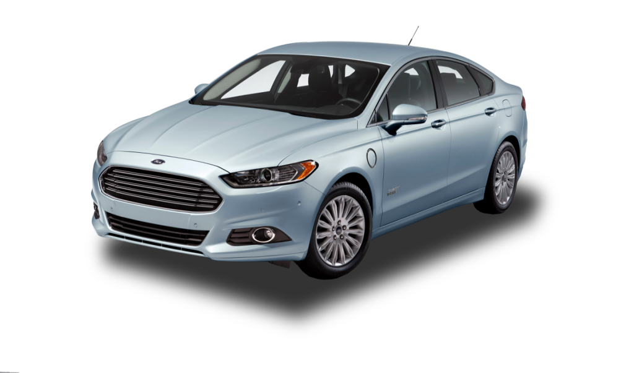



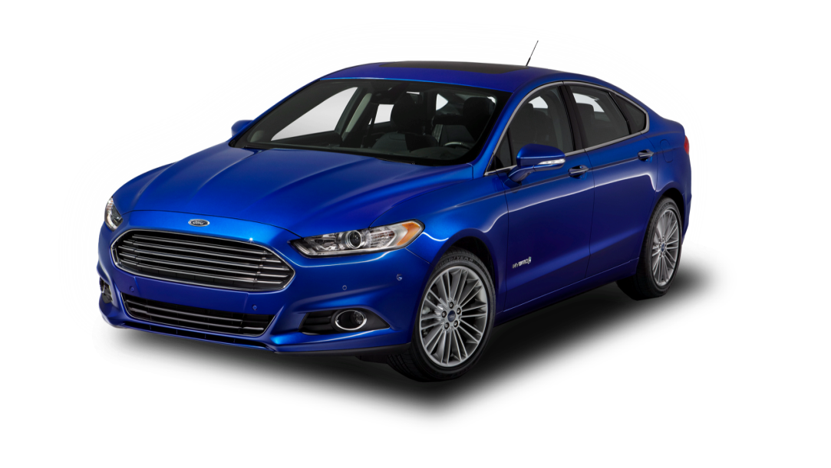

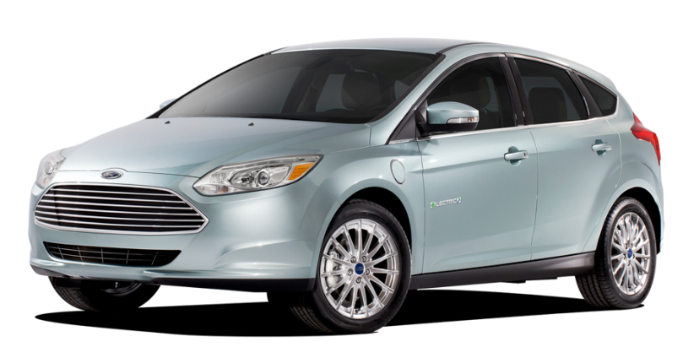

ELECTRIFIED VEHICLES
TRIPLING
PRODUCTION CAPACITY
IN NORTH AMERICA BY 2013

Slide 3



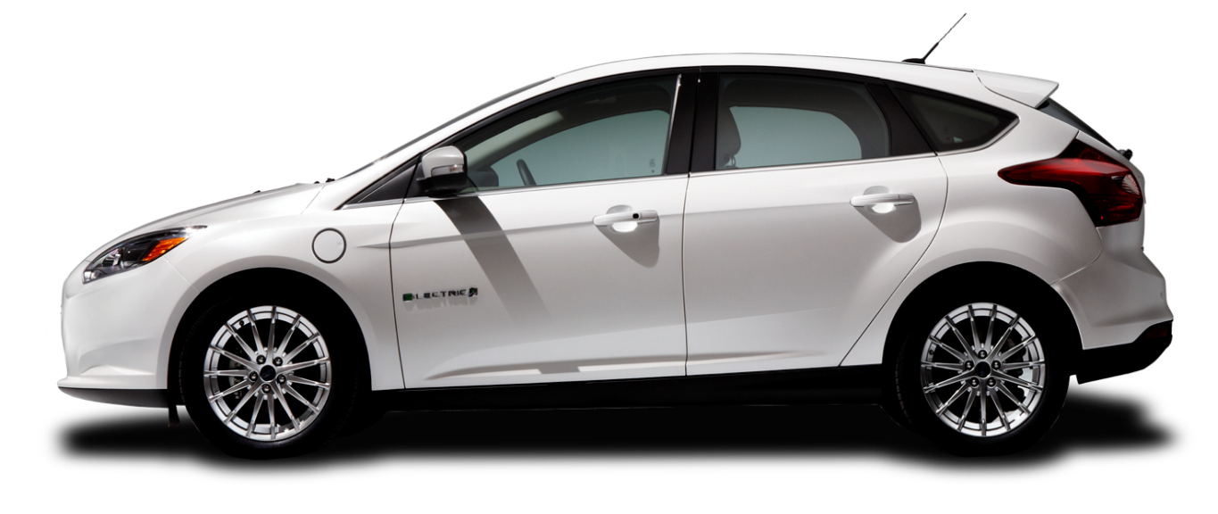
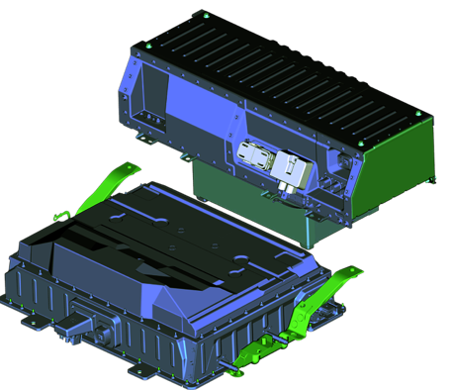
110 MPGe Advanced Li-Ion Battery
5 PASSENGER 25-30% smaller
FASTER CHARGING 50% lighter
LIQUID-COOLED
23kWh
LITHIUM-ION BATTERY PACK
MORE EFFICIENT
BATTERY TEMPERATURES

Slide 4
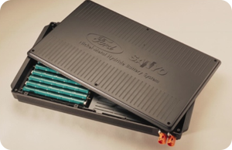

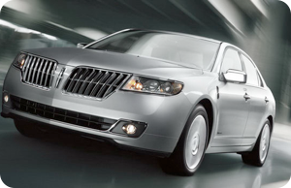
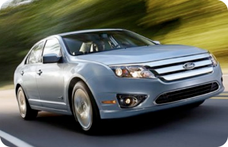
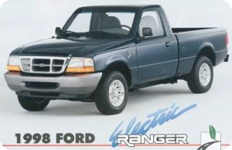

RELIABILITY
Researching and developing modern electrified vehicles for decades
1996
1998
2004
2009
2010
Cell Testing and Research
Ford Escape Hybrid
Ford Ranger Electric
Ford Fusion Hybrid

Slide 5
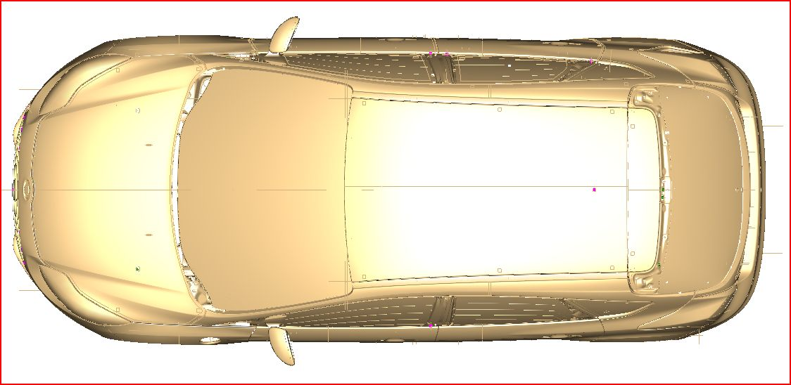
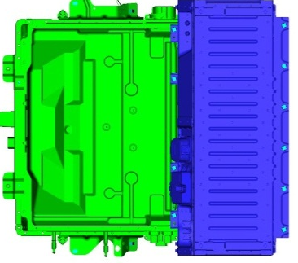
Graphical Crash Requirements - FMVSS 305
30mph
Rigid
Barrier
30mph
30º Left & Right
Angular
33.5mph
Left & Right
27º Crabbed Cart
50mph 70% Overlap
V-to-V Left & Right
Frontal Crash Events
Side Crash Events
Rear Crash Events

Slide 6
Graphical Crash Testing for Public Domain & Internal
35mph NCAP
Rigid Barrier
NCAP 20mph Oblique
Left & Right Pole (5th/50^{th%})
High Speed
V-to-V
Left & Right
Rear
40mph 40%
IIHS Offset
High Speed
V-to-V
Left & Right Side
38.5mph
NCAP Left & Right
Side MDB
31mph
Left IIHS
Cart

Slide 7
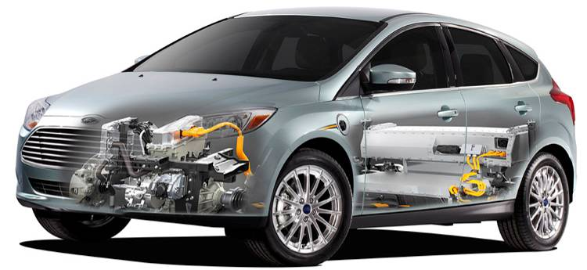
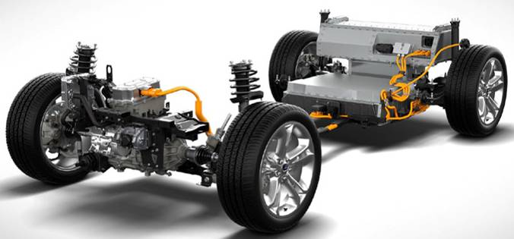
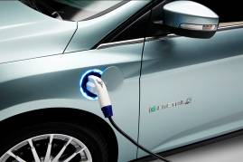
Focus Electric Battery Location
BEV Upper Battery Pack is mounted in the trunk behind the second row seats. Lower portion of pack extends through trunk floor to the outside of the vehicle
BEV Battery Packs
BEV Lower Battery Pack is mounted under the vehicle below the second row seats

Slide 8
FMEA Analysis
Potential
Effects
Noise Factors &
Failure Modes
Prevent
Actions
Stress
No Effect
Protection Activated
Damage/
Retention
Leakage
Venting
Fire/Flame
Normal Conditions
Noise Factors
Off-Normal Conditions
Failure Modes
Over Temperature
Over Charge
Over Discharge
External Short
Internal Cell Short
Vehicle Level Design Actions
Pack Level Design Actions
Cell Level Design Actions

Slide 9
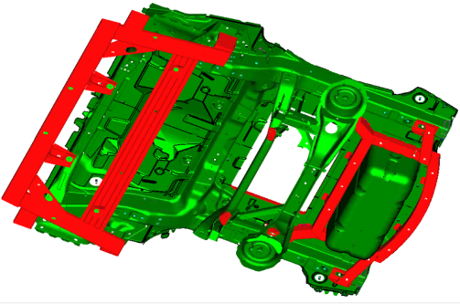
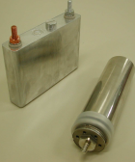
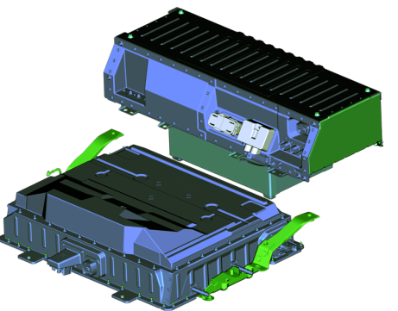
Vehicle, Pack & Cell Level Actions
Pack Level Actions
Battery Pack Structure
Vent Management Sys
Pack Cooling Sys
Battery Controls Sys
Power Limits (Temp, Age, others)
Over Temp
Over Charge/Discharge
ENS Control
Cell Balancing
Battery Sensors (V, I, T)
Fusing
Vehicle Level Actions
Vehicle Structure
Vehicle Cooling Sys
Vehicle Controls Sys
Charging Control Sys
Cell Level Actions
Cell Chemistry
Cell Design
Cell Manufacturing
(occurrence reduction)

Slide 10
Typical Testing and Verification
  Mechanical: Vibration, Shock, Battery Enclosure Integrity
  Electrical: Electrical Short circuit, Over
  Charge & Dis-charge Protection
  Environmental: High/Low Temperature Exposure Thermal Shock, Humidity and Moisture Exposure, Corrosion, Immersion
Examples of typical tests that may be conducted on battery cells, battery pack assemblies, and/or entire vehicles.

Slide 11
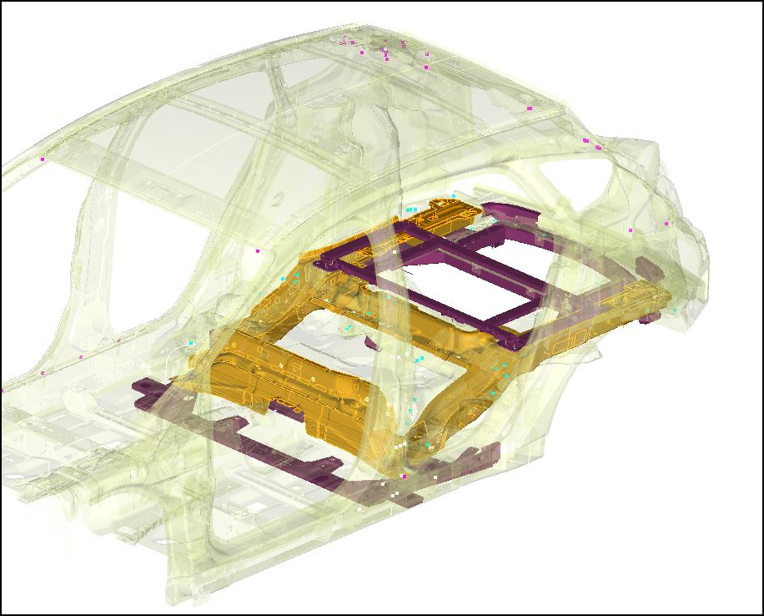
Focus Electric – Vehicle Level Structural Components
Unique Designed
(Material &/or gauge revised)
Structural additions for battery pack crash protection
(Purple)

Slide 12
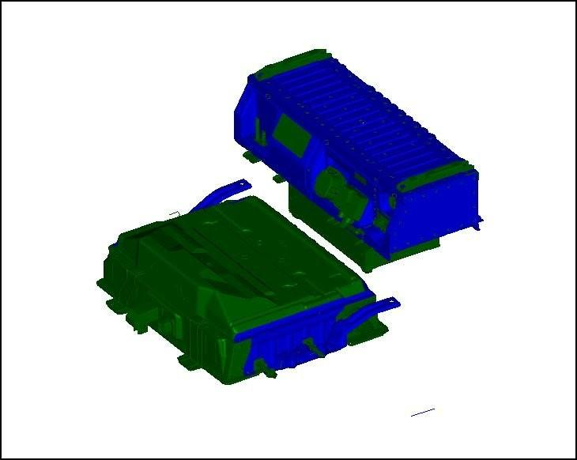
Focus Electric – Battery Pack Structural Components
Battery Pack Casing
Casing modifications for enhanced crash protection. (Blue)

Slide 13
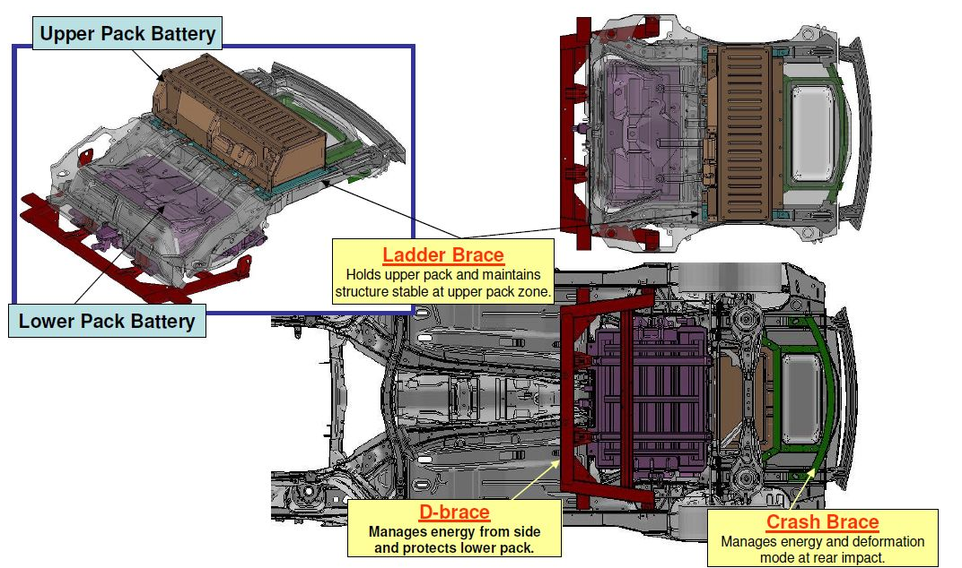
Focus Electric – Rear Body Structure

Slide 14


Guidance for Potentially Damaged Batteries
Guidance for Ford Motor Company Electric and
Hybrid-Electric Vehicles Equipped With
High Voltage Batteries
(Vehicle Owner/Operator/General Public)
Electric and Hybrid-Electric Vehicle Considerations in the event of damage or fire involving an electric vehicle (EV) or hybrid-electric vehicle (HEV):
• Always assume the high voltage (HV) battery and associated
components are energized and fully charged.
• Exposed electrical components, wires, and HV batteries present
potential HV shock hazards.
• Venting/off-gassing HV battery vapors are potentially toxic and flammable.
• Physical damage to the vehicle or HV battery may result in immediate
or delayed release of toxic and/or flammable gases and fire.
Vehicle Information and General Safety Practices
• Know the make and model of your vehicle.
• Review the owner’s manual and become familiar with your vehicle’s
safety information and recommended safety practices.
• Do not attempt to repair damaged electric and hybrid-electric vehicles
yourself. Contact an authorized Ford Dealer or vehicle manufacturer
representative for service.
Crashes
A crash or impact significant enough to require an emergency response
for conventional vehicles would also require the same response for an
electric or hybrid-electric vehicle.
If possible
• Move your car to a safe, nearby location and remain on the scene.
• Roll down windows before shutting vehicle off.
• Place vehicle in Park, set parking brake, turn off the vehicle, activate
hazard lights, and move key(s) at least 16 feet (5 meters) away from
the vehicle.
Always
• Call 911 if assistance is needed and advise that an electric or
hybrid-electric vehicle is involved.
• Do not touch exposed electrical components or the engine
compartment, as a shock hazard may exist.
• Avoid contact with leaking fluids and gases, and remain out of the way
of oncoming traffic until emergency responders arrive.
• When emergency responders arrive, tell them that the vehicle involved
is an EV or HEV.
Fires
As with any vehicle, call 911 immediately if you see sparks, smoke, or
flames coming from the vehicle.
• Exit the vehicle immediately.
• Advise 911 that an electric or hybrid-electric vehicle is involved.
• As with any vehicle fire, do not inhale smoke, vapors, or gas from the
vehicle, as they may be hazardous.
• Remain a safe distance upwind and uphill from the vehicle fire.
• Stay out of the roadway and stay out of the way of any oncoming
traffic while awaiting the arrival of emergency responders.
Post-Incident
• Do not store a severely damaged vehicle with a lithium-ion battery
inside a structure or within 50 feet (15 meters) of any structure or
vehicle.
• Ensure that passenger and cargo compartments remain ventilated
(i.e., open window, door, or trunk).
• For vehicles in the United States, notify Ford Motor Company
1-800-392-3673 (then follow the prompts on the voice response menu),
an authorized Ford dealer or service center as soon as possible as there
may be other steps to secure and/or discharge the HV battery.
• For vehicles in Canada, notify Ford Motor Company 1-800-565-3673
(then follow the prompts on the voice response menu), an authorized
Ford dealer or service center as soon as possible as there may be
other steps to secure and/or discharge the HV battery.
• Call 911 if you observe leaking fluids, sparks, smoke, or flames, or
hear gurgling or bubbling from the HV battery.
The damaged vehicle guidance that is outlined in the Focus EV “Emergency Response Guide” is consistent with NHTSA recommendations

Slide 15


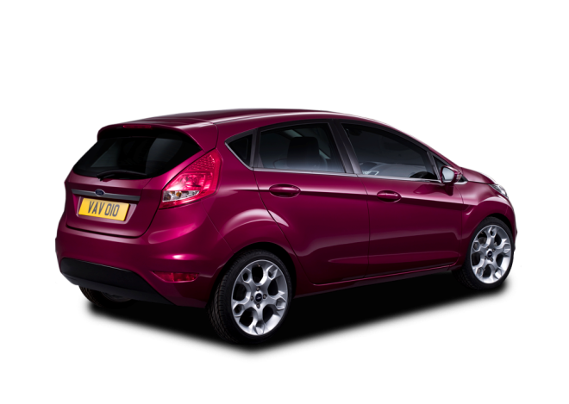

Great Products, Strong Business, Better World

