Slide 1
Consideration of Hybrid and Electric Batteries on Commercial Vehicles
May 18, 2012 Presentation to the
National Highway Transportation Safety Administration
Colin Casey
Chief Engineer, Hybrid Powertrain
Navistar, Inc.

Slide 2
Agenda
Commercial Electric and Hybrid Vehicles
Requirement Differences: Commercial vs. Auto
Safety Considerations for Commercial (H)EV.
Design Practices of Commercial H/EV Systems.

Slide 3
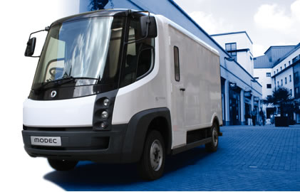
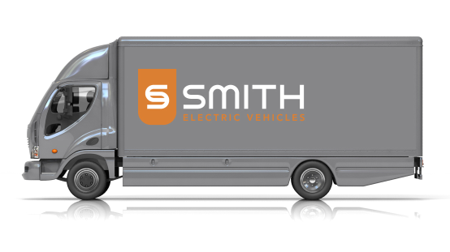
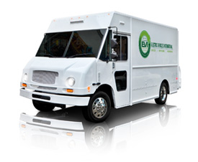

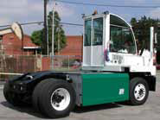
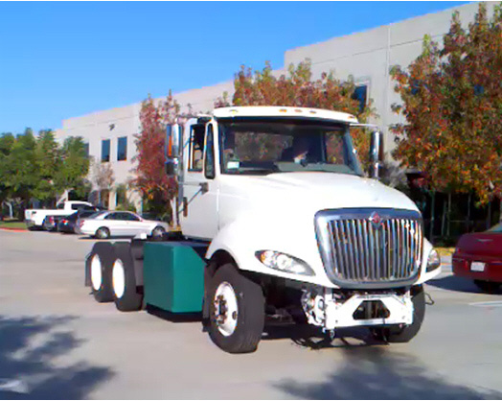
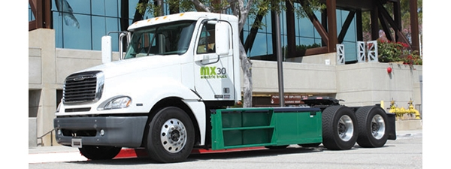
Range of Commercial Electric Vehicles
Notes:
Navistar e-star, FCCC/EVI walk-in van, Smith Newton, Freightliner/EVI EV M2, Balqon EV drayage tractor, Transpower EV tractor, Balqon EV tractor.

Slide 4
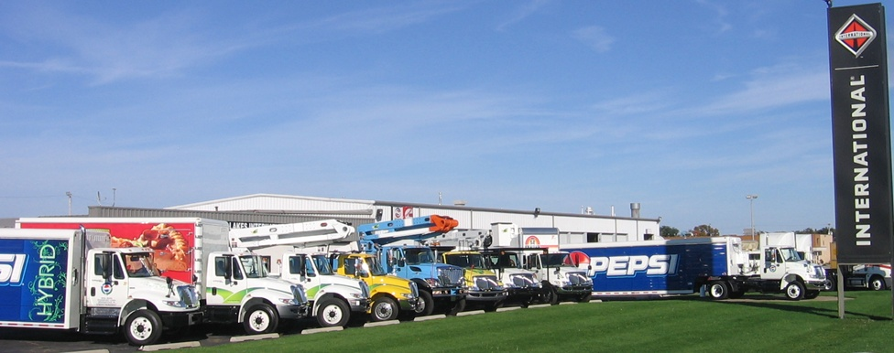
Range of Hybrid Commercial Vehicles
Box Trucks
Beverage Delivery
Utility/Boom
Tractor/Trailer
Shuttle Bus
School Bus
Class 5-7
Notes:
Eaton Hybrid introduced in late 2006. Over 2500 hybrid vehicles in service. No hybrid safety incidents? in over 5 years of operation.

Slide 5
How does commercial truck EV and battery safety differ from light vehicle EV safety?
The considerations for safety are really no different.
Commercial trucks, like automobiles, must be designed with the intent to not cause harm to assemblers, drivers, occupants, service technicians, other travelers, or emergency responders.
Due to the differences in power, size, weight, body, and multi-varied configurations of commercial vehicles, the design implementation of commercial truck EV and HEV systems for safety must be uniquely considered.

Slide 6
EV Safety Considerations
High Voltage Electrical Safety
  “Do not allow access to high voltage potentials.”
  Physical Safety
  “Prevent the RESS (battery) from emitting heat, light, or smoke.”
  Motion Safety
“Prevent unintended acceleration.” (eg. FMVSS-124)
“Provide consistent braking response.” (eg. FMVSS-102,105,121)
Sound Safety?
“Make pedestrians aware of EV’s presence.”
Notes:
Electrical and Material safety most relevant to hybrid and eV batteries.

Slide 7
Energy Potential: EV vs. Diesel
1 US Gallon of #2 Diesel contains up to 137,380 BTU** of stored chemical energy.
  mathematically equivalent to 40.26 kwhr.
How much energy do HEVs and EVs carry?
A 5 kwhr HEV battery contains the energy equivalent of 1/8th gallon of diesel fuel.
A 120 kwhr EV battery contains the energy equivalent of 3 gal of diesel fuel.
By comparison, Commercial vehicle trucks will carry fuel tanks with a capacity for 50 to 200 gallons of diesel fuel.
  2013 kwhr to 8056 kwhr of energy.
The stored battery energy of (H)EV is much lower than diesel fuel;
But electrical and chemical concerns must be addressed.
** (American Petroleum Institute)

Slide 8
Auto vs. Truck (H)EV Installations
Aspect | Auto | Commercial Truck
Mounting | Within Frame | On Frame Rail
Orange Wiring & Connections | Hidden within a Compartment | Visible and Touchable
Environment | Sheltered inside the cabin | Outside the cab, Exposed to elements
Vibration |  | More severe
Power Levels | < 150 kw | 350kw+
Crash Test | FMVSS 305 | does not apply
Useful Design Life | 100,000 miles | 350,000 - 1,000,000 miles

Slide 9
Commercial (H)EV Battery Specifications
 | Hybrid | PHEV | EV
GVW Class | 5-8 | 5-7 | 2-8
Battery Capacity | 2-28 kwhr | 16-50 kwhr | 40-380 kwh
Battery Voltage | 320v-750v | ~350v | 300v-540v
Power Level | 25kw – 350kw | 25kw – 120kw | 70kw – 240kw
Battery Charger | n/a | J1772 L2 | J1772 L2-3

Slide 10
Commercial Design
Many Commercial Truck and Battery Safety requirements are self-developed and self-imposed.
  Examples:
  Navistar: NDR-12 “Design Compliance for High Voltage Electric Equipment on Vehicles”
  Volvo: “High Voltage Distribution in Vehicles Design Guideline”
Many requirements and practices are drawn from hybrid and electric automotive examples (next page).
SAE Truck and Bus developing DRAFT SAE J2910 “Recommended Practice for the Design and Test of Hybrid Electric Trucks and Buses for Electrical Safety.”

Slide 11
SAE and International Standards
Many valuable, detailed specifications exist, whose scopes do not extend to commercial vehicles (limited to GVWR < 10,000#)
SAE J1766 “Recommended Practice for Electric and Hybrid Electric Vehicle Battery Systems Crash”
SAE J2344 “Guidelines for Electric Vehicle Safety”
SAE J2464 “Electric Vehicle Battery Abuse Testing”
SAE J2929 “Electric and Hybrid Vehicle Propulsion Battery System Safety Standard - Lithium-based Rechargeable Cells”
FreedomCar SAND2005-3123 “FreedomCar Electrical Energy Storage System Abuse Test Manual for Electric and Hybrid Electric Vehicle Applications.”
International Specifications do cover commercial (H)EV vehicles.
ISO6469-1 “Electric road vehicles - Safety specifications - Part 1: On-board rechargeable energy storage system (RESS)”
IEC R100 “Uniform Provisions concerning the Approval of Vehicles with regard to Specific Requirements for Electric Power Train.

Slide 12

System Level Design Practices
Identification (Orange) and Labeling of High Voltage components.
High Voltage Isolation from Chassis.
High Voltage Wire and Insulation Rating.
  Shielded wiring. Double insulated wiring.
  Use of orange convolute over HV wiring.
Cover Panels limiting access to HV wires/connectors.
“finger proof” high voltage connectors and terminals.
Interlock circuits on High Voltage Cables.
Ignition key Interlock.
Isolation Detection and Response (Ground Fault detection)
  Case Grounding Straps.
High Voltage Service / Emergency Disconnects.
Controls
  limits and derating within safe operating areas.
  Battery, Inverter, Motor, and Contactor diagnostics.
  Microprocessor integrity diagnostics, processor redundancy.
  Redundant voltage and current measurements and comparison.
Instrument Panel Gauges and Warning Lamp(s)

Slide 13
Battery Architecture Practices
Stable Chemistry selection.
Cell design and testing.
Cell-, Module-, and Pack-level Fusing.
Battery-Integrated High Voltage Contactors.
Battery Management System
  Individual Cell voltage measurements.
  Multiple temperature measurements.
  Safe Operating Area calculations
  Contactor Overrides
    Over-voltage shutdown
    Over-current shutdown
    Over-temperature shutdown.
Pack-integrated high voltage service disconnect.

Slide 14
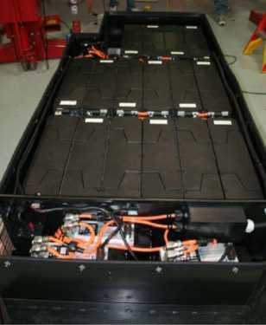
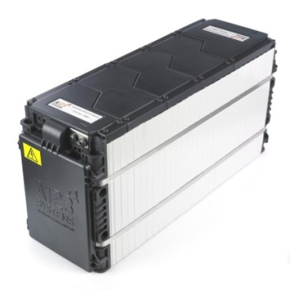

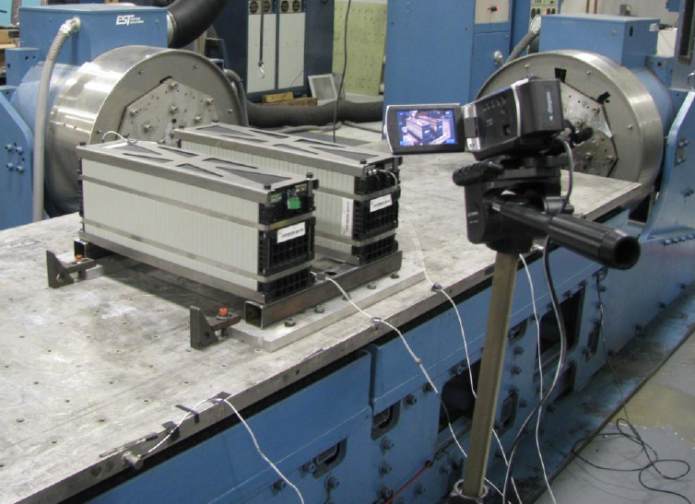
Battery Validation Testing
Validation required of battery pack manufacturer.
Testing per J2464 or FreedomCar.
Cell, Module, or Pack tested for EUCAR Level 1-5.
Abuse Testing
  Over-charging.
  Over-discharging.
  Over-voltage.
  Over-temperature.
  Nail penetration.
  Crush Test.
  Simulated Fuel Fire.
  Rapid Discharge.
  Thermal Shock.
  Short Circuit and Partial Short Circuit.
Environmental & life testing.
Module Vibration Test (SAE J2380)

Slide 15
Crash Worthiness for Commercial (H)EV
Full Scale Crash Testing of Hybrid/EV commercial trucks is not mandatory.
  FMVSS 305 specifies requirements for electric light duty vehicles to disable high voltage systems after a crash.
  SAE J1766 also specifies the method to conduct a test for light duty vehicles.
Truck battery crash worthiness is addressed by component abuse testing.
  Truck battery crash worthiness is also addressed through mounting.
    For example, Hybrid and Plug-In Hybrid School Bus RESS are mounted in protective “fuel tank cages.”
  One truck manufacturer has voluntarily performed hybrid battery side-impact testing of its HEV trucks (video on YouTube). http://www.youtube.com/watch?v=cq7l8gkD_c0
Some Hybrid and EV designs incorporate an inertia switch to disable the high voltage system when “bumped”.
  Commercial vehicles typically do not include air bags, and consequently do not have calibrated collision sensors. Also difficult to calibrate for truck variations.
  Inertia switch actuation level is not validated through physical vehicle test.
  Inertia switch trip level can be sensitive to normal truck vibration.
  Emergency procedures to cut the 12v power will disable battery contactors.

Slide 16
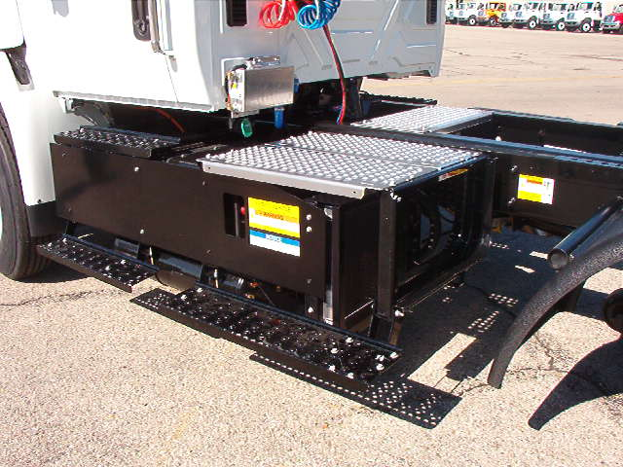
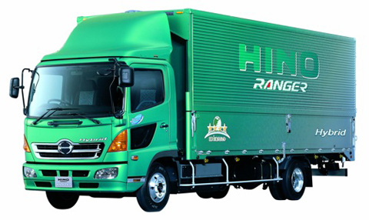
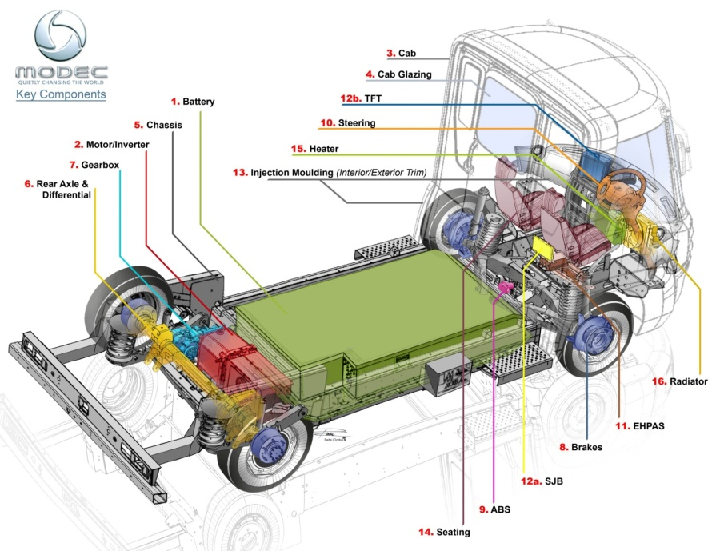
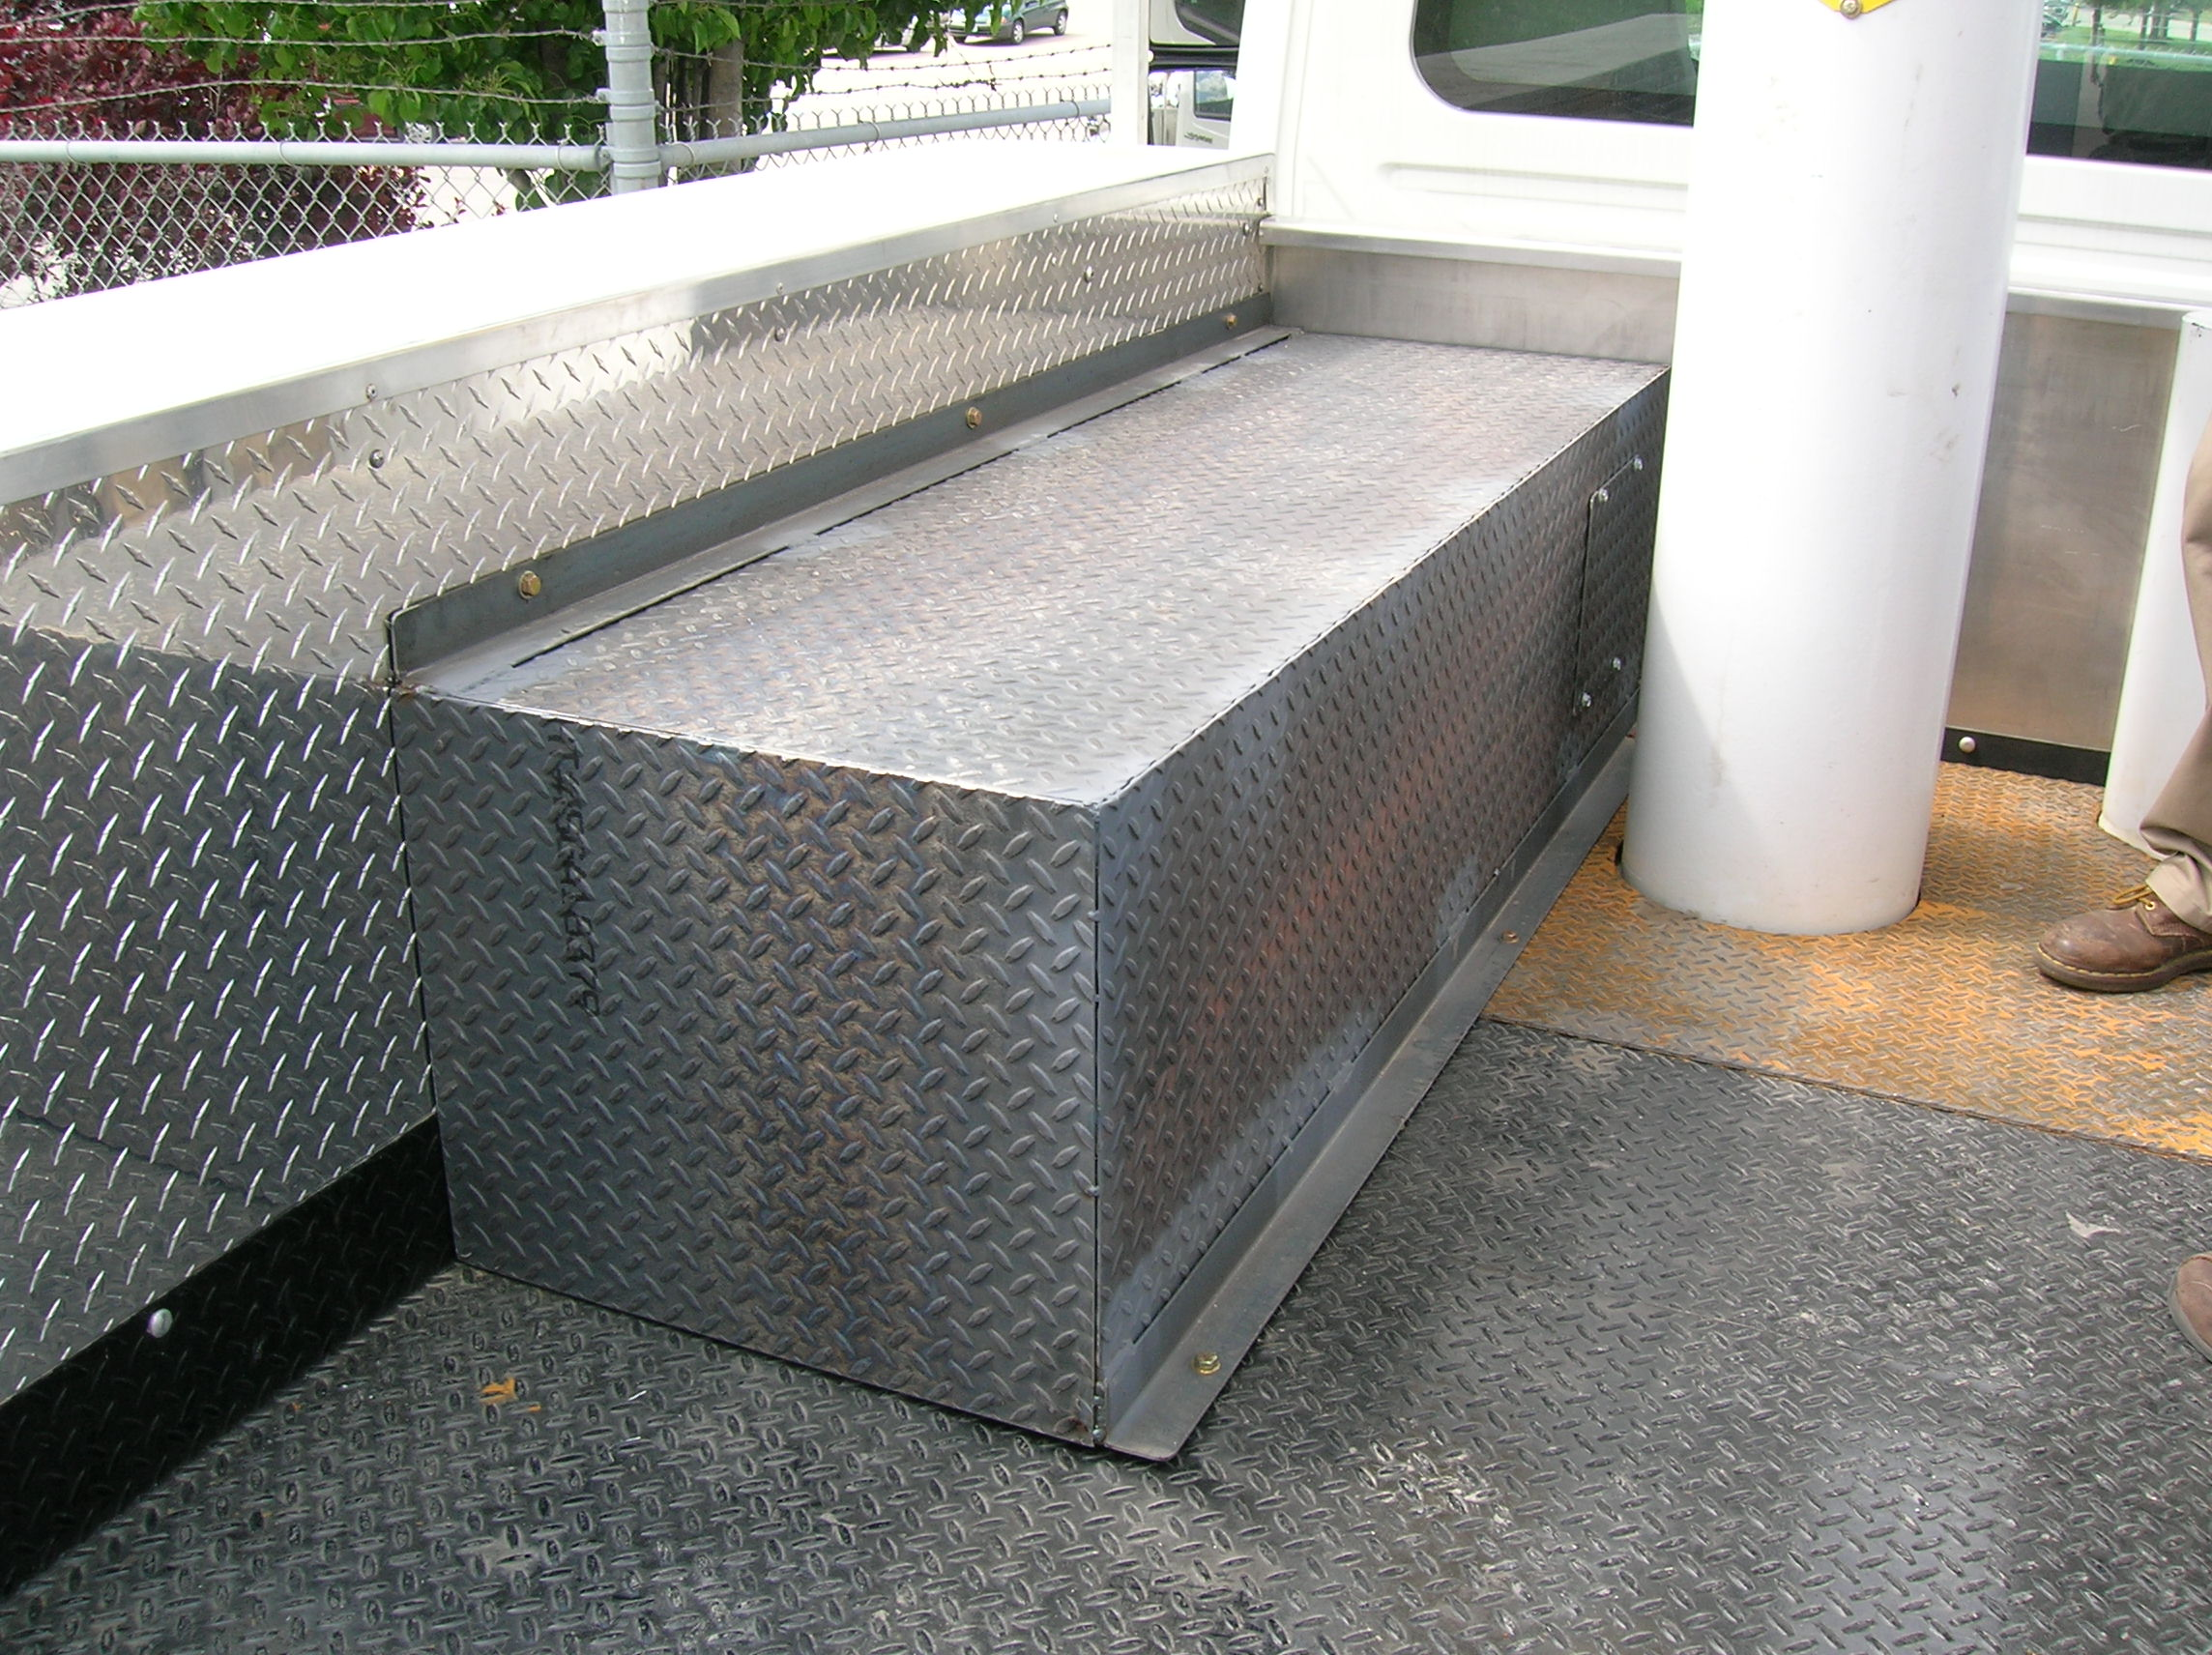
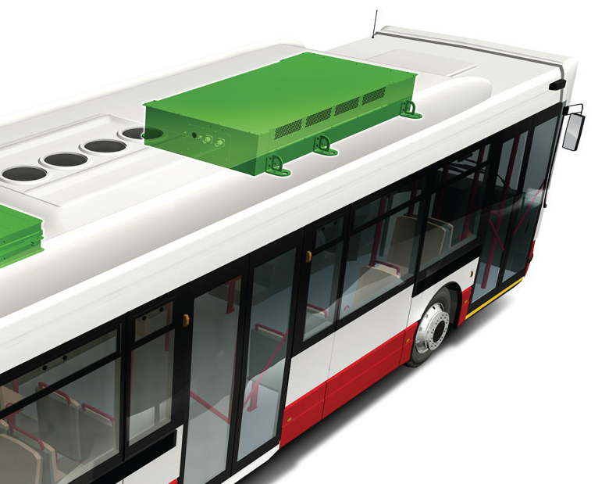
Commercial Truck Battery Mounting
  Mounted within a Protective Structure
    Or Mounted “Out of Harm’s Way”
Within a protective “cage” or behind a barrier
Between Truck Frame Rails
Within a Cargo Body (Utility)
Roof-mounted (transit bus).

Slide 17
Summary
Commercial trucks and buses come in a wide range of variations and applications.
Commercial (H)EV vehicles are bigger, heavier, and more highly powered, but require similar attention to safety.
Commercial hybrid and electric vehicle battery safety discipline is self-imposed where not mandated.
Commercial OEMs have benefitted and are leveraging many practices developed for light duty automotive, and are developing SAE recommended safety practices specific to Trucks & Buses.

