Slide 1
Bob Galyen
Chairman, SAE International Battery Standard Committee
President, Magna E-Car Systems Global Battery Business
Li-ion Battery Safety
“Systems Integration and
Gap Assessment”
Electric Vehicle Safety Technical Symposium – DOT Headquarters
Friday, May 18th 2012

Slide 2
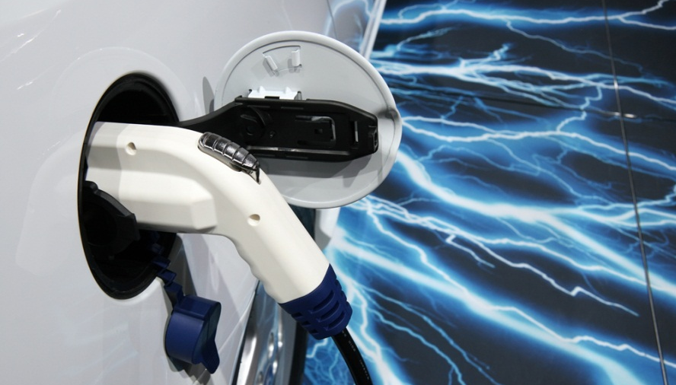
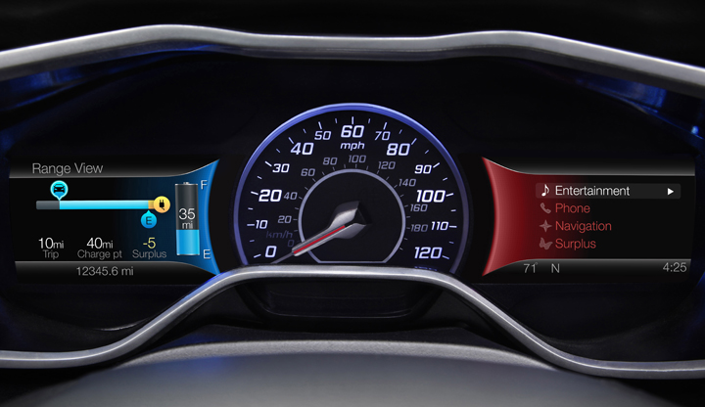
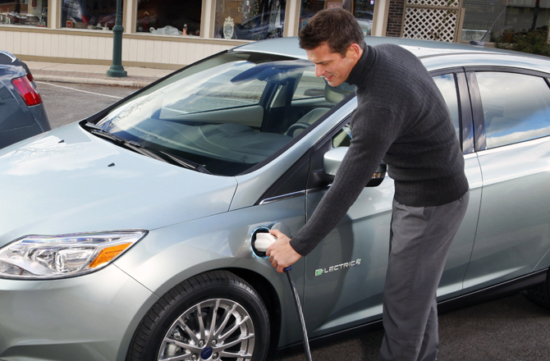
Metrics for Energy Storage Systems: (cells/modules/packs)
Safety
Performance
Life
Cost

Slide 3

Baghdad Battery – Cell technology has come a long way in 2000 years!
In 1938, while in Baghdad, German archeologist Wilhelm Koenig discovered a five inch clay jar containing a copper cylinder that surrounded an iron rod. The jar showed signs of corrosion and seemed to have once contained a mild acid, such as vinegar or wine.

Slide 4
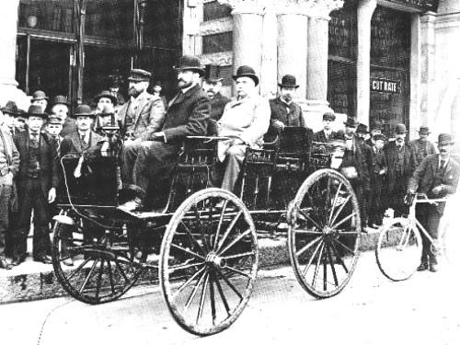
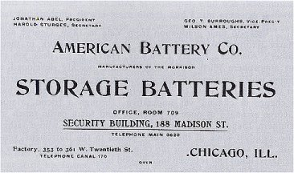

Reemergence of Electrified Automobiles
William Morrison of Des Moines, Iowa builds the first successful electric automobile in the United States in 1891
Same primary issue 120 years ago as today which is energy storage via battery technology
Necessitated by environmental pollution, cost and dependency on foreign fuels
New technologies drive societal expectations of governance for public protection (safety) – this drives the need for standards across the value chain
Morrison Electric at the1893
Columbian World's Expo in Chicago

Slide 5
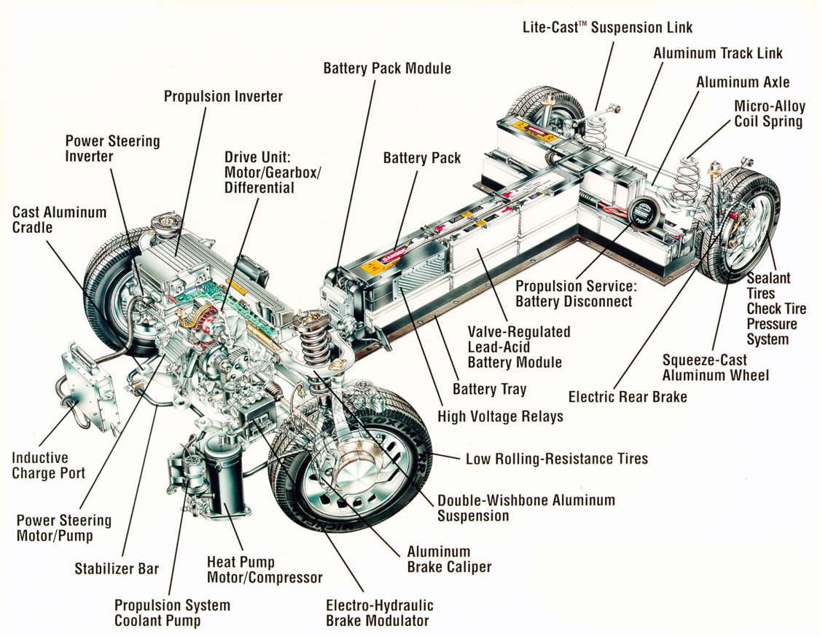
Example: Systems Integration
1996 GM EV1
Photo courtesy of General Motors
Notes:
11. An innovative Magne Charge system was used to recharge an EV1's batteries. This charger offered a user-friendly charging paddle rather than a conventional plug and no metal-to-metal connection was used. Rather, the charger transferred energy to an EV1's chargeport via magnetic induction.
12. Nickel-metal-hydride batteries - the same technology that powers today's hybrid vehicles - provided enough energy in Gen 2 (second generation) EV1s for a 100 to 120 mile driving range. Gen 1 models used a less expensive valve regulated lead-acid battery pack that allowed a too-limiting real world driving range of just over 50 miles
13. The EV1 was a joy to drive. We know ... we were behind the wheel of a Gen 1 model for a year. It was fast, extremely efficient, and quiet, although not really silent. In the absence of background noise from an internal combustion engine and exhaust system, a driver could hear other faint sounds like tires contacting pavement, wind streaming past windows, and subtle gear whine.
14. Slippery aerodynamics and low rolling resistance were refined to art forms by GM designers and engineers. The EV1 featured the lowest coefficient of drag of any production vehicle at 0.19 Cd. We're not altogether sure GM's claim was true about this being the same Cd as an F-16 fighter "wheels down," but it had a nice ring to it and sounded plausible. On a flat highway at speed, you could let off the accelerator and coast longer than you could believe.
15. The EV1's cockpit was reminiscent of what one would expect in a jet fighter with its overall layout and digital instrumentation. While it was designed to seat only two, great care was taken to reinforce that the EV1 was not only super-efficient, but functional in ways drivers have come to expect. Exemplifying this was the EV1's trunk, which was spacious enough to hold a set of golf clubs.
16. The EV1 was built at GM's Lansing Craft Centre in Lansing, Michigan, a plant that specialized in low-volume vehicle production. Prior to the EV1, the Craft Centre was used for the production of the Buick Reatta.
17. Battery costs are believed to have been $20,000 to $30,000 for the electric vehicle models manufactured by automakers during the 1990s test marketing period. While no auto manufacturer has officially stated actual battery costs, back-channel discussions with those involved in these programs indicate these cost figures are realistic. The EV1's T-shaped battery pack surely fell within this range. While it's true that mass production volume can significantly decrease costs for many components, battery cost was so great that volume could not overcome this problem at the time ... it would only result in more profound losses.

Slide 6
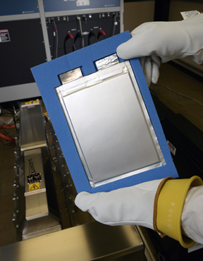
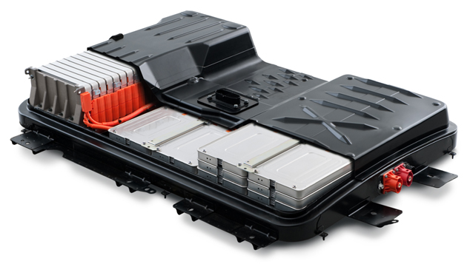

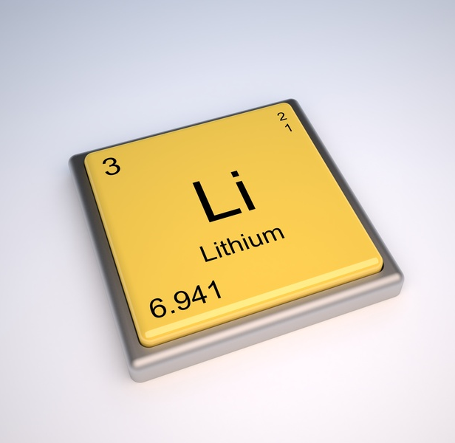

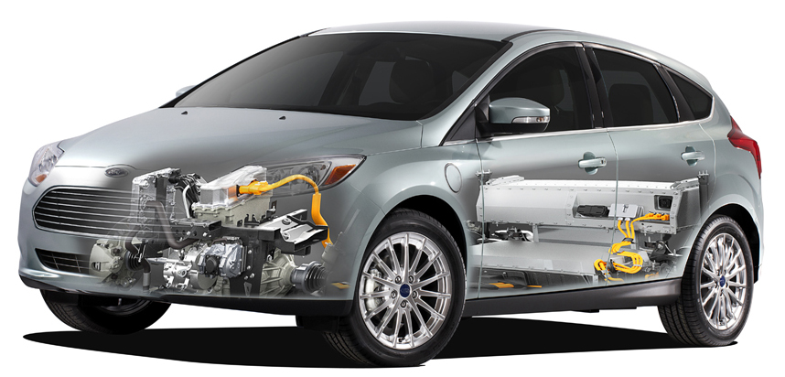

Value Chain: Total Life Cycle Comprehended
INFRASTRUCTURE
Raw
Materials
Modules
Applications
Recycle
Develop Standards Across Entire Value Chain
Cells
Packs
2nd Use

Slide 7
Societal Approach:
How do we fill the gaps?
Public understanding is key!
  Acceptance and knowledge of electrification technology via industry and government working cooperatively
Communication
  Electronic Media – WWW, television, …..
  Print Media – trade journals, newspapers, ……
  Networking – enormous number of symposiums, workshops, ……
Education
  Government Training Programs
  Industry Trade Organizations
  Web Based, …..
Standardization – tremendous worldwide effort
  SDO’s
  SAE, IEC, ISO, UL, IEEE, ….
  Examples: J1772 Charging Interface & standards for onboard charge control via common controls interface

Slide 8
Safety Driven by Requirements!
Example of Hierarchy
VTS: VEHICLE
SSTS: PROPULSION SUB-SYSTEM
CTS: BATTERY PACK
SCTS: CELL
MATERIALS: SEPARATOR
SAFETY FEATURES at ALL LEVELS:
Mechanical
Electrical
Thermal
Monitoring
Diagnostics
Algorithms

Slide 9


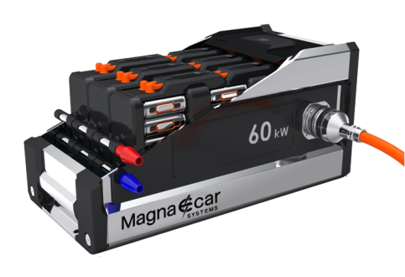
Examples of Battery Pack Requirements (~33 KWh/Gal)
 | BEV | PHEV | HEV
PACK Requirements
Energy Content | 16-36 kWh | 6-16 kWh | 0,2-2 kWh
Peak Power | 70 -120 kW | 50 -120 kW | 10 -60 kW
Voltage Range | 250 - 430 V | 250 - 430 V | 48 /120 / 400 V
Weight Target | 200 – 400 kg | 80 – 200 kg | 7 – 45 kg
Cooling | Option liquid | liquid | Air / liquid / refrigerant
Cold Temp. performance | Available Energy and power in low temp. critical design parameter | Important but not critical | Cold crank is a critical design parameter:3-7kW pulses (-30°C)
Loss Power System (average) | 300-500 W | 300-500 W | 20-200 W
Cell “Size” (VDA Standard) | 40 -80 Ah ( BEV1, BEV2) | 20-30 Ah ( PHEV1, PHEV2) | 5-7Ah ( HEV)
Life performance | 2.000 “EV” cycles; calendar life important factor | Up to 6.000 “EV” cycles + HEV operation | HEV operation
Design Criteria | Electrical range / Packaging (specific useable Energy) | Electrical range, driving performance (full SOC range) | Power performance

Slide 10

SAE Battery Standards Steering Committee
Advanced Battery Concepts
Battery Safety
Battery Recycling
Truck and Bus Batteries
Starter Battery
Hybrid Battery Testing
Battery Labeling
Battery Electronic Fuel Gauging
Battery Transport
Battery Packaging
Small Task Oriented Vehicle Batteries
Battery Materials Testing
Battery Terminology
Battery Testing Equipment
SAE Battery Standards Steering Committee
Secondary Use
Start/Stop
Capacitive Energy Storage
Started – Nov. 2009
Current Membership
>500 Representatives
>150 companies
  OEM’s
  Suppliers
  Government
  Academia
Specific Topics
  18 Committees
  Interaction
  Inter-related
Battery Field Discharge and Disconnect

Slide 11
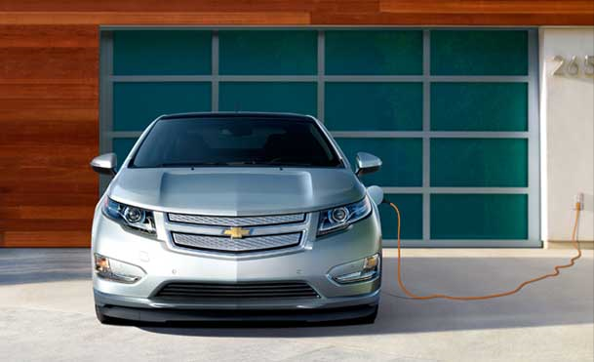
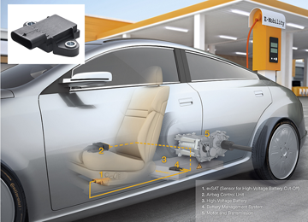

Battery Safety Committee
Chairman - Galen Ressler of General Motors
Scope:
  Create and maintain standard test procedures for all battery safety aspects
Document | Title | Date | Status
J2464 | Electric and Hybrid Electric Vehicle Rechargeable Energy Storage System (RESS) Safety and Abuse Testing | Nov 06, 2009 | Revised
J2929 | Electric and Hybrid Vehicle Propulsion Battery System Safety Standard - Lithium-based Rechargeable Cells | Feb 18, 2011 | Issued

Slide 12
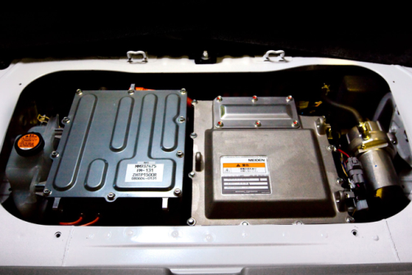
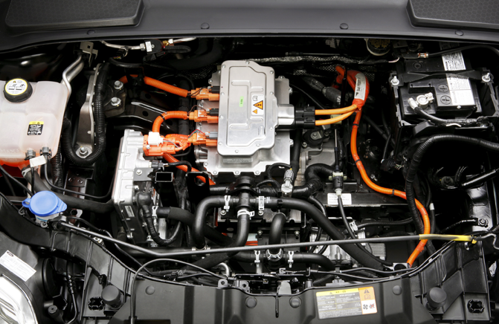

Battery Labeling Committee
Chairman: Mark McGory of Jamac Label
Scope:
  Provides labeling guidelines at all levels; component, sub-component, subsystem and system-level architectures
Progress:
  J2936 Vehicle Battery Labeling Guidelines has passed balloting effective March 21, 2012, formatting for publication
  First industry standard giving comprehensive guidelines to cell, battery module and pack labeling

Slide 13





Battery Transportation Committee
Chairman: Tom De Lucia of A123 Systems
Progress:
  SAE Recommended Practice which aids in the identification, handling and shipping of un-installed lithium ion battery systems.
  The Recommended Practice utilizes and reference existing US and International hazardous materials (dangerous goods) transportation regulations.
  This Recommended Practice dove tails into the work being done to develop provisions for the UN Model Regulations and IMDG Code that address shipping of lithium ion/lithium metal batteries for recycling and/or disposal and shipping damaged lithium ion/lithium metal batteries.
Document | Title | Date | Status
J2950 | Recommended Practices (RP) for Shipping Transport and Handling of Automotive-Type Battery System - Lithium Ion | Feb 06, 2012 | Issued

Slide 14

Battery Recycling Committee
Chairman: Dr. Tim Ellis of RSR Technologies
Scope:
  Development of Technical Information, Recommendations and Standards for the recycling of automotive electrochemical cells
Progress:
  Enhanced labeling for improved handling and segregation of chemistries prior to recycling
  Development of uniform recycling nomenclature and definitions
  Compilation of recycling methodologies and benchmarking lifecycle costs

Slide 15
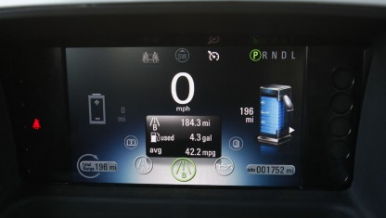
Electronics Battery Fuel Gauge Committee
Chairman: Joern Tinnemeyer of Cadex
Scope:
  This committee covers the recommended practices associated with reporting the vehicle’s (hybrid and pure electric) battery pack performance details to the automobile user. These practices detail the accuracies, error conditions and diagnostic requirements responsible for delivering an accurate assessment of the amount of available electrochemical fuel
Progress:
  Committee has agreed on a generalized system architecture
  Practice will include elements of the vehicle energy management system down to the cell level
  Initial J2946 draft has been written – significant areas still need more detail
  Goal is completion by Q2 2012

Slide 16
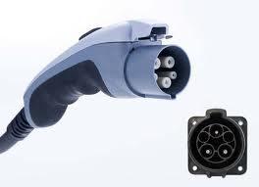
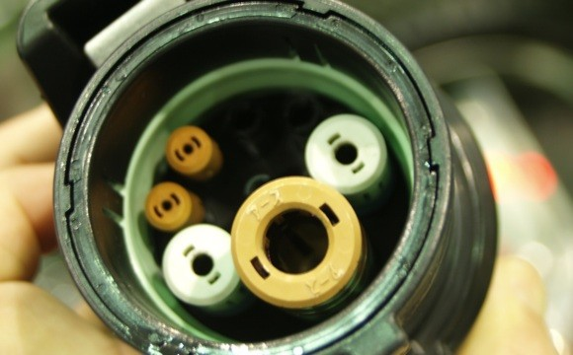
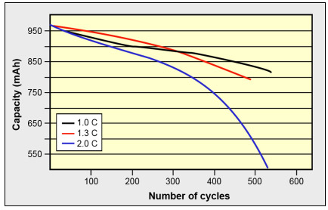
Battery Field Discharge and Disconnect Committee
Chairman: Dom Gabrielli of Ford Motor Company
Scope: The scope of this committee’s work will include establishment of recommended practices to enable safe field procedures for normal or damaged battery pack systems for service or accident scenarios requiring action to:
  Disconnect an energy storage system in order to isolate it from the vehicle’s high voltage system and/or the vehicle chassis when possible
  Determine the need for high voltage battery discharge via an easy to understand flow diagram
  Create a method to safely discharge energy storage systems in the field via a device specified for such use, which will be detailed within this document.

Slide 17
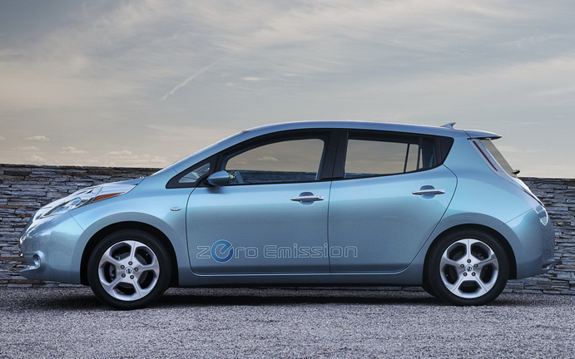

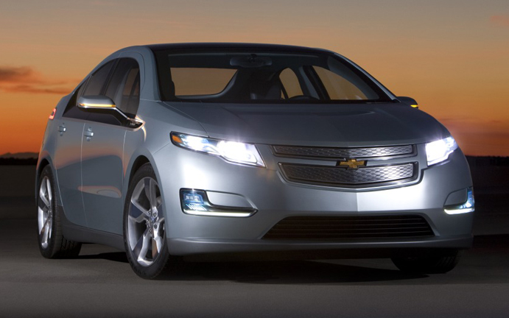
On the Road in 2011 and 2012
Nissan Leaf
SAE seeks to work with other SDO’s and governments in harmonizing global standards for bettering the standards of living for generations to come.
Ford Focus Electric
Chevy Volt
It will take a concerted effort of science, engineering, policy, testing and validation to assure the battery systems of the transportation sector meet safety performance, life and cost expectations of the general consumer.
Notes:
The three most prevalent production vehicle of last 2 years are the Nissan Leaf, Ford Focus and the Chevy Volt.

Slide 18
Thank you

