Slide 1


Notes:
Introduction:
In this activity, we’ll take a look at a number of roadway signs, signals, and symbols (pavement markings). We’ll talk about what they mean and what action is needed based on your role, as a driver of a motorized vehicle (motorist), as a driver of a non-motorized vehicle (bicyclist), or as a pedestrian.
Background:
The signs, signals, and symbols and pavement markings used in this presentation are approved through an organizing body of professionals as part of the Federal Highway Administration of the U.S. Department of Transportation. This group puts forth a manual to encourage a standard use of signage throughout the United States. So, if visiting another State you should see the same signs, symbols and pavement markings as you see in your State. (FYI- the manual referenced is called the Manual on Uniformed Traffic Control Devices (MUTCD) and the organizing body is the MUTCD Team.) Some States and localities are testing different strategies for pavement markings to see if they are effective for increasing the safety of pedestrians and bicyclists. These are not included in this presentation.

Slide 2


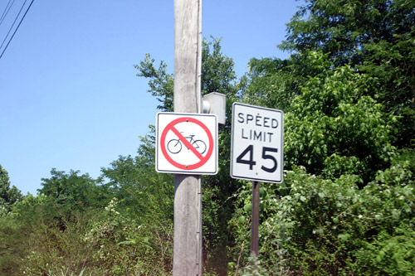
What does each sign mean for a …
Bicyclist?
Motorist?
Pedestrian?
(Dan Burden)
(Dan Burden)
Notes:
Sign: Bicycle Warning
Yellow signs indicate caution.
Guided Responses:
Bicyclist –
(top picture) This sign is to alert motorists to expect to see bicyclists.
(bottom picture) The presence of a no bicycling sign is a clear indication you are not allowed to bicycle on this particular road. This particular road has a marked speed limit for motorized traffic of 45 miles per hour (mph); for your safety, some local jurisdictions wish to limit bicyclist to roadways with lower speed limits.
Motorist –
(top picture) Expect to see bicyclists entering or crossing the roadway; be careful driving around them.
Pedestrian –
(top picture) Expect to see bicyclists and be careful, to make sure they see you. Bicyclists, like motorists, should yield to you if you are in a crosswalk; but walk defensively in case they don’t see you or follow the rules of the road as they should.
Other--
(bottom picture) Note the speed of 45 miles per hour (mph). Some localities opt to post no bicycling in higher speed areas to encourage bicyclists to seek safer routes with lower speeds.

Slide 3
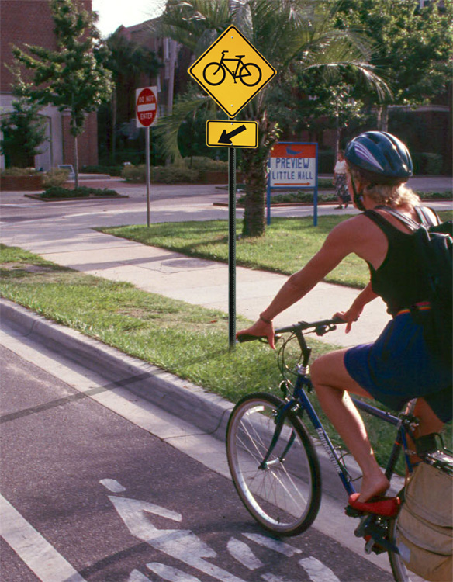

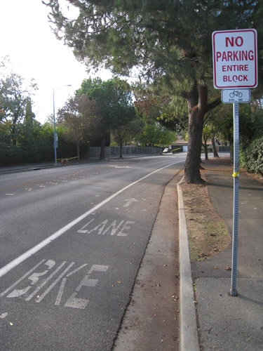
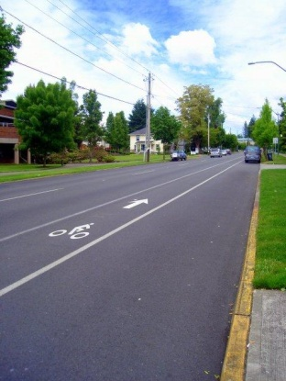
What does each sign mean for a …
Bicyclist?
Motorist?
Pedestrian?
(Dan Burden)
(Brad Crawford)
(Elaine Nelson)
Notes:
Sign: Bike Lane sign
The yellow sign indicates a warning to road users where a bike path/lane crosses a street. The white sign indicates the presence of a bike lane.
Road Marking:
This slide shows three examples of roadway markings you may see to show a bike lane.
Guided Responses:
Bicyclist – Unless specifically posted, you can choose to ride in the bike lane or on the roadway. Generally, you are not required to ride in the lane. Some States, however, may require otherwise.
Motorist – By seeing a yellow bicycle sign or lane markings, you should expect to see and use caution driving around bicyclists. Implied meaning - motorists may not drive or park in a marked bike lane.
Pedestrian – Expect to see bicyclists. While bicyclists should yield to you in a crosswalk, protect yourself in case they don’t see you.

Slide 4

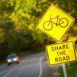
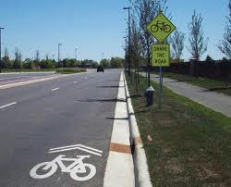
What does each sign mean for a …
Bicyclist?
Motorist?
Pedestrian?
Notes:
Sign: Yellow + Share the Road
Yellow signs indicate caution. The “share the road sign” is highly misunderstood. Sometimes it is because of lack of knowledge and sometimes it’s because it doesn’t suit the need of the particular road user. For example, some motorists don’t like to share the road with bicyclists because they are in a rush to get somewhere or they feel bicyclists slow down and get in the way of the flow of traffic. Some motorists feel the sign is directed to the bicyclist, and sharing the road means the bicyclist should move over, get off the road, or use the sidewalk. Some bicyclists feel the sign is directed only to the motorist. The guided responses that follow will discuss the meaning of this sign.
Road Marking: Bike Sharrow
This marking indicates the travel lane is shared by bicyclists and motorists, so it’s meaning is similar to “share the road” for motorists and bicyclists. Typically, lanes that have a share the road sign or sharrow, are routes where motorists can expect to see bicycles on the road. The bike sharrow is relatively new and is used more often now to draw attention to the need for cars and bikes to share the road.
Shared lanes are different than bike lanes which are set aside for bicyclists only, and are marked by a solid white line. Note: If there is not a marking on the roadway it does not mean bicycles can’t ride there.
Guided Responses:
Bicyclist – Bicyclist is allowed to ride on the roadway. Implied is that a bicyclist should ride single file if motorized traffic is present. Like other slow moving vehicles (tractors), a periodic check to see if there is a long line of traffic trying to get by you might include a consideration of moving over to allow up traffic to pass before resuming travel. However, a bicyclist must always consider first his/her own safety and pulling over may not be the safest option. For more information on expectation of bicyclists on a roadway, see your State’s driver’s manual or state Department of Transportation website, or contact your local bicycle coalition.
Motorist – Expect to see and be careful driving around bicyclists. Implied is be respectful (don’t honk your horn, throw items or spit or yell at bicyclists to “get on the sidewalk” as you pass.) A number of States and localities are proposing or have implemented laws to require motorized vehicles to allow 3, 4, or 5 feet between themselves and the bicyclist when passing (the actual distance depends on your local or State specific law.)
Pedestrian – Expect to see bicyclists. Look LEFT- RIGHT- LEFT for bicyclists, use eye contact, etc., just as you would with motorists. Bicyclists, should yield to you if you are in a crosswalk, but they may not see you or follow the rules of the road, so always protect yourself.

Slide 5
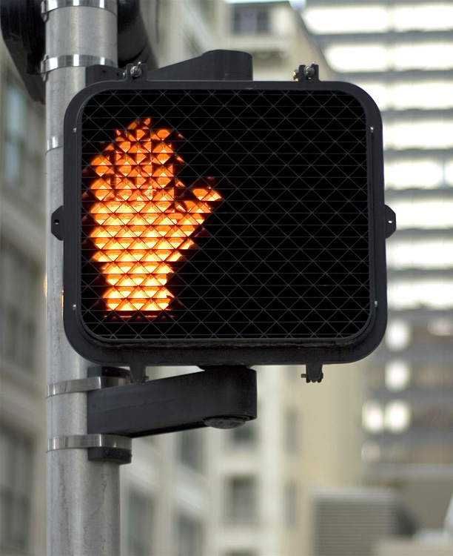
What does this signal mean for a …
Bicyclist?
Motorist?
Pedestrian?
Notes:
Sign: “Don’t Walk” Pedestrian signal – steady orange (hand)
This sign is to be followed by all pedestrians and bicyclists crossing in a crosswalk.
Guided Responses:
Pedestrian – If you have not started crossing, do not begin crossing; wait for the next walk signal. If you are in the middle of the crosswalk, complete crossing as quickly as possible. If there is a refuge island, walk to that point and wait until the next WALK signal to finish crossing.
Bicyclist – If you are riding as a vehicle on the street, this symbol is for pedestrians and tells them they do not have the right-of-way. As a vehicle, you must allow them to finish crossing if they are in the middle of the crosswalk (if there is no island for him/her to stand on to wait until the next signal). However, you should always use caution, especially around younger children and the elderly.
If you are riding on the sidewalk or using the crosswalk to make a left hand turn (using the pedestrian crosswalk) you are expected to act like a pedestrian and cross with the WALK signal. Some States say you must get off your bike and walk it in a crosswalk. This may be especially important if there are a lot of pedestrians crossing at the same time. Again, if you are crossing in a crosswalk you must act like and follow the pedestrian rules.
Motorist – same as bicyclist.

Slide 6
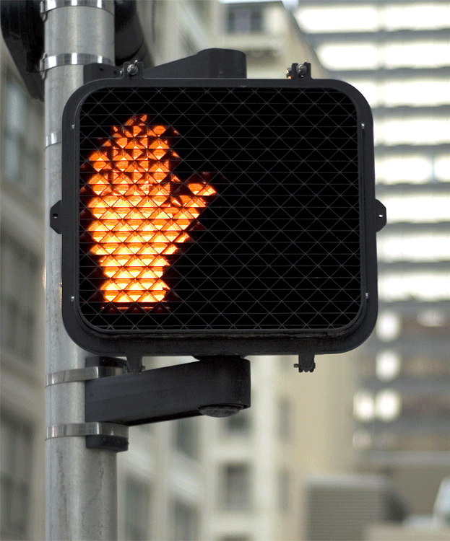
What does this signal mean for a …
Bicyclist?
Motorist?
Pedestrian?
Notes:
Sign: “Don’t Walk” Pedestrian signal - flashing orange (hand)
This sign is to be followed by all pedestrians and bicyclists crossing in a crosswalk.
Guided Responses:
Pedestrian – The flashing orange hand means if you are already in the crosswalk, finish crossing. If there is a refuge island, walk to that point and wait until the next WALK signal to finish crossing. If you have not begun to cross, stop and wait for the next walk signal. Always watch for traffic to make sure drivers see you before you cross (look LEFT – RIGHT – LEFT) and look side to side for traffic as you cross.
Bicyclist – If you are riding on the sidewalk, you must follow pedestrian rules, including crossing the street with a walk signal. If you are using the crosswalk to make a left hand turn (using the pedestrian crosswalk) you are expected to act like a pedestrian and cross with the WALK signal. Check your State to see if you must dismount and walk your bicycle in a crosswalk).
If you are riding as a vehicle on the street, this symbol is for pedestrians and tells them they should not begin crossing if they haven’t started, but should finish crossing if they are already in the crosswalk. As a vehicle (bicycle), you must allow them to finish crossing if they are in the middle of the crosswalk. Always use caution, especially around younger children; being right isn’t worth risking a crash that could cause an injury or death to a pedestrian or bicyclist.
Motorist – Continue to watch for pedestrians; they still have the right-of-way if they are already in the crosswalk. While pedestrians are not supposed to begin crossing, use caution to avoid a crash. A crash between a car and a pedestrian will cause injury and even death to a pedestrian.

Slide 7
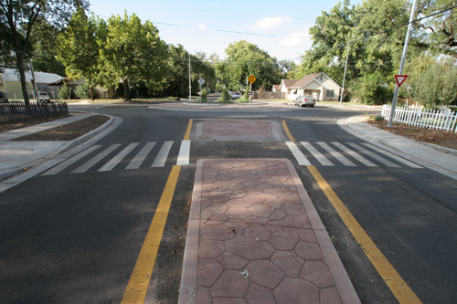



What does this mean for a …
Bicyclist?
Motorist?
Pedestrian?
(Dan Burden)
(Dan Burden)
(Dan Burden)
(Dan Burden)
Notes:
Road Design: Pedestrian Refuge Island
While not a sign or signal, this piece of infrastructure has significant meaning for pedestrian safety.
Guided Responses:
Pedestrian – When the first half of the roadway is clear, you can cross and wait on the refuge island until the second half of the roadway is clear, then complete crossing. Or you can wait until both sides of the roadway are clear of traffic before crossing. Remember to keep looking left-right-left for traffic as you cross.
Bicyclist – If you are crossing midblock, like shown in these pictures, or in a pedestrian crosswalk, you are expected to behave by the same rules as a pedestrian and dismount and walk your bike across the road. Again, you can wait at the island for the next lane of traffic to clear before completing crossing.
Motorist – Watch for any pedestrians or bicyclists on the refuge island and drive with care, especially when making turns. Remember that if the pedestrian is in the crosswalk, they have the right of way to complete crossing. Drive with extra care around younger children and the elderly.

Slide 8
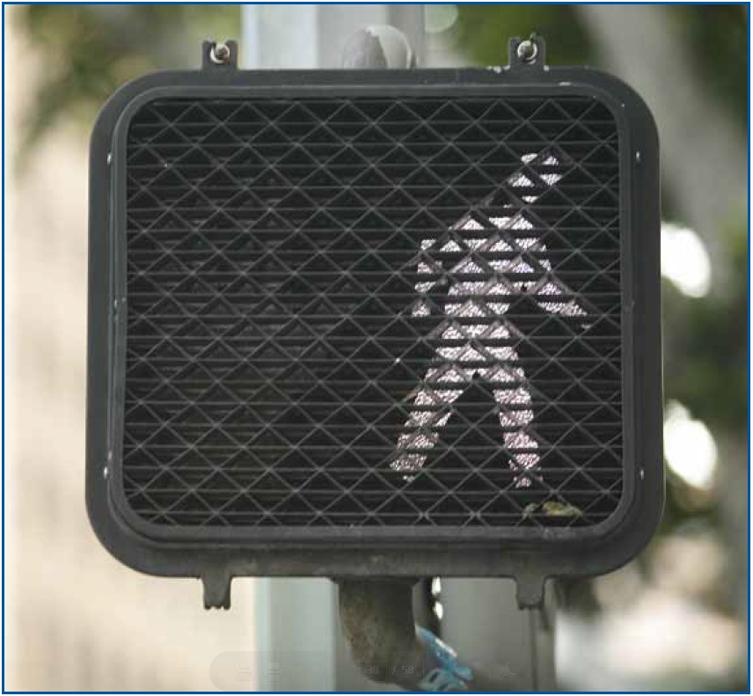
What does this signal mean for a …
Bicyclist?
Motorist?
Pedestrian?
Notes:
Sign: “Walk” Pedestrian signal –
Guided Responses:
Pedestrian – Pedestrians are allowed to enter the crosswalk when the WALK signal is displayed. Even though you have the right-of-way, always look for traffic and don’t begin crossing until it is safe to do so. Always watch for traffic as you cross.
Bicyclist – If you are riding in the street you must follow the same rules as motorists. This means if you have a green light and are making a left or right turn you must yield to pedestrians with the WALK signal. If you have a red light and are allowed to make a right turn on red, you must stop first and not make your turn until the traffic is cleared (traffic includes pedestrians). Always use caution, especially around younger children.
Motorist – Same as for bicyclist.

Slide 9
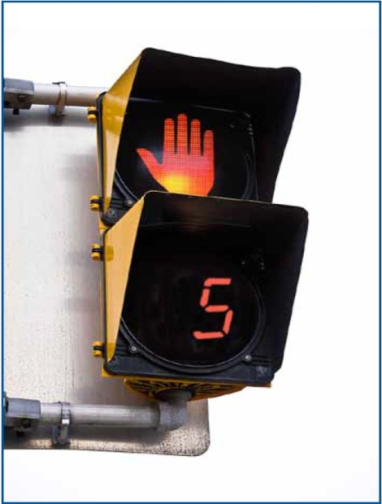
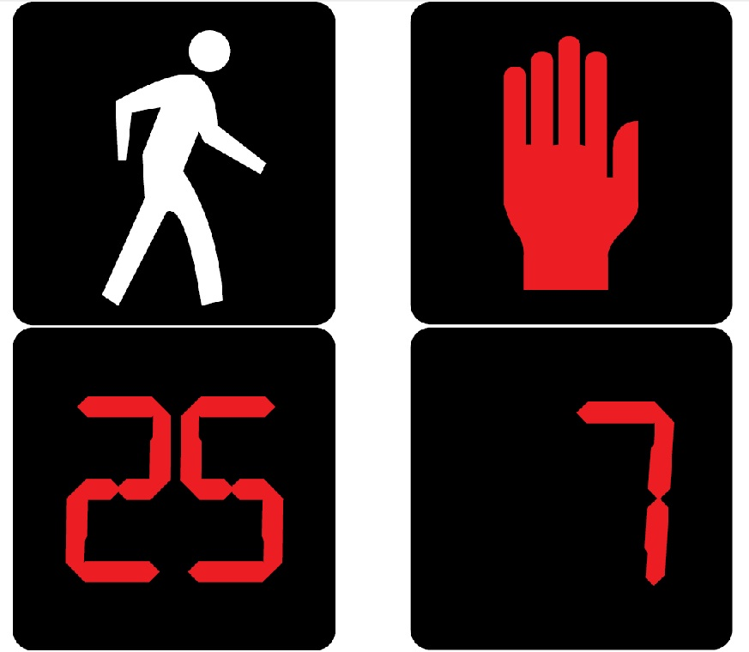
What does this signal mean for a …
Bicyclist?
Motorist?
Pedestrian?
Notes:
Sign: “Don’t Walk” Pedestrian signal – flashing countdown
This sign displays both the image and a number countdown value. The number at which the countdown begins and starts flashing varies according to how long traffic engineers have established it takes a “typical” pedestrian to cross the street. Unfortunately, this countdown time does not always take into consideration a pedestrian with disabilities or an elderly pedestrian who may require longer to cross safely.
Guided Responses:
Bicyclist – Pedestrians already in the crosswalk must be allowed to finish crossing if there is no island for him/her to stand on to wait until the next signal. However, always use caution, especially around younger children or the elderly. Being right isn’t worth a crash.
Motorist – Same as for bicyclist.
Pedestrian – If the number and/or orange hand is flashing and you have not started crossing, stop and wait for the next WALK signal, If you are in the middle of the crosswalk, complete crossing before the timer reaches zero, speed up your pace if necessary.
If a pedestrian refuge island is available, and the don’t walk symbol begins flashing or is solid, wait at the island until the next pedestrian walking signal to complete crossing.

Slide 10
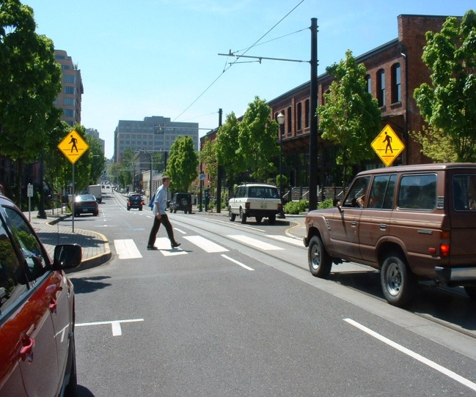
What does this sign and marking mean for a …
Bicyclist?
Motorist?
Pedestrian?
(Andy Hamilton)
Notes:
Sign: Pedestrian Crossing
Road Marking: Pedestrian Crosswalk
Guided Responses:
Bicyclist – You are required by law to slow down (yield) or stop to allow pedestrians in the crosswalk, to finish crossing. Know your State and local laws, you may be required to stop when there is a pedestrian waiting to cross the street.
Motorist – Same as for bicyclist.
Pedestrian – You have the right of way if you are already in the crosswalk. Motorists and bicyclists should slow down for you. Always err on the side of caution and watch out to make sure motorists and bicyclists do what they are supposed to do. If they don’t, you have the most to lose in a crash, so walk defensively.

Slide 11
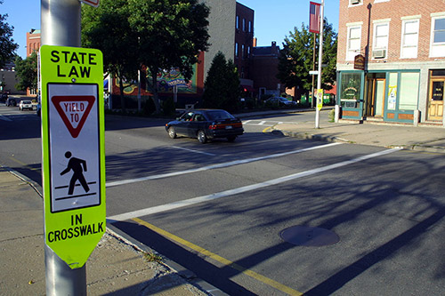
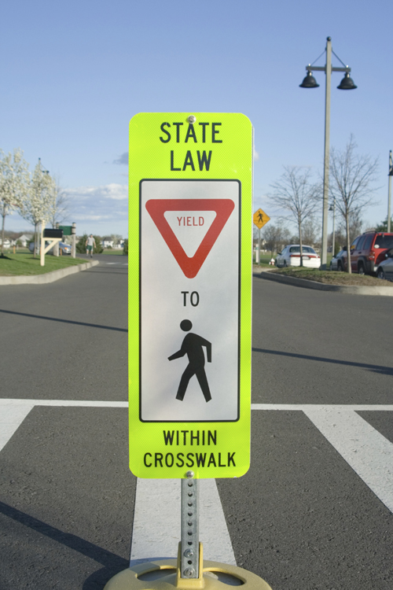
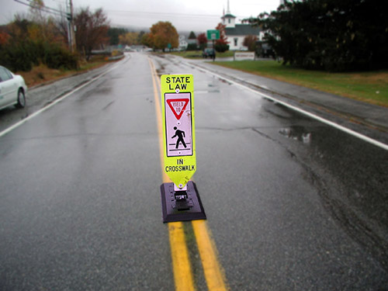
What does this sign mean for a …
Bicyclist?
Motorist?
Pedestrian?
(Dan Burden)
(Dan Burden)
Notes:
Sign: Pedestrian Crossing – You may see sign in the color shown or in yellow; remember this color means warning. Many local communities are choosing to install these signs in addition to the pedestrian crossing road markings as an extra reminder to bicyclists and motorists to yield to pedestrians. Note how the fluorescent color is easily seen in gray/rainy weather.
Guided Responses:
Bicyclist – You are required by law to slow down (yield) to allow pedestrians to cross in the crosswalk.
Motorist – Same as for bicyclist.
Pedestrian – You have the right-of-way if you are already in the crosswalk. Motorists and bicyclists should slow down for you. Always err on the side of caution and watch out for motorists and bicyclists.

Slide 12
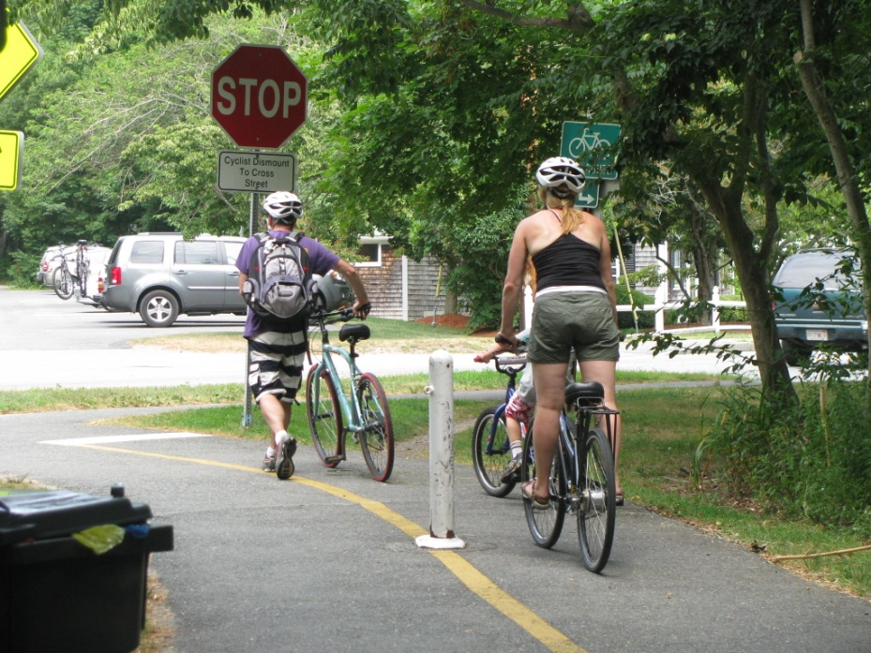
What does this sign mean for a …
Bicyclist?
Motorist?
Pedestrian?
(Laura Sandt)
Notes:
Sign: Stop
Path Marking: Stop line (white). Divided lane (yellow)
Guided Responses:
Bicyclist – The stop sign is for all path users. You must stop (at the white stop line) and look left-right-left again, for traffic. The white stop line is where you are expected to stop and look left-right-left for traffic before proceeding. If you can’t see clearly, because maybe the tree branches are in the way, roll forward to the edge and again look left-right-left again for traffic. Proceed only when clear.
Ride to the right of the yellow line; traffic going the opposite direction will use the left lane.
Motorist – In this scenario, the motorists in the parking lot have the right-of-way because the stop sign is for path users. Motorists should always drive cautiously in case a bicyclist doesn’t stop.
Pedestrian – Since the sign is on the path, it is for all users of the path. Therefore, a pedestrian is required to stop and proceed only when clear. Before crossing, stop to the far right of the path and look left, right, left, and behind you (for bicycles) to make sure it is safe to cross. Walk to the right of the yellow line; traffic going the opposite direction will use the left lane.

Slide 13
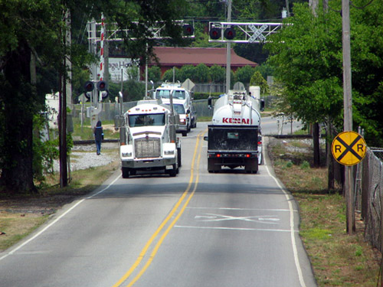
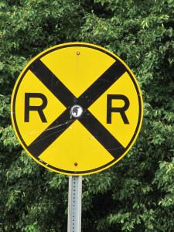
What does this sign, and signal mean for a …
Bicyclist?
Motorist?
Pedestrian?
(Dan Burden)
Notes:
Sign: Approaching Railroad Crossing (top picture)
Yellow signs indicate caution. This circular sign is frequently posted before a railroad crossing.
Signal: Railroad Signal (bottom picture)
Road Marking: Approaching Railroad Crossing (bottom picture)
Guided Responses:
Bicyclist –
(top picture) Yellow signs indicate CAUTION. This circular sign is used in advance of a railroad crossing to provide the road user extra warning that a railroad crossing is ahead; the user should be prepared to react.
(bottom picture) Be prepared to stop if the railroad crossing signal is activated (signal flashes and gate is down or coming down). If the sign is flashing, DO NOT attempt to beat the gate and cross or go around it.
Motorist –
(top picture) Yellow signs indicate CAUTION. This circular sign is used in advance of a railroad crossing to provide the road user extra warning that a railroad crossing is ahead and the user should be prepared to react.
(bottom picture) Be prepared to stop if the railroad crossing signal is activated (signal flashes and gate is down or coming down). If the sign is flashing, DO NOT attempt to beat the gate and cross or go around it.
Pedestrian –
Neither picture specifically relates to pedestrians, but it is important to emphasize that railroads are not a place to hang out. If you cross the tracks as part of your walk to school or other places, follow the same rules as for bicyclists and motorists.
Additional important points for all:
Not all railroad crossings have active lights and gates.

Slide 14
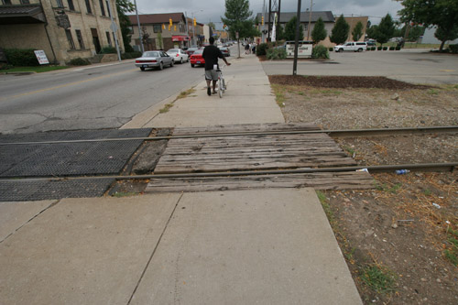
What do these road markings mean for a …
Bicyclist?
Motorist?
Pedestrian?
(Dan Burden)
(Dan Burden)
Notes:
Road Marking: Double Yellow Line
(top picture) Vehicles may not pass slower moving traffic in front of you. Maintain your current position on the roadway.
Railroad Tracks
(bottom picture) Sometimes railroad tracks will have a drop bar to prevent traffic from crossing when a train is approaching and sometimes it will look like this. Usually there is flashing light to direct vehicles to a train approaching.
Guided Responses:
Bicyclist –
(top picture) As a bicyclist you are a vehicle on the road; the same rules of the road apply. Do not pass on the left; maintain your current position on the roadway.
(bottom picture) For bicyclists in particular, a railroad sign should alert a bicyclist to adjust to cross the tracks making sure their bike tires are turned to a 90 degree angle to both tracks.
Motorist –
(top picture) Do not pass; maintain your current position on the roadway
(bottom picture) As a motorist, cross the tracks; do not stop on tracks or try to beat a train.
Pedestrian –
(top picture) Not applicable
(bottom picture) Railroads are not a place to hang out. If you cross the tracks as part of your walk to school or other places, follow the same rules as for bicyclists and motorists.
Additional important points for all road users:
Not all railroad crossings have active lights and gates.

Slide 15
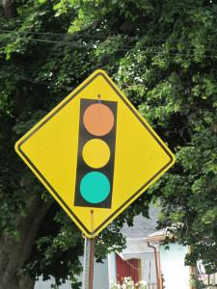
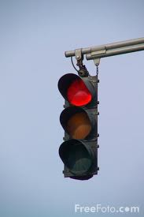
What do these signs and signals mean for a …
Bicyclist?
Motorist?
Pedestrian?
Notes:
Signal: Traffic Light
Sign: Approaching Traffic Signal
Yellow signs indicate caution.
Guided Responses:
Bicyclist –
(top picture) Review: red means stop; green means go only when clear; yellow means prepare to stop.
(bottom photo) This sign is often placed prior to a traffic signal when traffic engineers feel it is best to give the driver extra warning (like when there is a curve or hill before the signal). This gives the driver a warning to get ready to react accordingly. The traffic light sign indicates to slow down and look for the upcoming traffic signal (since you don’t know if the signal will be red, yellow, or green, you should always slow down).
Motorist – Same as for bicyclist.
Pedestrian –
(top picture) While traffic signals like this are for vehicles, pedestrians should make note. If the vehicle has a green light, you should not try to cross the street and expect the drivers to stop just because you are in a crosswalk. If the signal is red, make sure the bicycle or motorist has actually stopped and no other traffic is turning, before you attempt to cross the street.
(bottom picture) This sign is directed at vehicles (bicyclists and motorists)

Slide 16
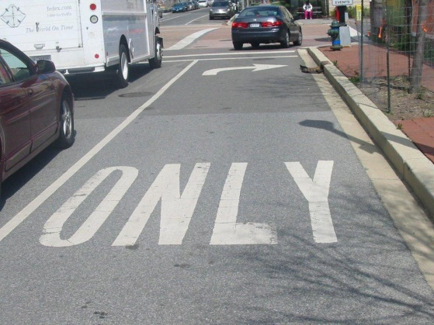
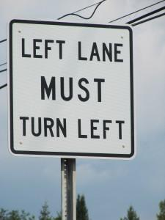
What does this sign and road marking mean for a …
Bicyclist?
Motorist?
Pedestrian?
Notes:
Sign: Left Turn
Lane Marking: Right Turn only
Guided Responses:
Bicyclist – Signs, signals and road markings direct the road user where he/she should be positioned on the roadway. In addition to being in the proper lane, a bicyclist should also use the left hand or right hand turn signal to indicate his/her intended behavior to other road users.
Motorist – Signs, signals and road markings direct the road user where he/she should be positioned on the roadway. In addition to being in the proper lane, a motorist should also use a left or right turn signal to indicate his/her intended behavior.
Pedestrian – These signs and markings are for vehicles. However, if you are trying to cross the street, make sure you make eye contact with the bicyclist or motorist, and look for turning vehicles whose drivers may not see you.

Slide 17
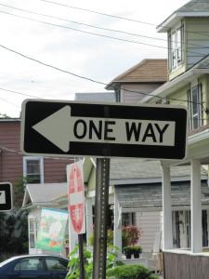
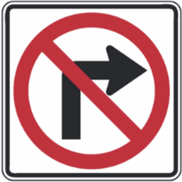
What do these signs mean for a …
Bicyclist?
Motorist?
Pedestrian?
Notes:
Sign: No Right Turn
Sign: One Way only
Guided Responses:
Bicyclist – Both signs are for vehicles – that means bicycles as well as cars. You are not permitted to turn right; you may only travel in the direction the ONE WAY sign is pointing.
Motorist – Same as for bicyclist.
Pedestrian- The no right hand turn sign is typically a sign used for vehicles (both bicyclists and motorists). The one way sign indicates which direction traffic is coming from. Before crossing the street, look for traffic in the direction traffic is coming from. Even though a no right turn is permitted, if you are crossing the street at that point, look for traffic to be on the safe side.

Slide 18
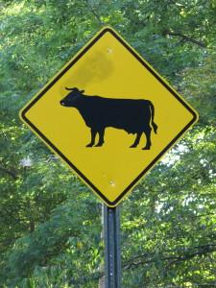
What does this sign mean for a …
Bicyclist?
Motorist?
Pedestrian?
Notes:
Sign: Cow Crossing
Yellow signs indicate caution. There are quite a few different type of animal crossing signs based on where you live or are visiting.
Guided Responses:
Bicyclist – Be on the lookout for cows (or other animals as posted). Encountering a cow, or any animal in the roadway, could cause you to lose control of your vehicle and crash.
Motorist – Same as for bicyclist.
Pedestrian – Be on the lookout if you are walking in an area that is known for “unfriendly animals.” If you don’t know what to do, maybe you shouldn’t be walking in this area.

Slide 19
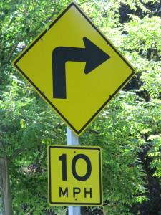
What does this sign mean for a…
Bicyclist?
Motorist?
Pedestrian?
Notes:
Sign: Decrease Speed With Turn
Yellow signs indicate caution.
Guided Responses:
Bicyclist – Even as a bicyclist, this sign should indicate that you likely need to slow down to comfortably and safely make the upcoming turn. Whether a bicyclist or a motorist, the key is maintaining control of your vehicle.
Motorist – Slow down to the posted speed prior to making your turn. Needing to decrease to a speed as low as 10 miles per hour likely means the upcoming turn is a sharp one.
Pedestrian – This sign is for vehicles.

Slide 20
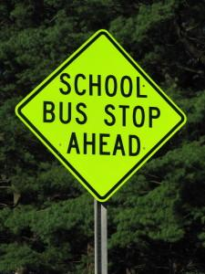
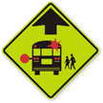
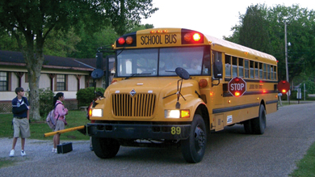
What do these signs mean for a …
Bicyclist?
Motorist?
Pedestrian?
School bus - Thibodaux - Louisiane, self made PRA
Notes:
Sign: School Bus Stop Ahead- Two signs are included, the first is currently being used, but will be phased out over the next ten years. The second sign is the new approved sign.
Guided Responses:
Bicyclist – The sign indicates to slow down and look for school buses that may have stopped or is preparing to stop to load or unload children. As a road user, you are required by law to stop for a school bus as well. If you are riding a bicycle on a sidewalk where the bus is loading or unloading, we recommend you stop and let children safely get on or off the bus and on their way.
Motorist – The sign indicates to motorists to slow down and look for school buses that may have stopped to load or unload children. Motorists are required by law to stop for a school bus when the red lights on the bus flash.
Pedestrian – The sign is not designated for pedestrians, however, it communicates you should be careful when walking near a school bus or crossing the street. While bicyclists and motorists are supposed to stop, sometimes they don’t. Protect yourself and always look for moving traffic.

Slide 21
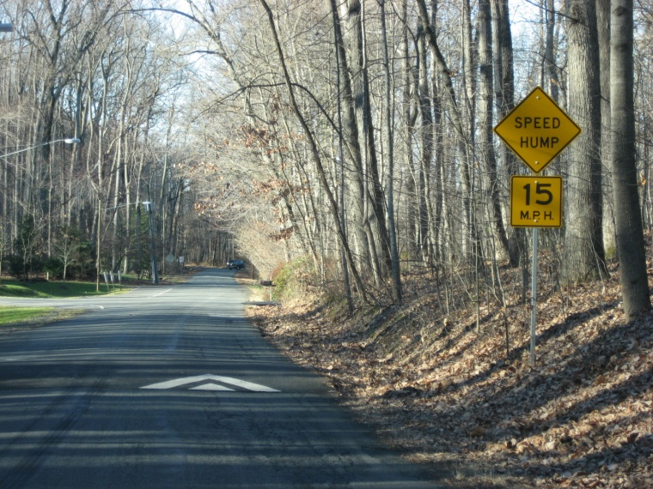
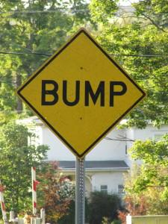
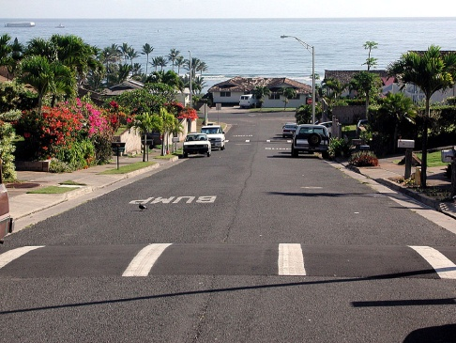
What do these signs and markings mean for a …
Bicyclist?
Motorist?
Pedestrian?
(Dan Burden)
Notes:
Sign: Speed Bump
Sign: Bump or Speed Hump
Bump signs or Dip signs) are typically placed in rural areas to alert motorists (and bicyclists) that there is a problem or flaw in the road. It is intended to warn the user to slow down and to have two (2) hands on the wheel (handlebar) to maintain control.
Street Marking: Speed Bump and Speed Hump
Speed Humps: These are intentional roadway features, low to the ground. Their purpose is to slow the speeds of motorized traffic, including “cut through traffic“ in areas where people live. They are most often seen in urban and suburban neighborhoods. Traffic Engineers and Planners call these “traffic calming devices.”
Speed Bumps: Are also intentionally placed, but are more prominently raised and are found in parking areas (apartment complexes, schools, office parks, shopping centers).
Guided Responses:
Bicyclist – Speed humps and bumps can be dangerous for bicyclists if they don’t stay alert for them and don’t slow down. Riding over them too fast can cause the bicyclist to lose control of their vehicle causing them to be thrown from the bicycle. ** Here’s where that helmet you wear every ride comes into play to protect your brain, if you fall. This scenario has happened to all ages and levels of experienced riders. Always ride focused and be prepared by wearing a helmet every ride.
Motorists –Lowering speeds in these urban and suburban neighborhoods allows for drivers to be aware of and respond to their surroundings, such as motorists exiting driveways or parking spaces, and for the presence of non-motorized road users, i.e. pedestrians and bicyclists. Many pedestrians and bicyclists walk/bicycle in these areas.
The speed of a car on impact is directly proportional to the degree of injury or likelihood of a pedestrian/bicycle fatality if a crash occurs. Going over speed bumps without regard to speed can damage a car and is not responsible behavior.
***Speed humps do not take the place of or in any way minimize the motorists’ need to drive alert and focused on the roadway at all times (no texting or talking on the phone.)
Pedestrians- Not applicable.

Slide 22
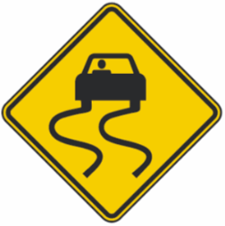
What do these signs mean for a …
Bicyclist?
Motorist?
Pedestrian?
Notes:
Sign: Slippery When Wet
Yellow signs indicate caution.
Guided Responses:
Bicyclist – This sign indicates the roadway is known to get slippery when wet. Slow down and drive cautiously to maintain control of your vehicle
Motorist - Same as bicyclist
Pedestrian - This sign is for vehicles, but as a pedestrian, if the roadway is wet and you are walking along the roadway, you should stay extra alert and get out of the way if necessary. What should you do differently if the road is wet and you want to cross the road? It takes vehicles longer to stop when the road is wet; allow extra time to cross or better yet, wait and let vehicles pass. (make sure you are visible too; bright colors or reflective wear).

Slide 23
Conclusion
Whether you’re a bicyclist, motorist, or pedestrian – signs, symbols, and street markings exist to enhance your safety. You should:
  Follow all signs, symbols, and markings
  Don’t assume others will follow them
  Ride, drive, and walk defensively!
8008-101912-v3
Notes:
“Ride, drive, and walk defensively” means always look out for other road users and protect yourself.

