Slide 1
Notes:
Notes to Facilitators:
This activity provides an opportunity for participants to identify safe and unsafe behaviors and environments for walking and bicycling. You may use some or all of those pictures provided, or assign youth to take pictures themselves and discuss them with their peers. The activity encourages identifying:
thumbs up– behaviors that are safe and/or conditions that make it safer for pedestrians and/or bicyclists;
thumbs down- behaviors that are not safe, conditions that make it less safe for pedestrians and/or bicyclists and
thumbs neutral – may depend on the situation or can’t clearly tell from the photo.
Note: Each slide includes bullets providing guidance for features to discuss. This activity should either be a dialogue between the adult facilitator and all participants, or between all participants with you directing or focusing the discussion as needed. This is not a lecture.
Note: While this presentation was designed and reviewed by National Highway Traffic Safety Administration and Federal Highway Administration of the Department of Transportation, Photographs and discussion points are selected to generate discussion.
(For OCCI) PBIC Image Library Usage Guidelines available at http://www.pedbikeimages.org/usage.cfm

Slide 2
Notes:
Thumbs up:
Presence of a dedicated bicycle lane for bicyclists
Space separating the motorists from the bicycle lane
Presence of overhead lighting
No traffic
Thumbs down:
None noted
Thumbs neutral:
None noted

Slide 3
Notes:
Thumbs up:
Bicyclist is using the dedicated bicycle lane, where bicyclists are more likely to be seen
Weather is nice (no rain, ice, snow)
Road is clear of any obstacles in bicyclists path
Bicyclists is wearing a helmet
Bicyclist is riding away from the “door zone” to protect herself from the potential hazard of getting hit by a car door
Traffic is light, but this is a two lane road, so speed may be slightly higher than a neighborhood street
Thumbs down:
Helmet strap isn’t tight; if the bicyclist fell, the helmet would not stay on her head
Thumbs neutral:
Bicyclist should consider wearing sunglasses to limit glare and keep bugs out of her eyes
Bicyclist should consider wearing bicycling gloves to protect hands in case of falls

Slide 4
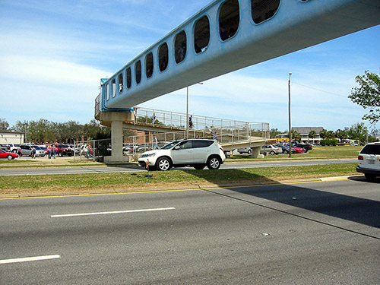
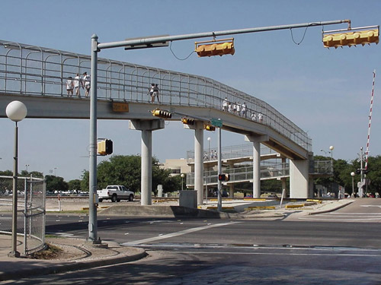
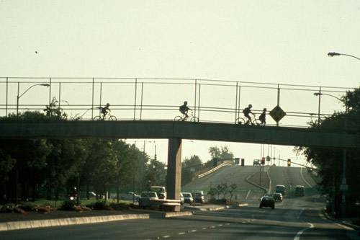
Notes:
Thumbs Up:
Elevated walkways allow pedestrians to cross a busy street without being exposed to motorized traffic; it decreases the pedestrians exposure to traffic
Some elevated walkways, such as this one, have a covering and thus limit a pedestrian’s exposure to weather conditions (rain, snow, ice)
Increasing safety at this particular spot (looks like this leads to a school or a ball park) where pedestrians frequently cross the road is likely a good financial decision and the crossing is likely to be used by the community. Sometimes projects like this happen because the community requests or demands that something be done to increase access and safety
Thumbs Down:
Building an elevated walkway can be a very expensive project and many communities will not opt for this type of project due to the expense.
Thumbs Neutral:

Slide 5
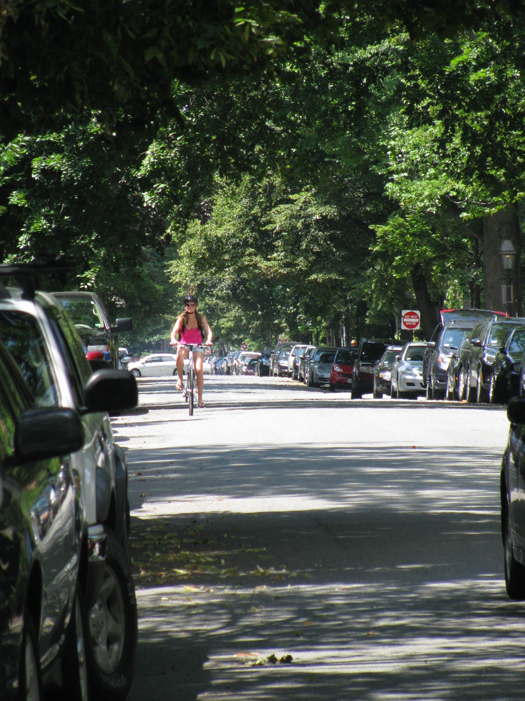
Notes:
Thumbs Up:
Looks like a neighborhood street (neighborhood streets have lower speed limits). This is a safer and/or more comfortable choice for many bicyclists who don’t bike all the time
Bicyclist is wearing a helmet
Bicyclist is riding in the proper direction, with the flow of traffic
Bicyclist is riding away from the “door zone” (about an arm’s length away from a driver’s door); this will protect her from the potential hazard of getting hit by a car door opening if a driver doesn’t look first.
Thumbs Down:
Cars parked on the side of this road represent a potential hazard
Thumbs Neutral:
Very lush- watch for overgrowth of trees/bushes that may obstruct vision of bicyclist or motorist
No bike lanes; however, the street is wide with a low volume of traffic
From the photo, we don’t know anything about the presence or the condition of the sidewalk for pedestrians

Slide 6
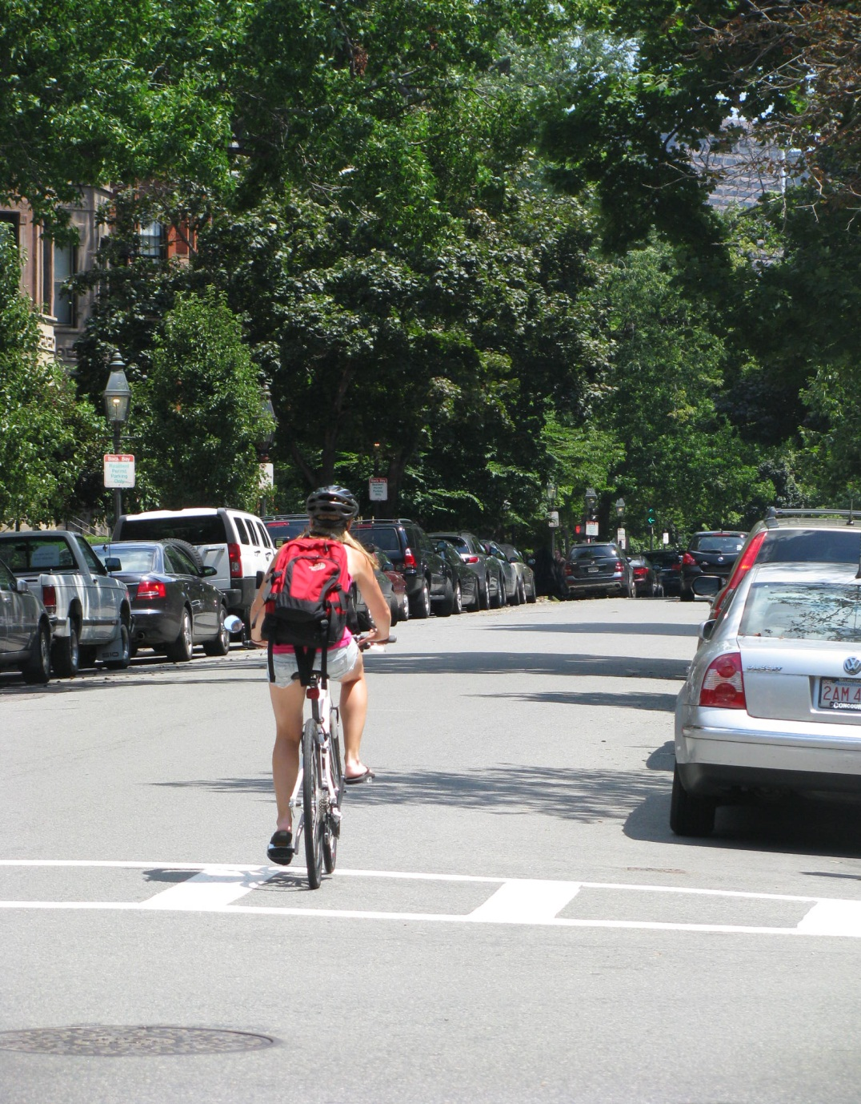
Notes:
Thumbs up:
Bicyclist is wearing a helmet
Bicyclist is riding in the proper direction, with the flow of traffic
Bicyclist is riding away from the “door zone” to protect herself from opening car doors
Bicyclist is carrying items on her back and using both hands on the handlebars
Bicycling on a neighborhood street (speed limit relatively low)
Bicyclist has two hands on handlebars and is carrying items in a backpack
Thumbs down:
There is not a bicycle lane
Thumbs neutral:
This is a one-way road (all cars are parked in the same direction). We can’t see if this is a one lane road or a two lane road.
Parked cars are a potential hazard so the bicyclist always needs to exercise caution by looking for cars pulling out and doors opening
The road seems to have a low volume of traffic

Slide 7
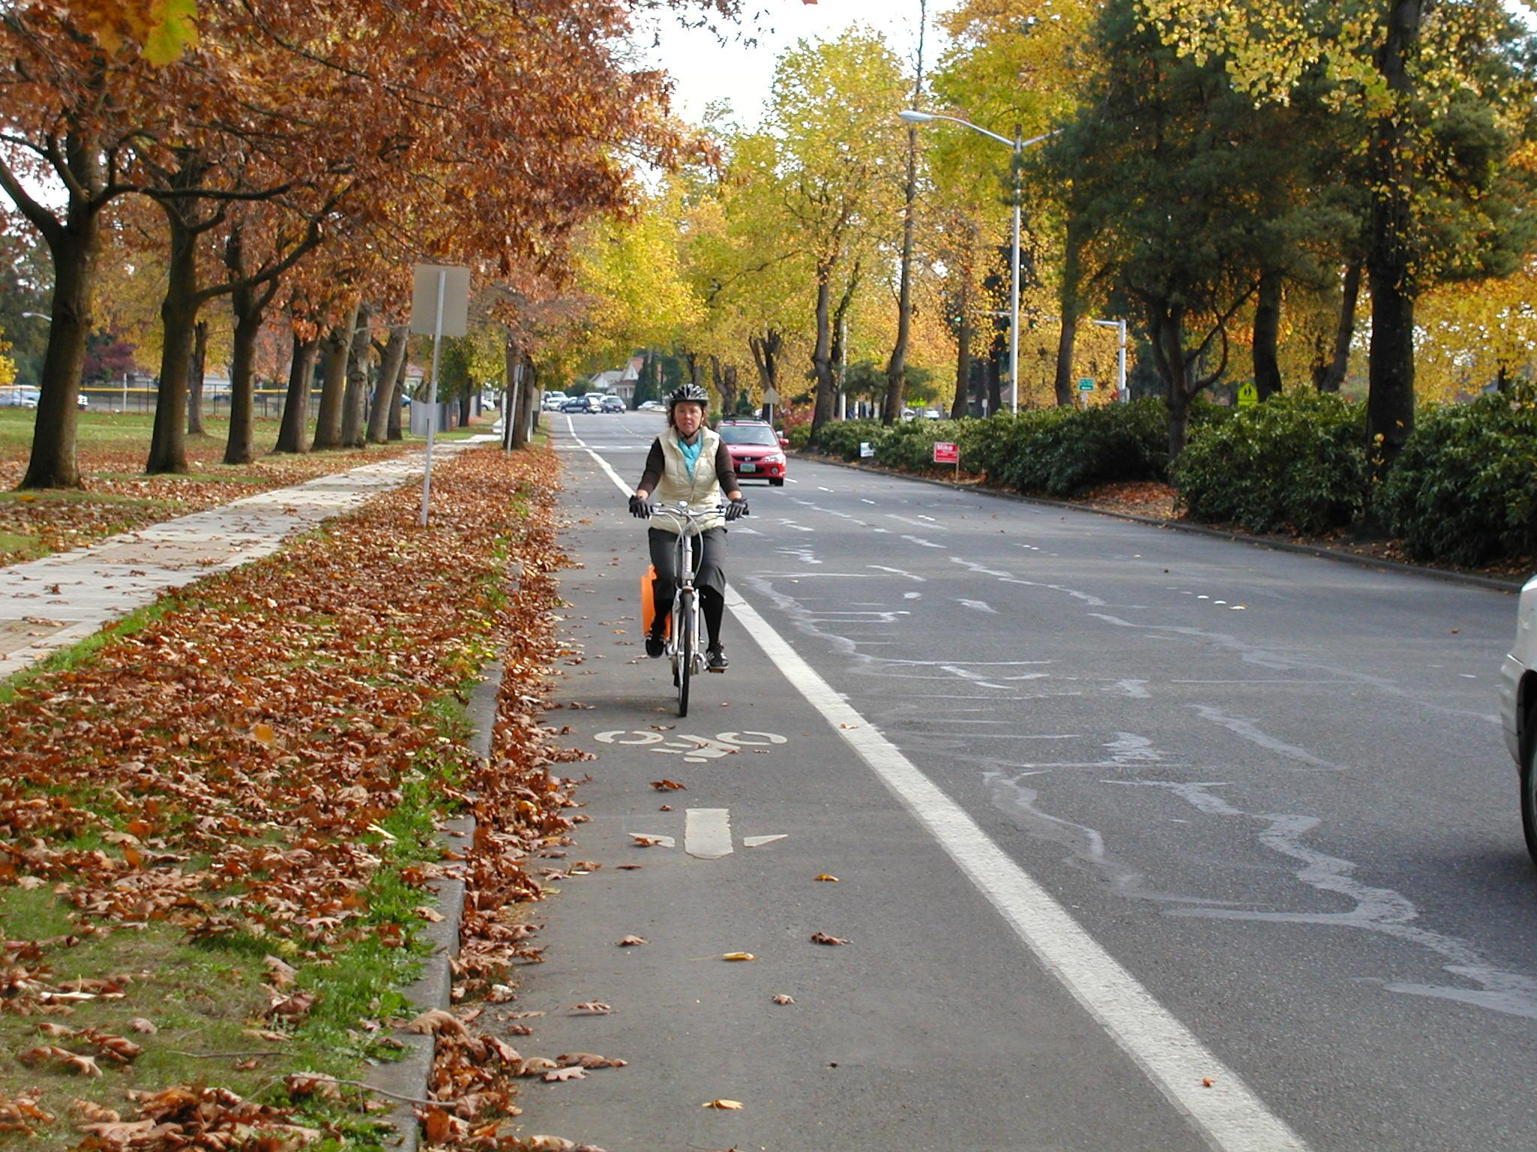
Notes:
Thumbs up:
There is a dedicated bike lane
Sidewalk is available for pedestrians
Bicyclists is wearing a helmet
Driver of the red car likely sees the bicyclists and is moving over to allow room while passing
In this picture, the leaves are to the side of the bike lane and out of the path of the bicyclist
Thumbs down:
None noted
Thumbs neutral:
Leaves are a potential hazard when wet

Slide 8
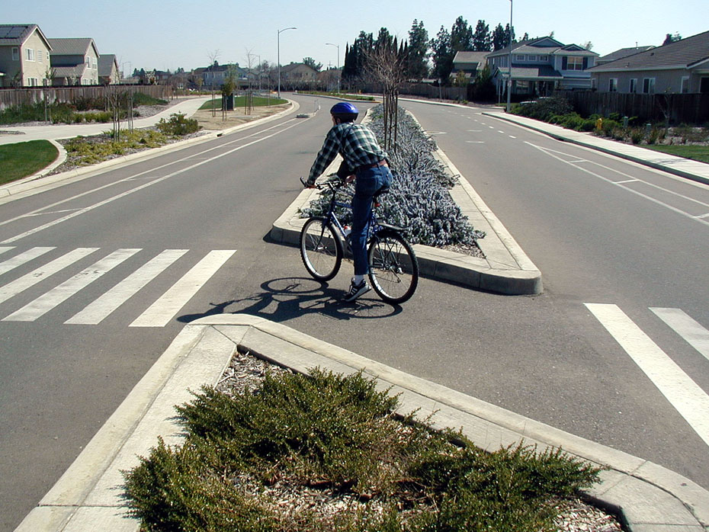
Notes:
Thumbs up:
There is a dedicated bicycle lane
The bicyclist is wearing a helmet
The bicyclist is stopped to look for traffic (see left foot down) before proceeding
There are sidewalks for pedestrians
Combination of engineering facilities (crosswalks, sidewalks, bike lanes) creates a desirable route for walking and bicycling

Slide 9
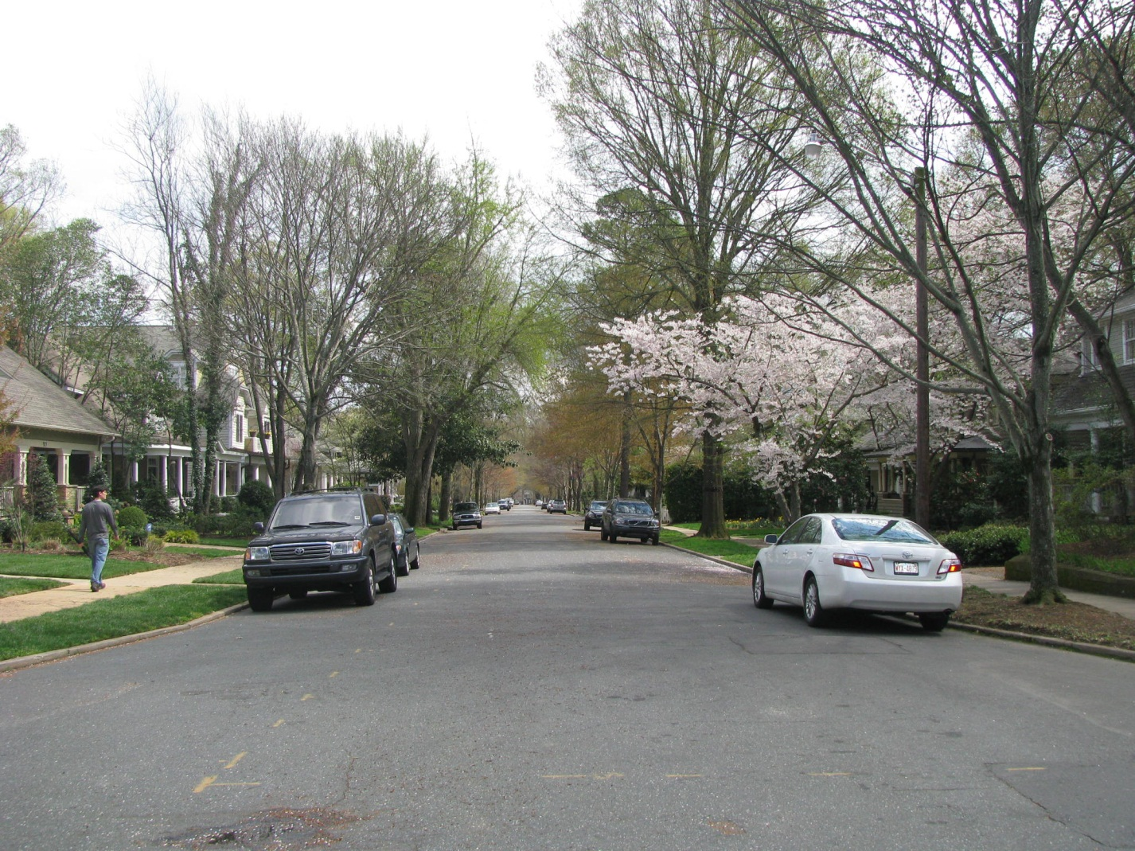
Notes:
Thumbs up:
Neighborhood has sidewalks for pedestrians
Residential neighborhoods like this usually have low traffic speeds
Thumbs down:
On-street parking means a bicyclist needs to exercise caution near parked cars in case the motorist unexpectedly pulls out into traffic or opens a car door into the bicyclist, often referred to as “dooring”
Thumbs neutral
No bike lanes are visible, but the street is wide with a low volume of traffic
Parked cars on a neighborhood street could also serve to slow speeds on the street (engineers would call this a “traffic calming” measure (other examples of traffic calming are speed bumps, traffic circles, etc.)

Slide 10
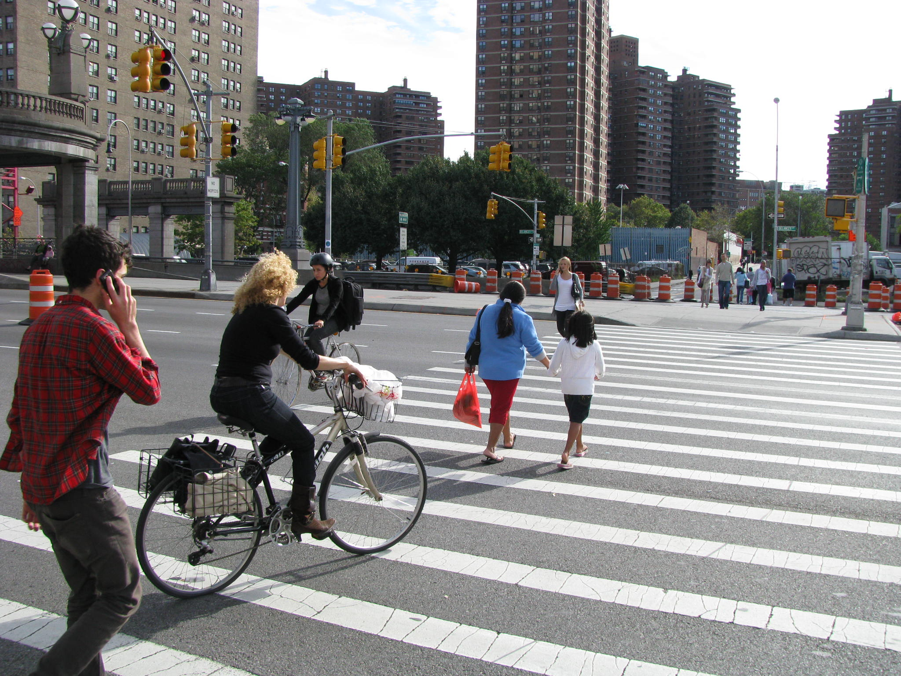
Notes:
Thumbs up:
The pedestrians are using the marked pedestrian crosswalk
The child is holding an adult’s hand
The far bicyclist is wearing a helmet
The bicyclist in the foreground has her items inside front and rear baskets so both hands can be on the handlebars
The bicyclist in the foreground is not wearing pants that are loose and likely to get caught in the bike’s chain
Thumbs down:
The bicyclist in the foreground is not wearing a helmet
The young man (pedestrian) is using a phone while crossing the street; this is a safety risk, eyes and ears should be completely focused on the road
Bicyclists are wearing dark clothes making them less likely to be seen
Thumbs neutral:
Bicyclists are riding in the pedestrian crosswalk. Depending on the local or state laws, the bicyclists may be required to dismount and walk their bicycles across the street
The construction zone on the far side of the street might pose some hazards or inconveniences along this route

Slide 11
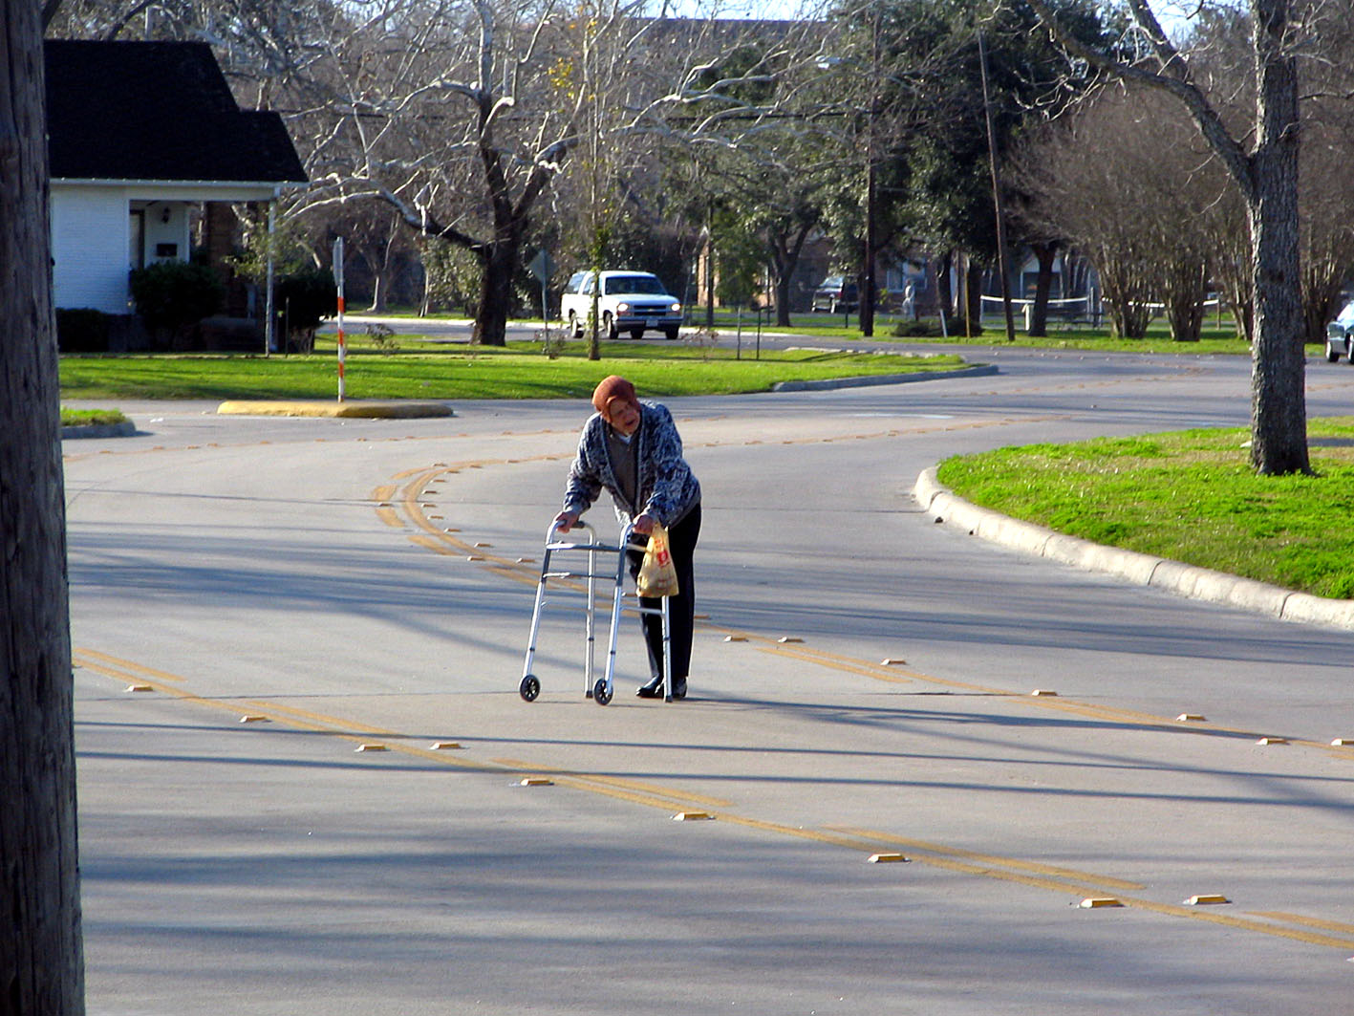
Notes:
Thumbs up:
Reflective lights on the road makes it easier for a driver to see the road markings in low visibility conditions (fog, rain, night)
The pedestrian is not wearing just all dark colors, the blue jacket and red hat might increase visibility by a driver
Car in the background has its lights on, increasing the driver’s visibility and also the ability of other road users to see the car
Thumbs down:
The pedestrian is not crossing at a corner or marked crosswalk
There is no visible marked crosswalk to assist pedestrians to safely cross
The pedestrian is crossing close to a curve (traffic circle) which is very risky
The pedestrian is possibly looking for traffic but isn’t looking in the correct direction; traffic will be coming from his right
This crossing location is very dangerous for this elderly pedestrian for a number of reasons:
Traffic coming into the circle (from the left side of the photograph), will likely be looking for traffic from their left and not be looking for a pedestrian crossing to their right
The pedestrian is crossing outside of a crosswalk and at a curve
Elderly pedestrians often take longer to cross; they are at high risk for severe injuries if hit by a moving vehicle because they are more fragile
The faster the speed of the motorized vehicle, the greater the injury or risk of a fatality to any pedestrian
Thumbs neutral:
None noted

Slide 12
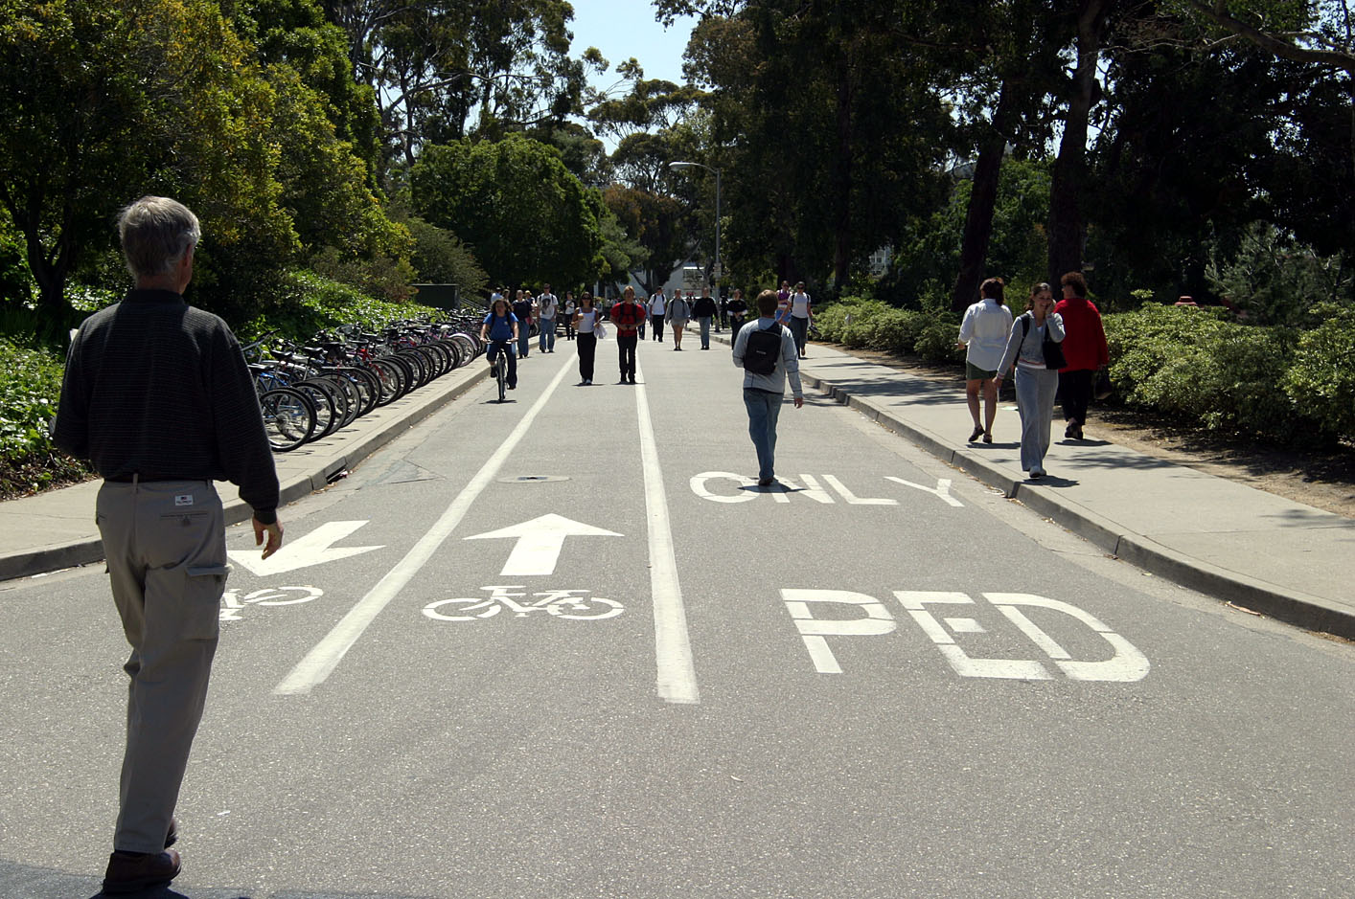
Notes:
Thumbs up:
The engineering facilities (sidewalks, bike racks, lane markings, and no motorized traffic) create a top notch environment for walking and riding)
Thumbs down:
Even with clear road markings and arrows, pedestrians are walking in the bicycle lane
Thumbs neutral:
None noted

Slide 13
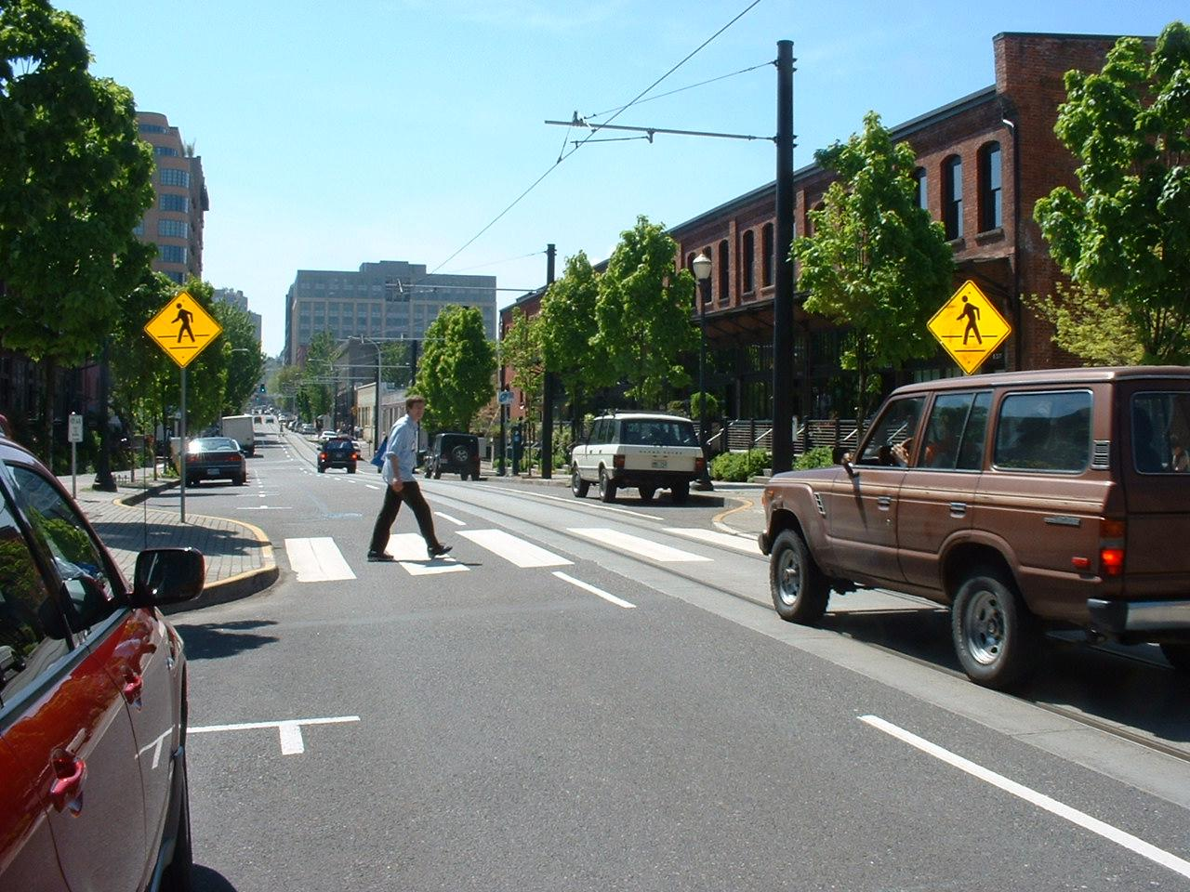
Notes:
Thumbs up:
Pedestrian is crossing at a marked crosswalk
Pedestrian appears to be looking establishing eye contact with the driver who is stopped for him to cross
Pedestrian crossing signs are clearly posted on this one way street with two lanes
Pedestrian crosswalk is visible
Thumbs down:
None noted
Thumbs neutral:
None noted

Slide 14
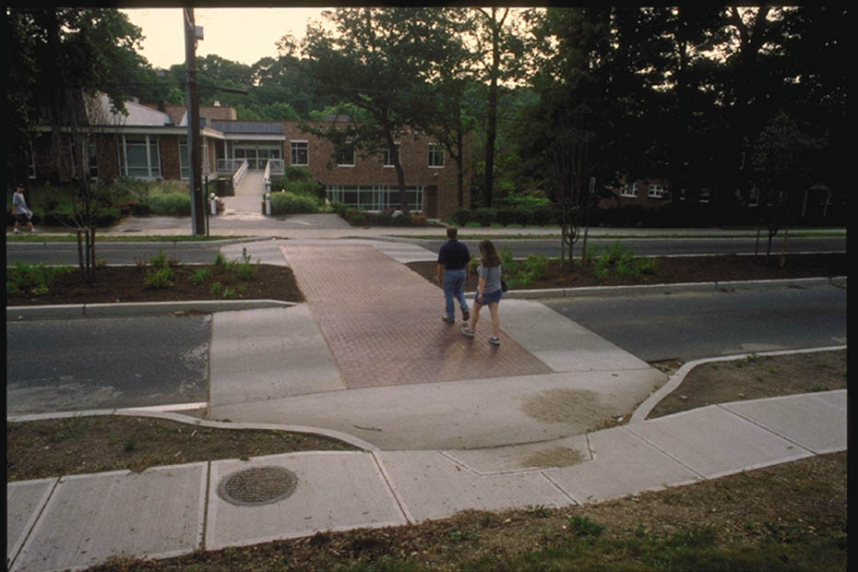
Notes:
Thumbs up:
Pedestrians are using a marked cross walk
Thumbs down:
None noted
Thumbs neutral:
Unclear whether pedestrians are watching for traffic as they cross
Unclear whether it is it is dusk or dawn or just the actual picture. Wearing bright clothing and reflective gear and/or a light can enhance the visibility of pedestrians to other road users. Examples of reflective gear includes fluorescent shoe laces, reflect bands or spots, etc.

Slide 15
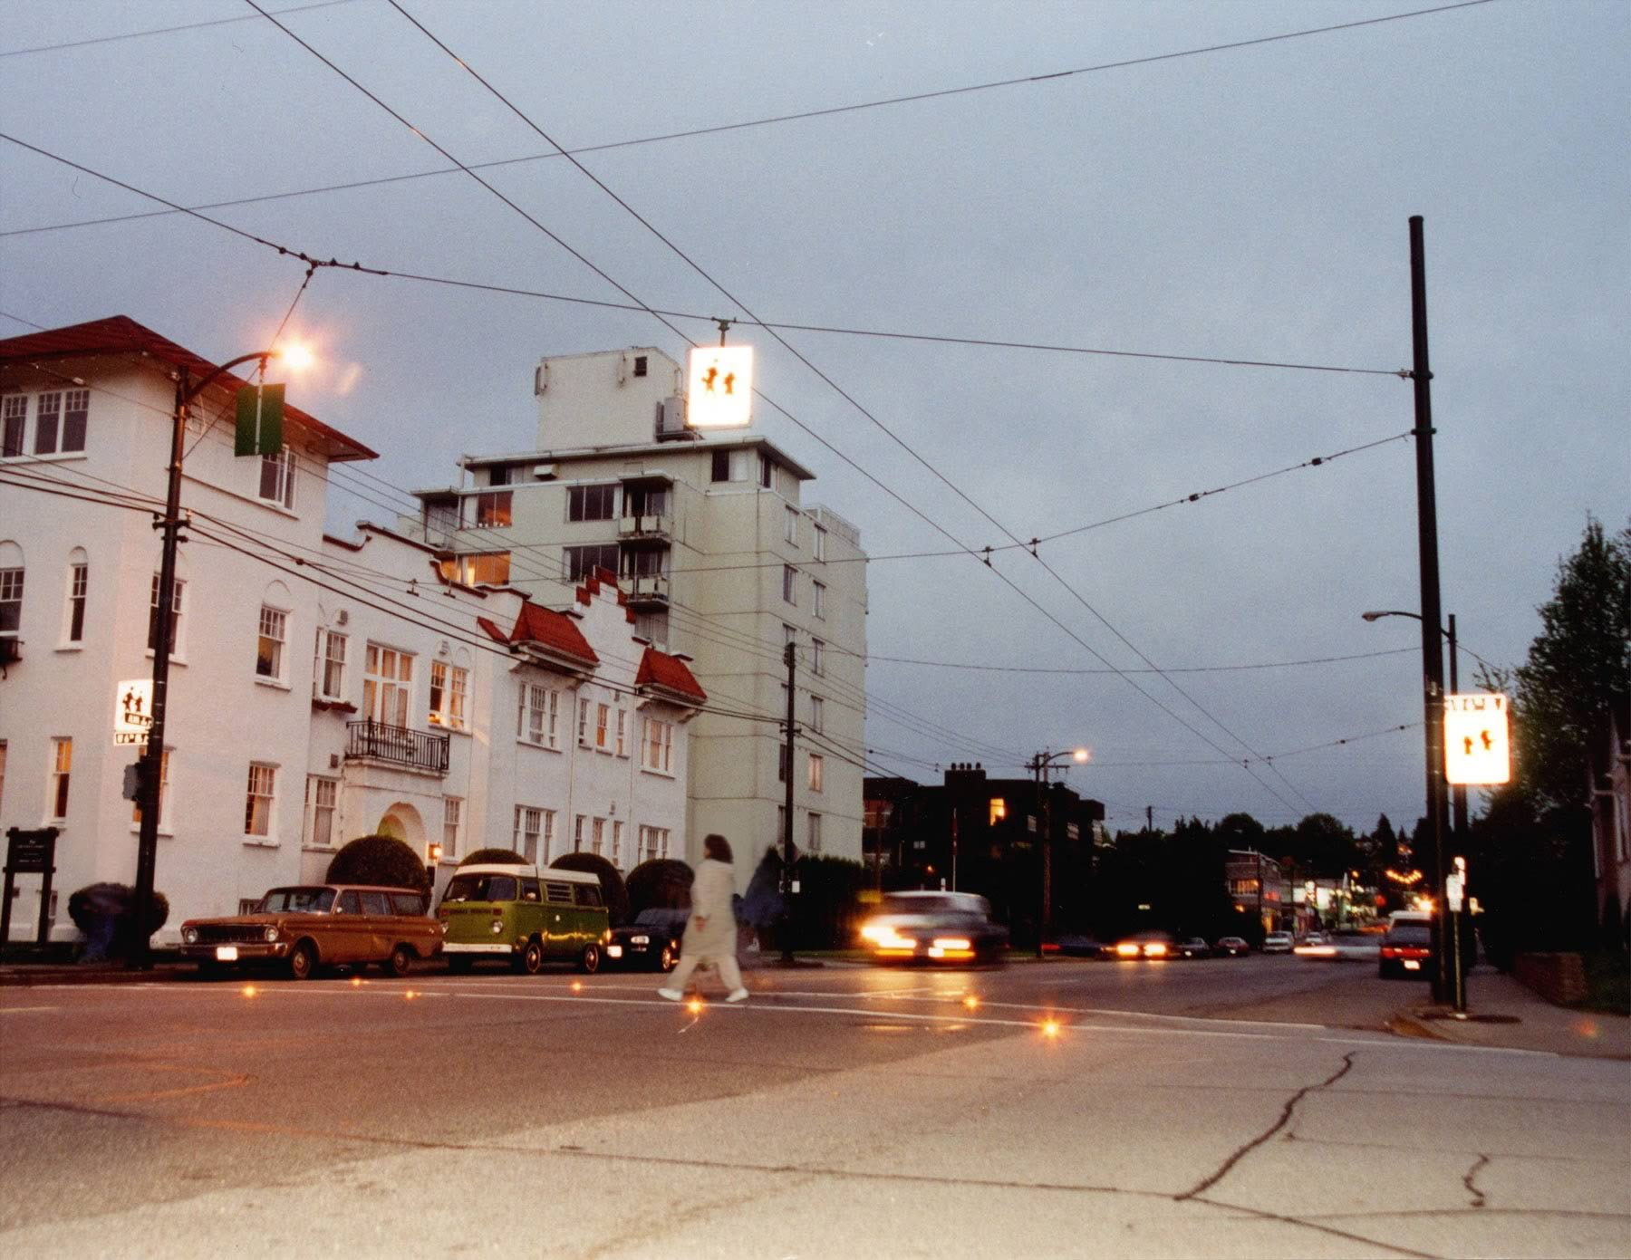
Notes:
Thumbs up:
Pedestrian is walking in a marked and lit crosswalk
Motorists are using their headlights to increase their ability to see
Thumbs down:
Because it’s dusk/dawn the ability for cars to see a pedestrian decreases. Therefore, the pedestrian here should make herself more visible by wearing bright or fluorescent color clothes and reflective materials (vest, dots, strips, shoe laces, etc.). Wearing lights or carrying a flashlight is better as night approaches
The pedestrian does not appear to be scanning left and right for traffic while crossing the street
Thumbs neutral:
None noted

Slide 16
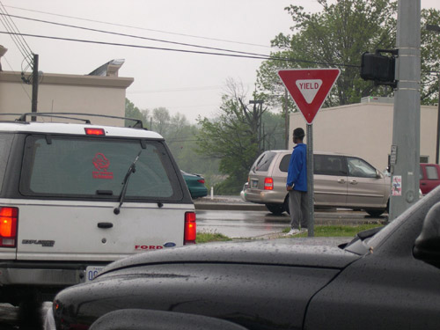
Notes:
Thumbs up:
Pedestrian is wearing a color that might make him more visible (fluorescent color would be better)
Thumbs down:
This appears to be a busy intersection marked only with a yield sign for traffic to enter the main road
It doesn’t look like there is a sidewalk to the pedestrians' right, so he is likely to cross the street either straight ahead (behind the tan/gray SUV, where no crosswalk is noted) or to his left (perhaps in front of the white SUV where it’s unclear if there’s a crosswalk)
With only a yield sign, drivers may not stop for the pedestrian and/or they may be more focused on making their turns onto the busy street. The pedestrian needs to take extra caution and walk defensively
It appears to be raining or at least misting. When the weather is poor, visibility for both the pedestrian and the drivers is lower and it takes longer for drivers to brake when roads are wet. The boy should ideally wait until the road is free of traffic before crossing, but may look for a driver to wave him to cross. If he crosses, he also needs to look for traffic in each lane of traffic and for turning traffic
The boy is wearing a bright color, however, since it is a rainy day, he should also wear reflective materials or lights and/or carry a flashlight
The boy has a headset on and is likely listening to music. This is not safe when around traffic; it is even more of a risk in this type of weather when extreme caution is important
Thumbs neutral:
The pedestrian should be aware (and mindful) that the drivers are likely not to come to a complete stop; they may be distracted and/or in a hurry to pull out while they can and not even notice him there

Slide 17
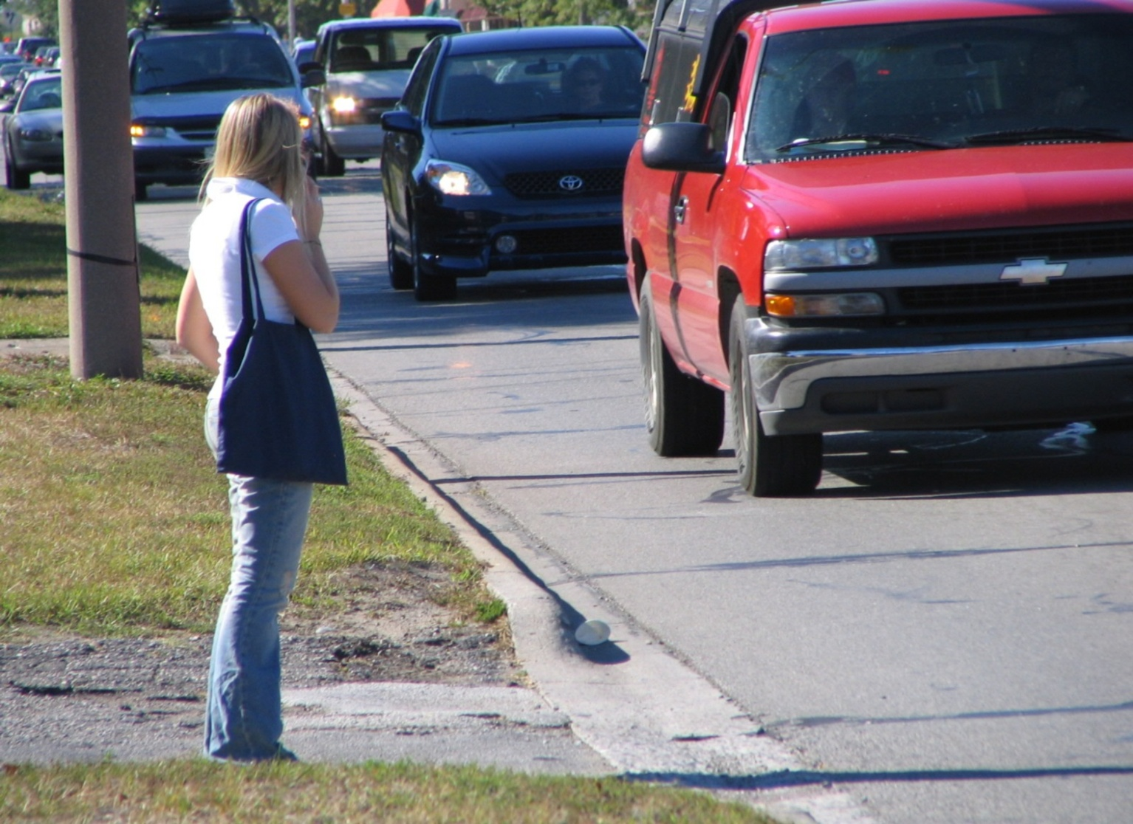
Notes:
Thumbs up:
Pedestrian appears to be waiting for a safe gap in traffic
Thumbs down:
The pedestrian is attempting to cross a busy street at an unmarked crosswalk
The curb cut signals that this might be a pedestrian crossing, but it nonetheless appears to be an unsafe place to cross
The pedestrian is using her cell phone and is distracted; she needs to get off the phone and use her eyes and ears before and as she crosses
If the pedestrian is waiting for her ride to pick her up, there is no place for the driver to pull out of traffic
Thumbs neutral:
None noted

Slide 18
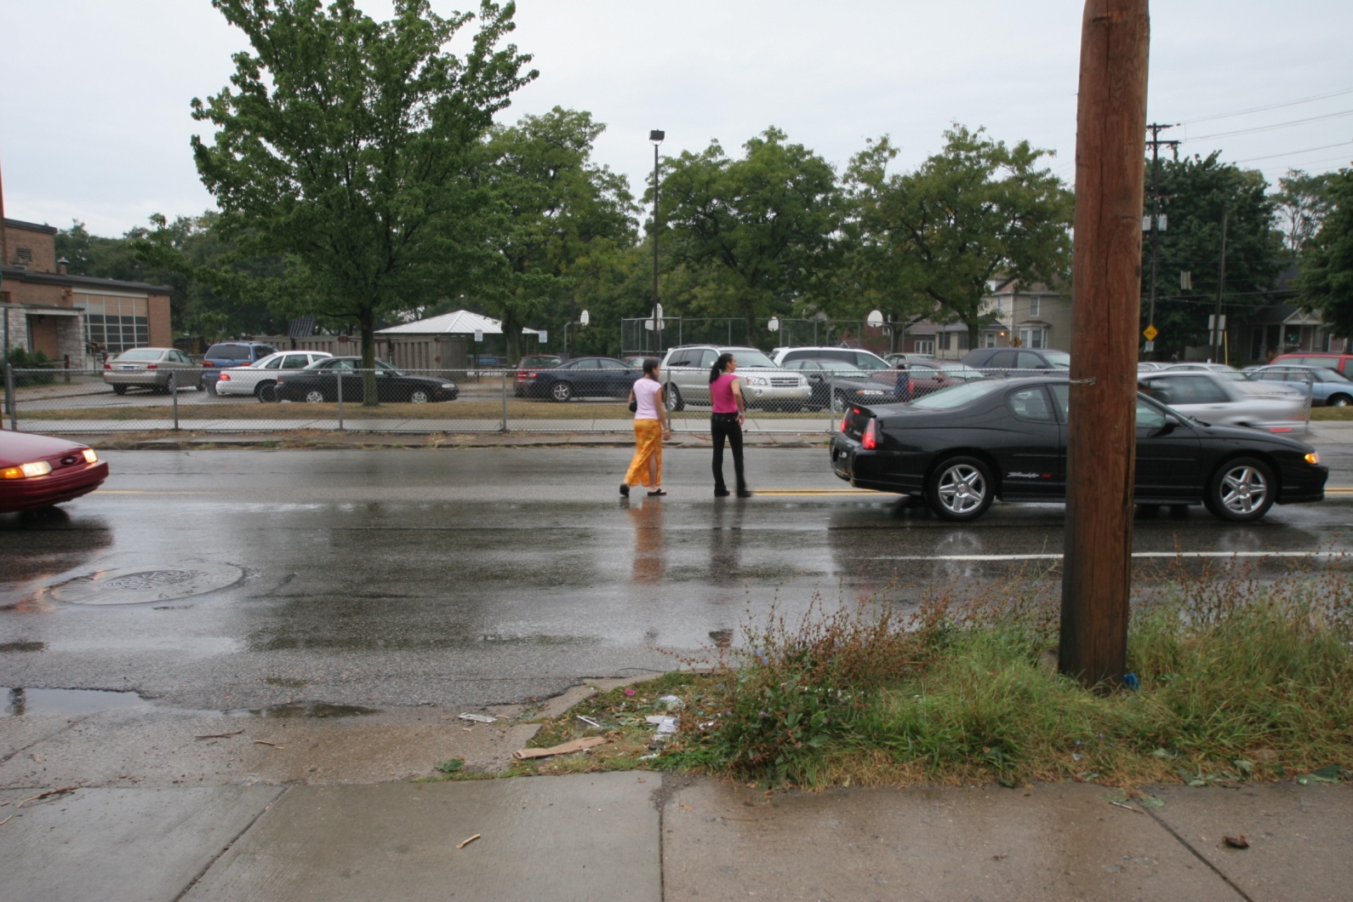
Notes:
Thumbs up:
Pedestrians are wearing brightly colored clothes
Thumbs down:
This is not a safe place or way to cross the street
Pedestrians are crossing in the middle of a block (not at a crosswalk or corner)
Motorists have reduced visibility because of the weather
Pedestrians appear to be stopping in the middle of the traffic
Thumbs neutral:
None noted

Slide 19
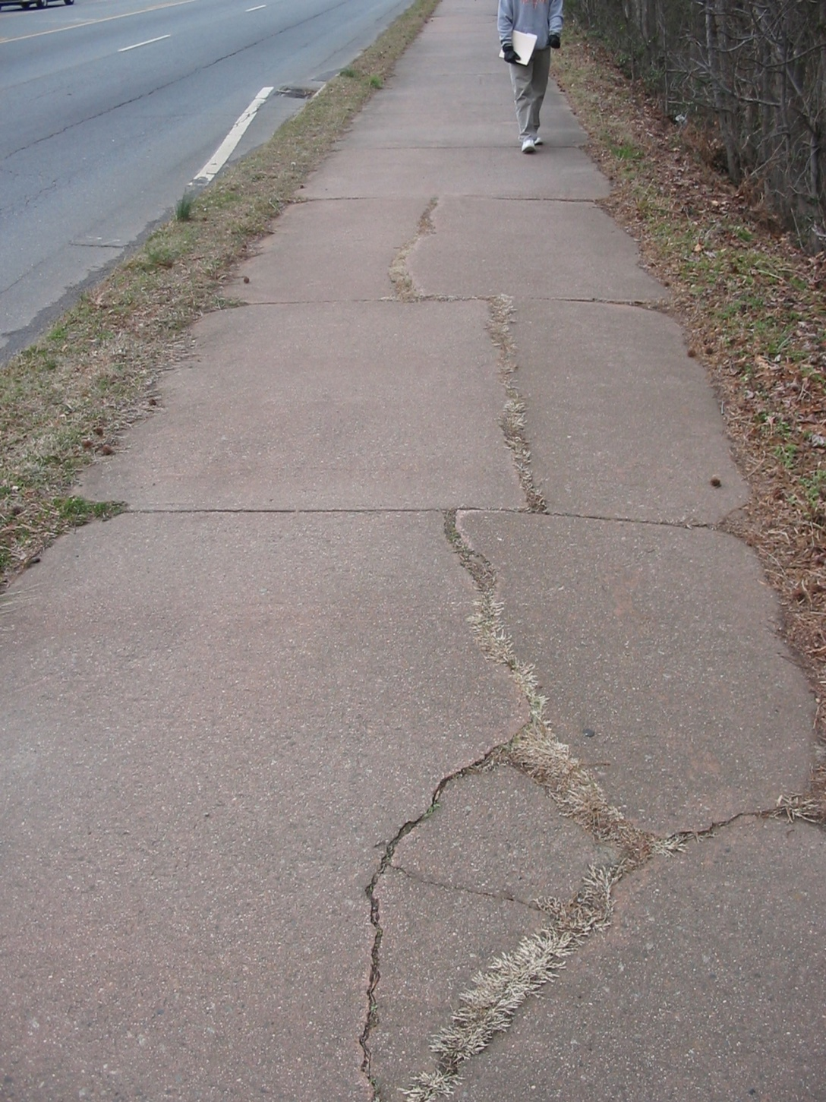
Notes:
Thumbs up:
Pedestrian is using the sidewalk
Thumbs down:
This sidewalk is in poor repair and may not be the safest option for pedestrians or bicyclists. The general public can submit a written request for sidewalk repair to their local government
Thumbs neutral:
None noted

Slide 20
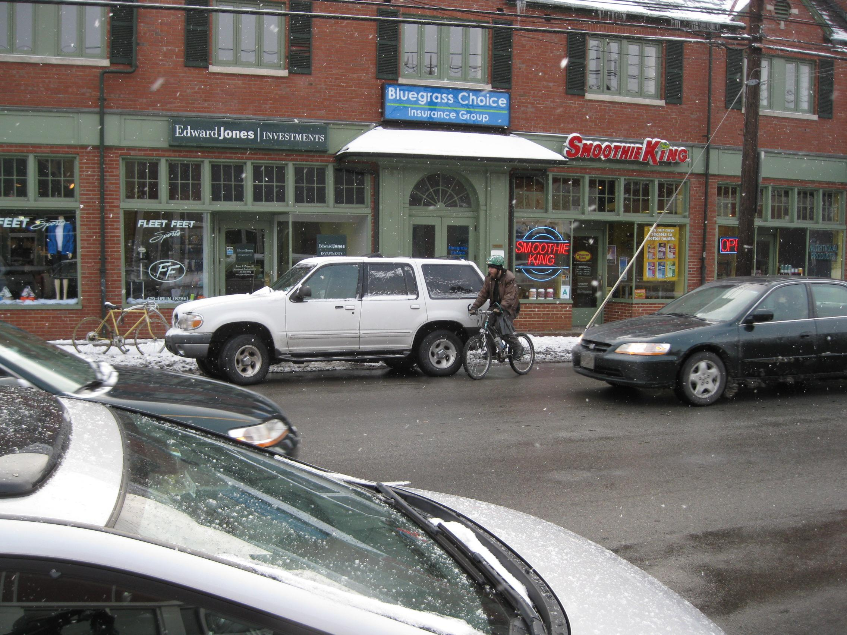
Notes:
Thumbs up:
The bicyclist is wearing a helmet
Thumbs down:
The bicyclist is very close to this parked car (in the door zone - a dangerous area for crashes if the motorist doesn’t look for any traffic before opening the car door)
Thumbs neutral:
The street is busy with lots of cars stopping and going; the bicyclist should use extra caution
The pavement is wet or perhaps icy; the bicyclist should use extra caution

Slide 21
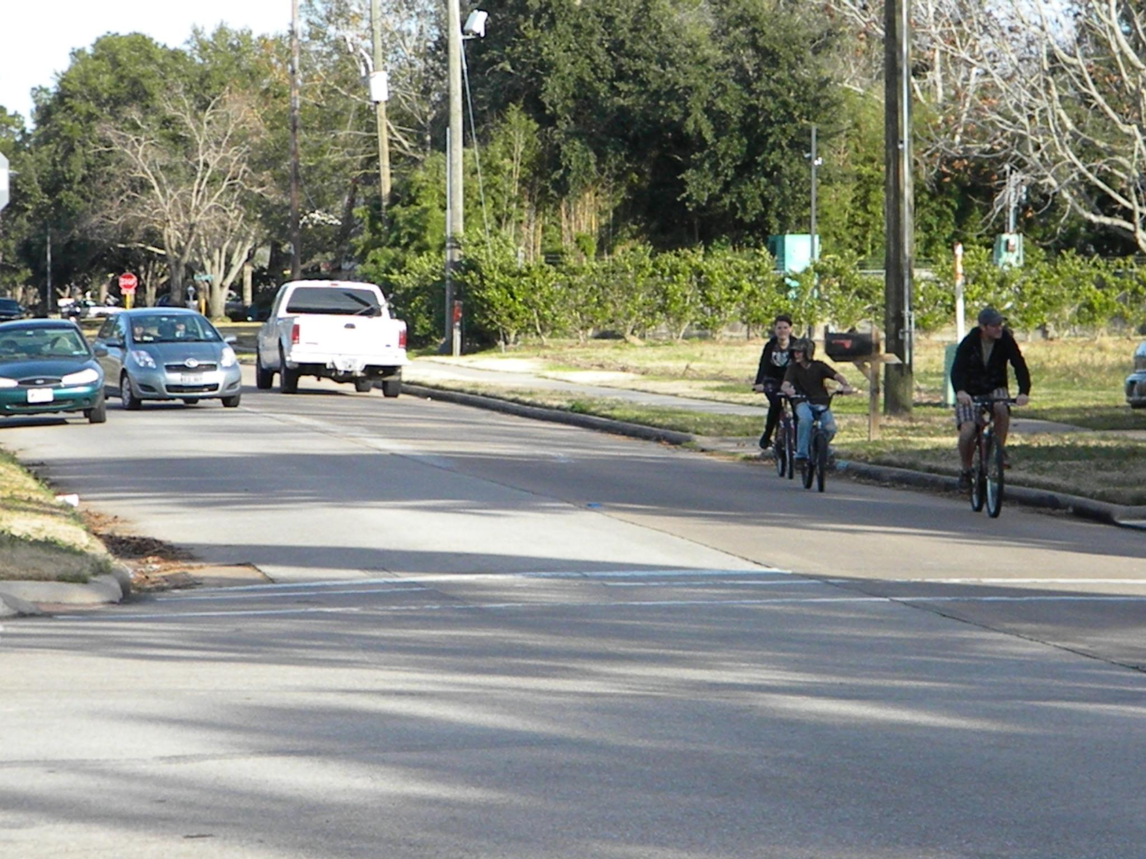
Notes:
Thumbs up:
There’s a sidewalk for pedestrians
Children are riding with an adult
Thumbs down:
Bicyclists are not wearing helmets
Bicyclists are riding on the wrong side of the road; they should be riding in the same direction as car traffic
There is no bike lane
Thumbs neutral:
Looks like the kids are riding with an adult; adult is being a poor role model. Everyone should have a helmet on and the adult should be demonstrating correct and safe behavior on the roadway
Boy is turning focus to his right and may not be attentive to the traffic in the roadway, including the person riding directly in front of him

Slide 22
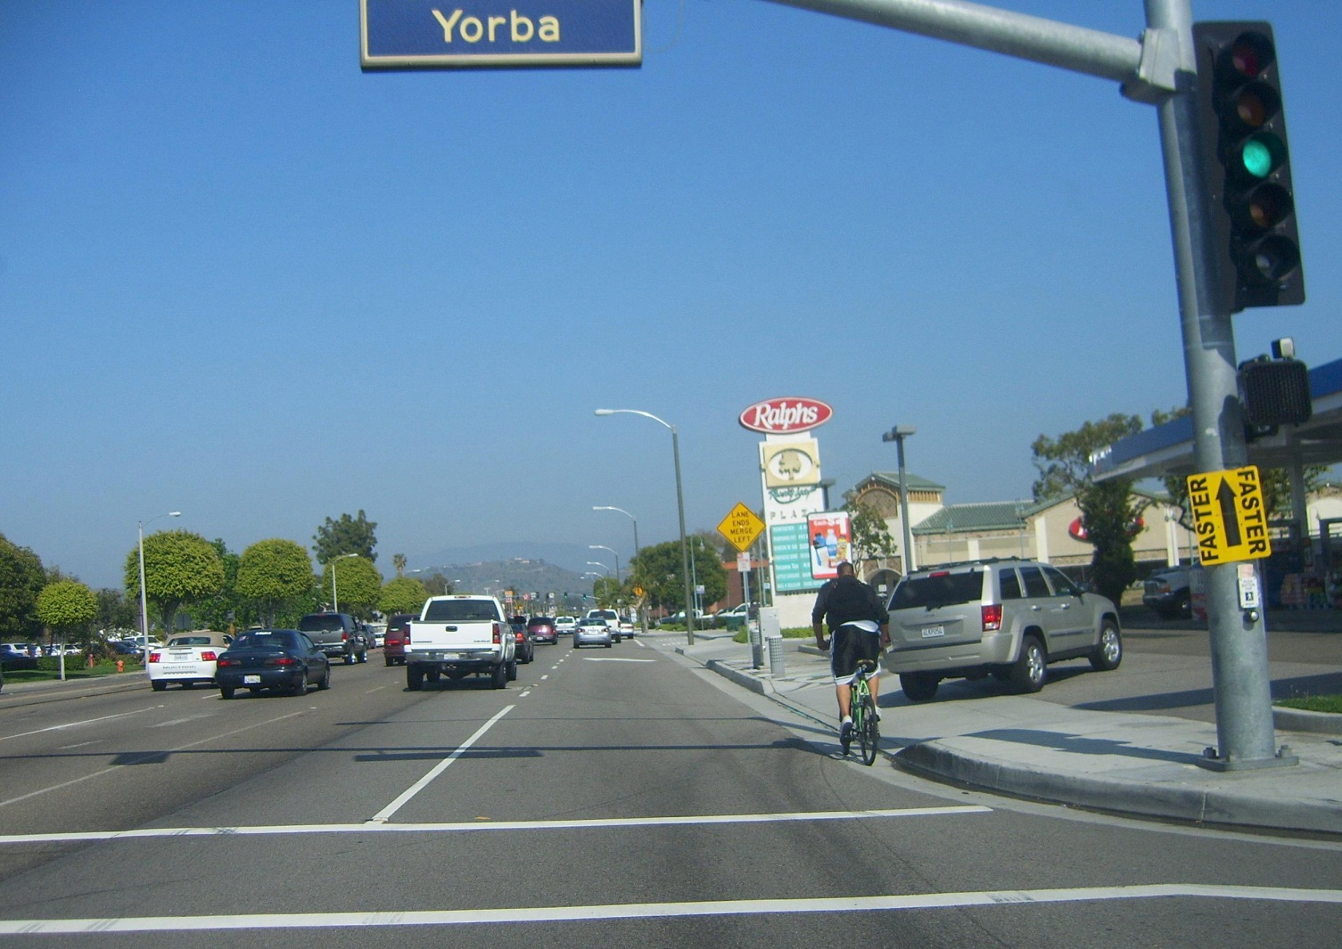
Notes:
Thumbs up:
Bicyclist is riding in the correct direction, with the flow of traffic
Thumbs down:
There’s no bike lane or shoulder for the bicyclist
This appears to be a busy road with high traffic volume; this may not be a safe route for bicycling
The SUV to the right may be backing up though no back up lights are being shown; bicyclists needs to use caution
The bicyclist is not wearing a helmet
Thumbs neutral:
None noted

Slide 23
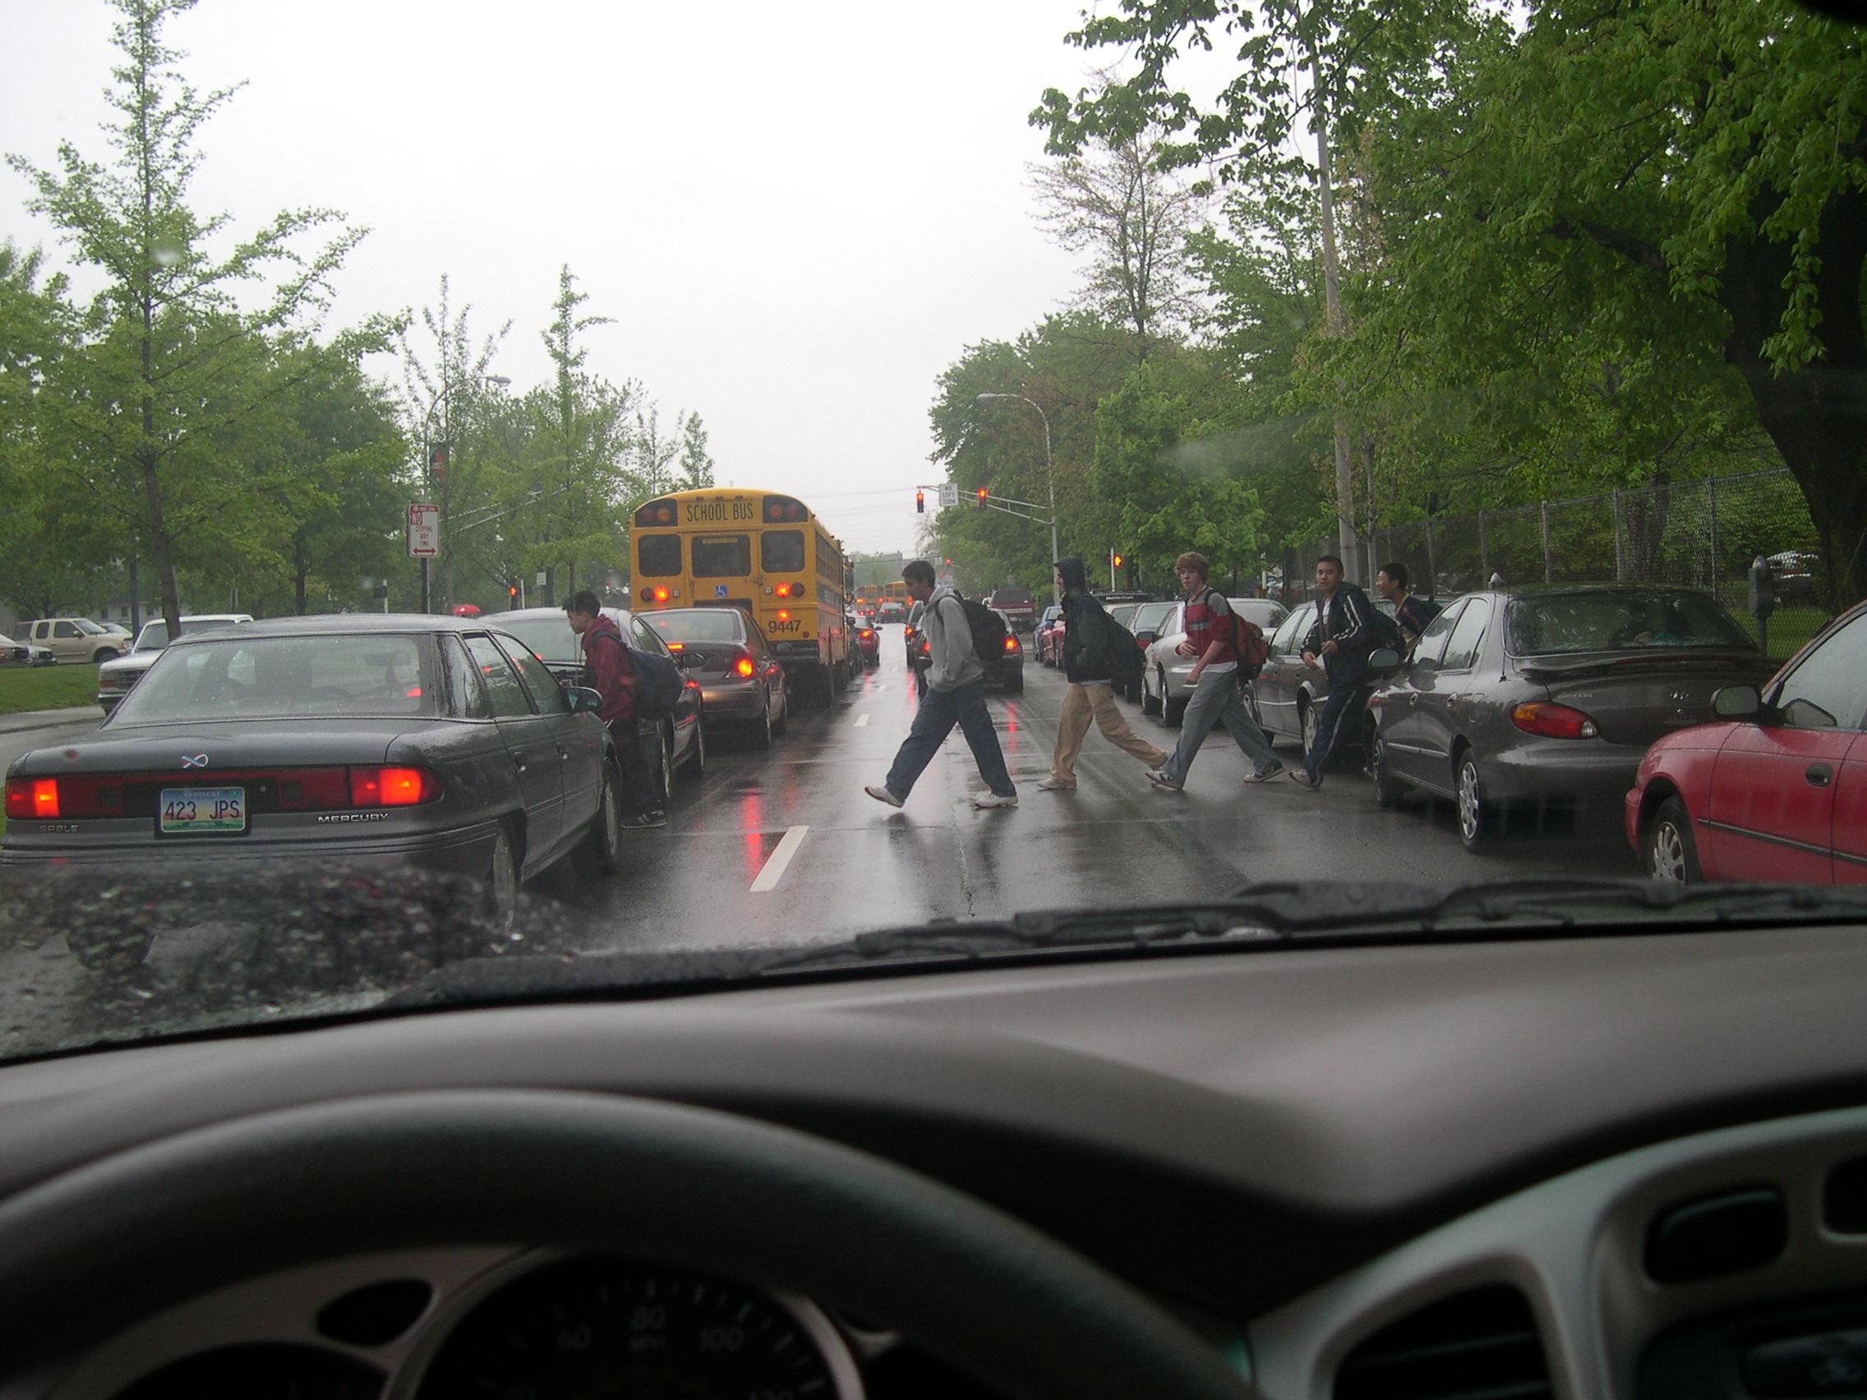
Notes:
Thumbs up:
Two of the pedestrians are looking and making eye contact with the driver
Thumbs down:
There is reduced visibility because of the rain; pedestrians must allow drivers more time to stop in rainy conditions
The pedestrians are crossing inappropriately in the middle of a block between parked cars
The pedestrians are not wearing bright colors, lights or reflective wear which would help make them more visible in rainy weather
Thumbs neutral
None noted

Slide 24
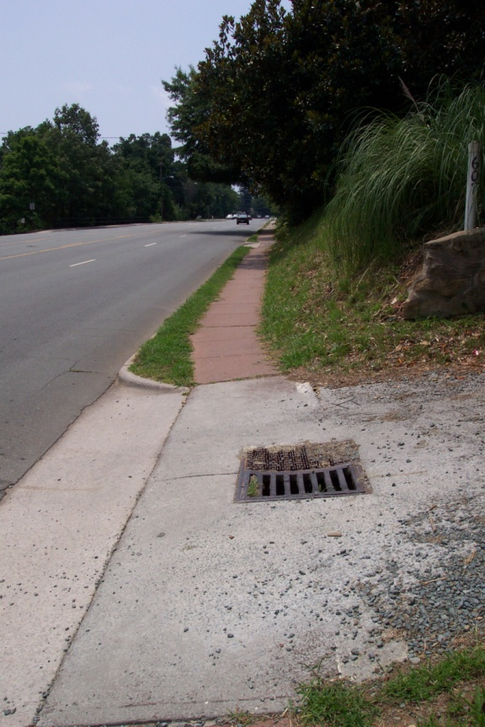
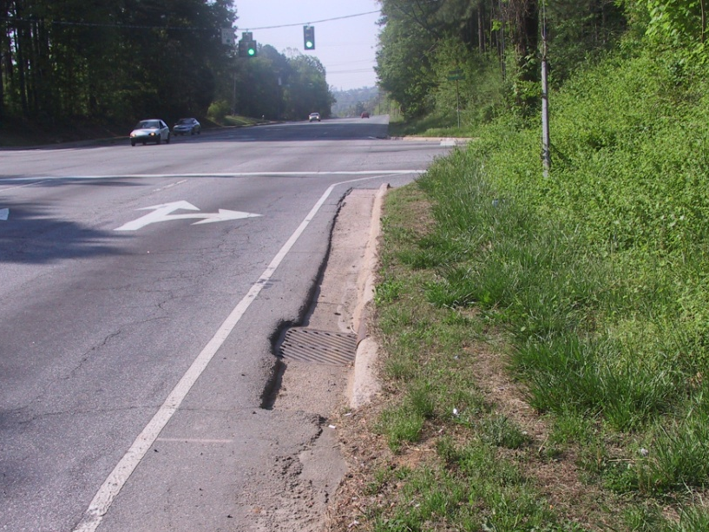
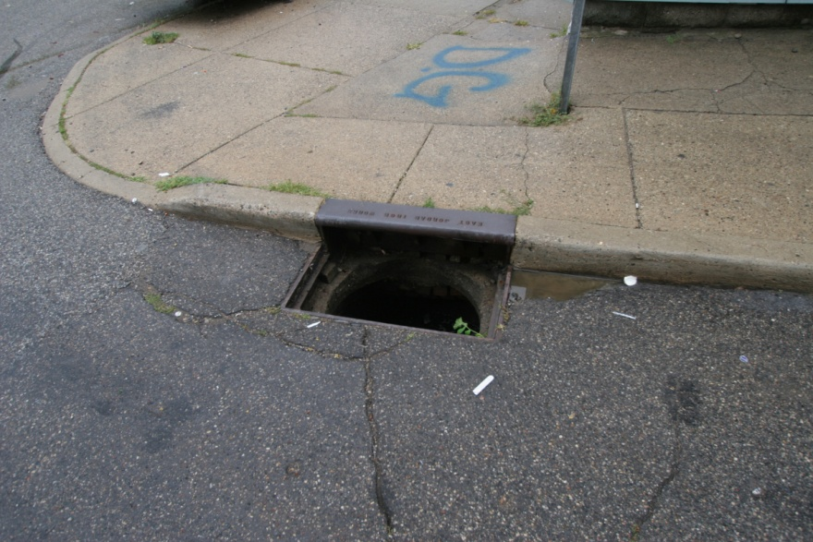
Notes:
Thumbs up:
None noted
Thumbs down:
No sidewalks or marked crosswalks (left top)
No bike lane (all)
The shoulder of the road is narrow and uneven (left top)
The grate or drain on the right is a hazard to bicyclists if they attempt to ride on the shoulder (left top)
Riding a bicycle on this sidewalk poses a risk for a crash if motorists comes out of this driveway. The driver coming out is likely to be looking for cars coming from the left side of the picture and not to their right
The drain grate pose a safety hazard to bicyclists riding a road bike with skinny tires; bicyclists must stay alert
The open grate is a major hazard to both bicyclists and pedestrians (bottom photo)
Thumbs neutral:
None noted

Slide 25
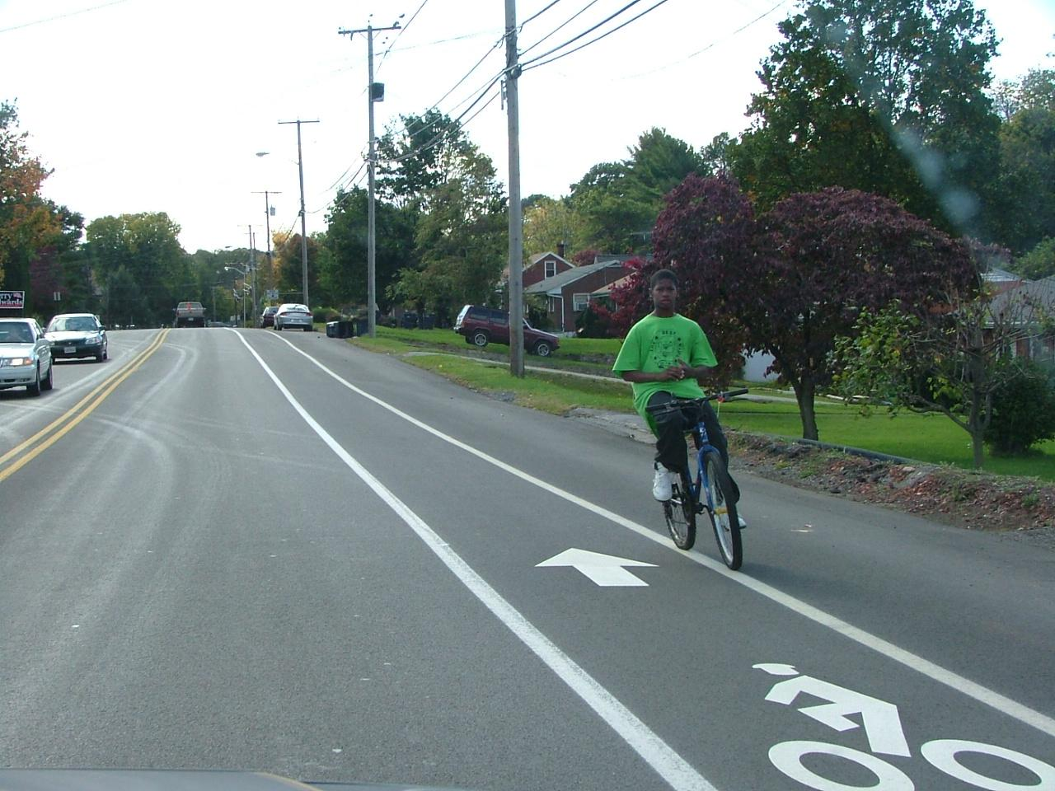
Notes:
Thumbs up:
A bike lane is present.
The bicyclist is wearing a bright colored shirt so other traffic can see him better
Thumbs down:
The bicyclist is not wearing a helmet
The bicyclist should keep at least one hand on the handlebars at all times, preferably two
The bicyclist is riding on the wrong side of the road
This photo emphasizes that even when the roadway markings exist, some people may not follow them
Note: Bicyclists, as vehicle operators on the road, are legally responsible for following signs, signals and road markings
Thumbs neutral:
None noted

Slide 26
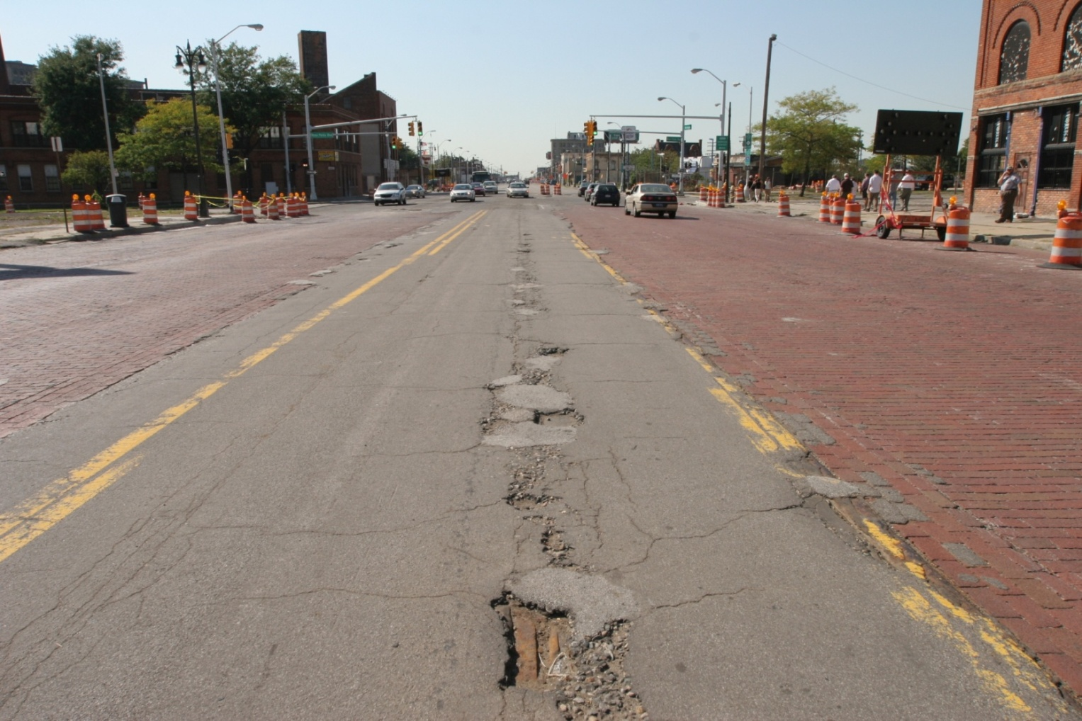
Notes:
Thumbs up:
None noted
Thumbs down:
This street is in poor repair with many potholes and cracks
The street is a construction zone
It is unclear whether there is a safe route for pedestrians, but the visible damage to the road makes route a fall risk for bicyclists
Thumbs neutral:
It is unclear why there is a red brick area and which road users are allowed to use it

Slide 27
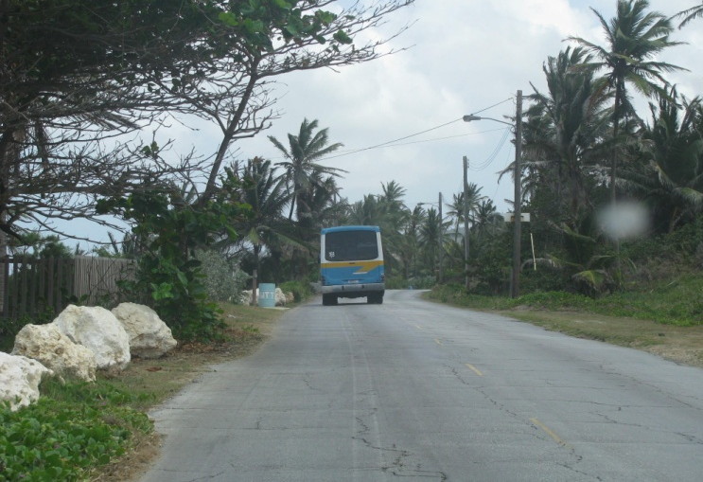
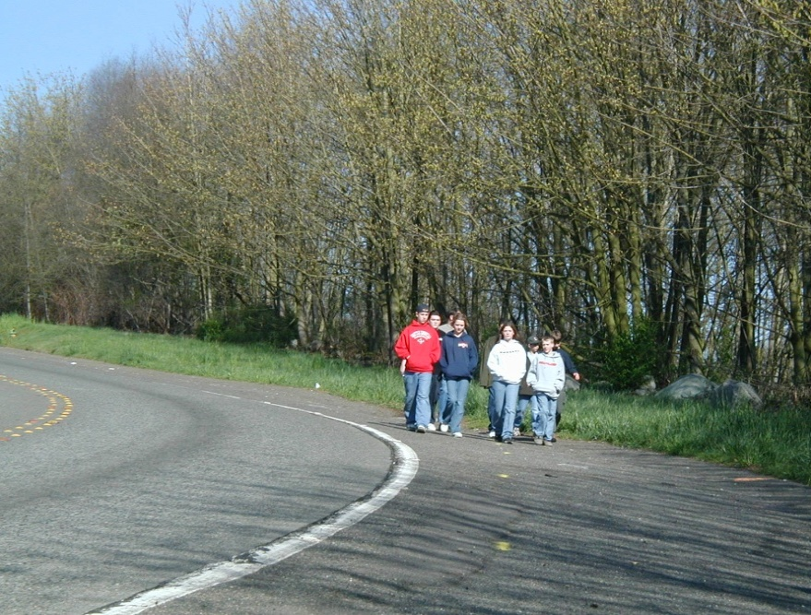
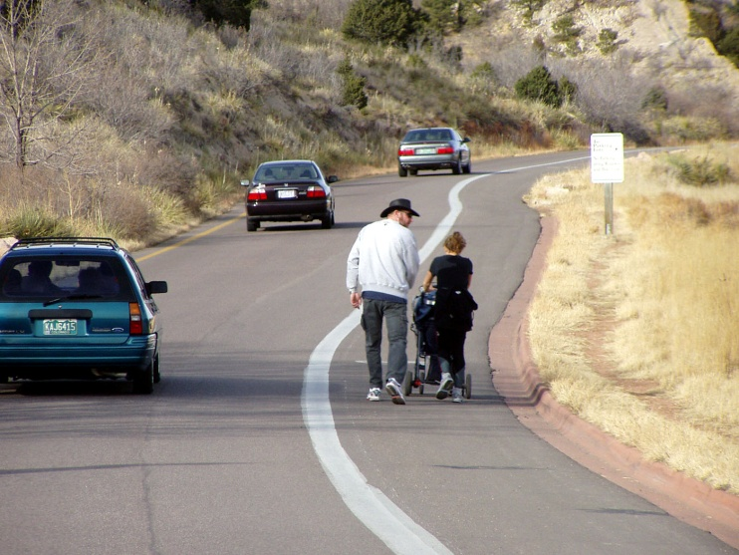

Slide 28
Summary Points
Know your routes before you take them alone, whether walking/biking
Examine your surroundings and see if you feel comfortable walking or biking; if you don’t feel comfortable, it’s not a safe route for you
Work with the surroundings you have asking yourself ways to adjust to increase your own safety
Always walk on a sidewalk if available; if none, walk facing traffic
Always bike in the same direction as traffic
Older bike riders are encouraged to ride on low speed roads rather than sidewalks, where faster moving traffic is more expected to be seen*
Everyone should wear a properly fitted bike helmet every ride
8430-090712-V1a
Notes:
* Children under the age of 10 have little experience in traffic and their brain physiologically lacks the maturity to make traffic-related decisions. While the brain continues to develop until age 24, by age 10, children can be taught some of the skills needed to ride on neighborhood roads.

