Slide 1

Speed-Measuring Device
Operator Training
Notes:
Ideally, instructors should have distributed The Speed-Measuring Device Operator Training Participant manuals at least two weeks prior to the first day of class. Make sure each student has a copy and issue replacements if necessary. If the manuals have not yet been distributed, do so now.
Introduce yourself and welcome students to Speed-Measuring Device Operator Training. Stress the importance of open communication, good feedback, and student participation.

Slide 2
Introduction
Chapter 1

Slide 3

Notes:
Instructor Introductions
Introduce yourself by providing:
Name
Title
Organization
Highway safety experience

Slide 4

Notes:
Have participants introduce themselves by providing:
Name
Agency
Role
What is one expectation or issue you would like to discuss OR question you want answered?

Slide 5

Notes:
Take a few minutes to describe the facilities and logistics of the location for those who may be unfamiliar with the set-up. Include directions to restrooms, the vending machines, and/or location of refreshments.

Slide 6
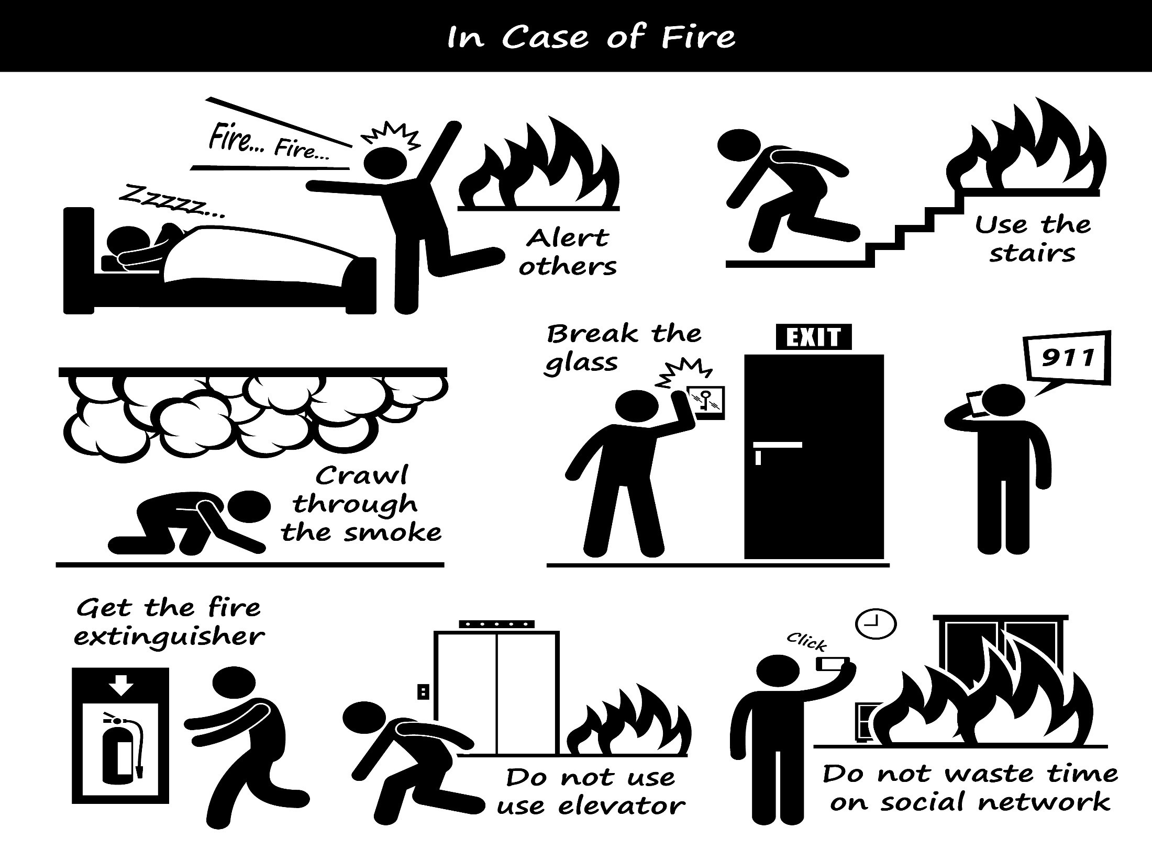
Notes:
Discuss building layout, including: emergency exits, fire extinguishers, fire alarm pull stations, and meeting area in case of a building evacuation.
Identify which participants have been trained in CPR and what the correct number would be to dial in case of emergency (i.e. 911 vs. 9-911)

Slide 7

THE S.W.I.M. PRINCIPLE
SAY WHAT IT MEANS
Notes:
SWIM Principle: As with any agency or organization, the use of acronyms, abbreviations, and jargon is common.
Encourage participants to stop and ask for clarification or explanation if they do not understand a term or phrase presented during this course.

Slide 8

Notes:
Module and chapter structure: The modules and chapters of this training are designed to be presented in sequence, with most content building on the information offered in previous lessons. Each module and chapter in your book consists of curriculum, PowerPoint slide images, discussions/activities, and supplemental materials that are designed to encourage interaction among participants.
Delivery of content: The chapters for this training are designed to encourage interaction among participants. Included in the guided portion of the lessons are group discussions, interactive questions, hands-on experience and numerous instances where participants are encouraged to share their own experiences.
“Tour Your Manual”: Make sure to direct participants to sections and let them look through the manual to see the tabs, resources, etc. Be certain to point out centrally located resources used repeatedly throughout the course if applicable.

Slide 9

Provide knowledge and skills necessary to become more effective in detecting speeding vehicles and gathering evidence to support a charge of a speed law violation.
Notes:
Read course goal aloud:
The goal of Speed-Measuring Device Operator Training is to provide knowledge and skills necessary to become more effective in detecting speeding vehicles and gathering evidence to support a charge of a speed law violation.

Slide 10
MODULE CONTENT
Chapter 1: Introduction
Chapter 2: Purpose of Speed Enforcement
Chapter 3: Absolute and Basic Speed
Chapter 4: Site Selection
Chapter 5: Tracking History
Notes:
The purpose of the Core Module is to provide the student with the knowledge and skills necessary to perform speed enforcement activities.
In addition to the Introduction, this module contains four other chapters:
Purpose of Speed Enforcement
Absolute and Basic Speed
Site Selection
Tracking History

Slide 11
PURPOSE OF SPEED ENFORCEMENT
Chapter 2
Notes:
Speeding is defined as exceeding the posted speed limit or driving too fast for conditions, and is one of the most prevalent factors contributing to traffic crashes.
The purpose of this section is to provide an understanding of how speed enforcement helps reduce crashes and their severity in addition to reducing the number of fatalities and injuries caused by speeding.

Slide 12
DRIVING CONTINUUM
Operator
Environment
Vehicle
Age
Experience
Sobriety
Fatigue
Physical Condition
Roadway design
Weather
Visibility
Location/congestion
Brakes
Tires
Suspension
Overall mechanical condition
Reacts
Evaluates
Provides Input
Notes:
Higher speed overwhelms a driver’s capabilities. Although vehicles and roadways can be designed to withstand high-speed traffic, human beings cannot be redesigned to handle increasingly higher speeds. A driver’s capability is limited by speed. The faster a vehicle is driven, the less control the driver has over it. No matter how good a driver may be, some loss of control over the vehicle will be the result if the driver goes too fast. Safe vehicle operation is directly related to the “Driving Continuum”, an interaction of operator, environment, and vehicle. Each element has different concerns which affect the others.
Referencing the slide on the previous page, ask students for examples of concerns below.
Operator concerns:
Age
Experience
Sobriety
Fatigue
Physical conditions
2) Environmental concerns:
Roadway design
Weather
Visibility
Location/congestion
3) Vehicle concerns:
Brakes
Tires
Suspension
Overall mechanical condition

Slide 13
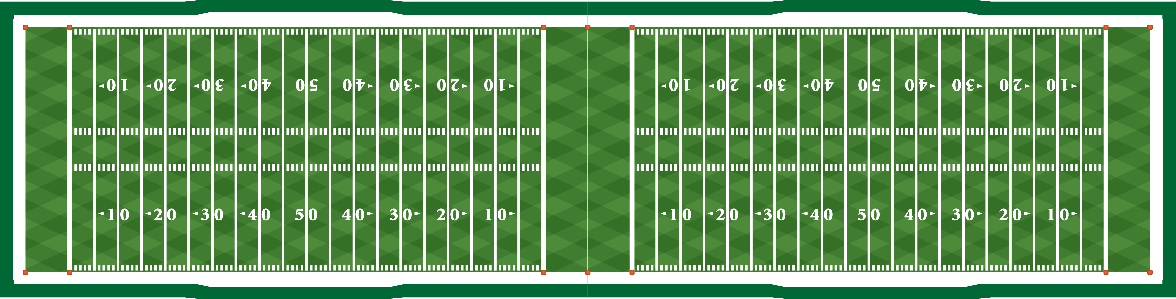

PERCEPTION-REACTION TIME
20 mph
62’
18’
44’
30 mph
106’
66’
40’
40 mph
159’
88’
71’
50 mph
221’
110’
111’
60 mph
292’
132’
160’
80 mph
460’
176’
284’
$$Perception+Reaction Distance+Braking Distance=Total Stopping Distance$$
Notes:
Stopping distance computed with a .75 drag factor. A brief discussion of drag factor and the coefficient of friction may be beneficial
Drag factor and the coefficient of friction are related. Drag factor refers to the slowing of the whole vehicle while coefficient of friction refers to the slowing force where the tires make contact with the roadway. Drag factor is similar for most vehicles with four wheels. Motorcycles and heavy vehicles can be much different.

Slide 14
SPEEDING-RELATED FATALITIES
BY ROADWAY FUNCTION CLASS, 2015
Non-Interstate: 79%
Interstate: 14%
Notes:
Emphasize percentage of total interstate fatalities (14%) vs. non-interstate fatalities (79%).

Slide 15
SUMMARY / REVIEW
Driving Continuum
Perception-Reaction Time
Speeding Related Fatalities
Notes:
Take 5 minutes to discuss the concepts just covered.

Slide 16
SPEED LAWS
Chapter 3
Notes:
Effective speed enforcement requires an understanding of the speed laws. Students must know the basic and statutory speed laws.
The basic speed law establishes the familiar “reasonable and prudent speed for existing conditions” standard.
The statutory speed law establishes specific posted maximum–and sometimes minimum speed limits.

Slide 17
Speed Laws
Basic Speed Law
Statutory Speed Law
No person shall drive a vehicle at a speed greater than is reasonable and prudent under the conditions.
Absolute Speed Law: Specifies a numerical value that is the speed limit.
Prima Facie Speed Law: Numerical limit above which drivers are presumed to be driving unlawfully.
Notes:
The establishment of speed limits is an act of the traffic law system. There are a variety of traffic laws and traffic control devices that regulate speed and it is important to be aware of how they are established, implemented, and enforced.
Most States have statutes that specify speed limits that generally apply for different types of roads unless otherwise posted. The legislators recognize that these statutory limits may not be appropriate for all locations and thus give the highway agency authority to establish limits above or below the general limits as warranted by conditions. The establishment of speed limits for specific road sections (zone) based on an engineering investigation is referred to as speed zoning and will be the focus of this module.
BASIC SPEED LAW
Most State motor vehicle laws include a basic speed law which encompasses the following premise: No person shall drive a vehicle at a speed greater than is reasonable and prudent under the conditions and having regard for the weather, visibility, traffic, and the surface and width of the roadway.
STATUTORY SPEED LAW
There are typically two types of statutory speed laws.
Absolute Speed Law
Specifies a numerical value that is the speed limit. Exceeding this value is always in violation of the law, regardless of the conditions or hazards involved. However, absolute speed limits lack flexibility, particularly in situations where traffic conditions vary widely. Approximately two thirds of the States have absolute speed limits.
Prima Facie Speed Law
Numerical limit above which drivers are presumed to be driving unlawfully.
Prima Facie speed violation allow violators the opportunity to demonstrate in court that their speed was safe for conditions at the time and not in violation of the basic speed law, even though they may have exceeded the numerical limit.
Approximately one third of the States have prima facie speed limits.

Slide 18
CRIMINAL VS. CIVIL VIOLATIONS
Criminal Violations
  Require proof beyond a reasonable doubt and to a moral certainty.
Civil Violations
  Require a mere preponderance of the evidence.
Notes:
Provide an example of a criminal speed violation versus a civil speed violation.
These may vary from State to State.
The difference is found in the burden of proof required to support the violation
Criminal violations require proof beyond a reasonable doubt and to a moral certainty
Civil violations require a mere preponderance of the evidence
NOTE: Add examples of specific State laws and statues.

Slide 19
SITE SELECTION
Chapter 4

Slide 20
SITE SELECTION
Choose locations based on:
  Speed being primary causative factor in crashes
  Citizen complaints
  Frequent speed violation
  Specifically focused or special speed regulations
  Speed surveys
Notes:
Explain selective traffic enforcement programs.
Briefly define interferences and that they may vary between specific speed-measuring devices.
Ask students:
What considerations do you take into account during site selection?

Slide 21
SAFETY CONSIDERATIONS
Officer Safety
Violator Safety
General Public
Notes:
Use dry-erase board or flipchart to solicit student discussion.

Slide 22
TRACKING HISTORY
Chapter 5

Slide 23

TRACKING HISTORY
…The most essential component of speed enforcement…
VISUAL OBSERVATION
AUDIO
CONFIRMATION
UNIT
CONFIRMATION

Slide 24
VISUAL OBSERVATION
Identify Target
Estimate Speed
Estimate Range
Check Environment

Slide 25
Weaving, Passing, and Convoys
Weaving
Speeding vehicles are generally overtaking other vehicles in their lane of travel. This often requires the speeding vehicle to continually change travel lanes to continue their established speed.
Observation of approaching traffic on multiple lane highways will alert officers to this situation.
Passing
Speeding vehicles must pass the slower vehicles that obstruct their travel lane and impede their speed. Passing should alert the officer to a potential speed violator. Many drivers believe it is OK to exceed posted limits while passing.
Convoys
Primarily on interstate or divided highways, it is common for a group of speeders to fall into a pack or “convoy.”

Slide 26



BASIC SPEED FORMULA
Notes:
Recall the basic formula for a time/distance calculations is:
Through algebra we can change this formula to find a distance if time and speed is known.

Slide 27
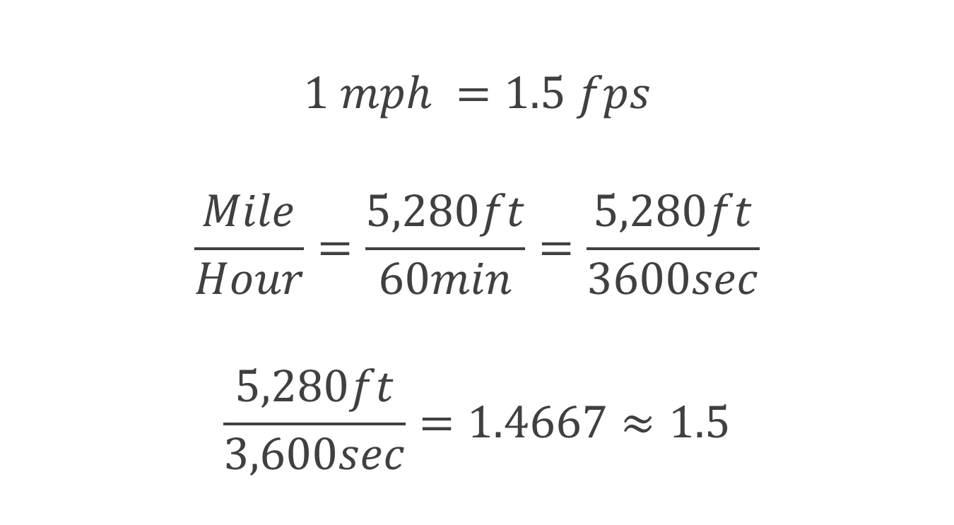
SPEED CONVERSION FORMULA
$$1 mph =1.5 fps$$
$$\frac{Mile}{Hour}=\frac{5,280ft}{60min}=\frac{5,280ft}{3600sec}$$
$$\frac{5,280ft}{3,600sec}=1.4667≈1.5$$
Notes:
Calculate conversion of mph to f/s.

Slide 28
AUDIO CONFIRMATION
Pitch of audio
Clarity of audio

Slide 29
UNIT CONFIRMATION
Steady readout from unit
Consistent with visual estimation

Slide 30
SUMMARY AND
SECTION REVIEW
Notes:
SECTION REVIEW (15 Minutes)
Instructor should review materials covered in lesson as time permits.

