Slide 1

Overview of NHTSA EV
Safety Testing and Research May 2012
Claude Harris
Director, Office of Vehicle Safety Compliance
NHTSA

Slide 2
NHTSA Mission
Safety
Save lives, prevent injuries and reduce economic costs due to road traffic and non-traffic crashes through education, research, safety standards and enforcement activity.
Consumer Programs
Increase fuel economy, damage protection, and theft protection, reduce odometer tampering, and provide consumer information.

Slide 3
NHTSA Major Accomplishments
The fatality rate per 100 million vehicle miles traveled (VMT) decreased from 1.53 in 2000 to 1.10 in 2010
Over 10,000 lives saved
Lowest level ever recorded
Seat belt use increased from 71% in 2000 to 84% in 2011
Primary seat belt laws in 32 states, DC, and Puerto Rico
Estimated 12,546 lives saved by belts in 2010
Seatbelts still are the most important safety feature on vehicles

Slide 4
History of NCAP/Enforcement Testing
Each year NHTSA conducts both New Car Assessment (NCAP) and Enforcement testing (compliance)
NCAP tests rate crash performance and occupant protection of vehicles and offer comparative consumer information
Compliance tests verify that vehicles meet the applicable Federal Motor Vehicle Safety Standards (FMVSS)
Both programs test vehicles with new technologies
In 2011, NHTSA tested 2 EVs equipped with Li-ion batteries for NCAP ratings and to ensure they complied

Slide 5
Focused EV/HEV Testing in 2011/2012
Program subjected EVs to the following tests:
FMVSS 208 (frontal impact)
FMVSS 214 (side impact both side pole and MDB)
FMVSS 305 (electrical isolation)
FMVSS 301 (rear impact)
FMVSS 305 specifies requirements limiting electrolyte spillage, retention of propulsion batteries, and high voltage electrical isolation. It is done in conjunction with other crash tests and does not evaluate post crash battery health or discharge capabilities

Slide 6
EV Testing in 2011/2012
Post crash rollover tests were performed for all impact tests to evaluate electrolyte spillage and liquid fuel leakage
In 2011, NHTSA performed a total of 9 tests on the Chevrolet Volt and Nissan Leaf for NCAP and compliance
The vehicles tested received favorable NCAP ratings and met the FMVSS requirements to which they were tested
In 2012, NHTSA is planning NCAP and compliance testing of 13 EVs (BEVs, PHEVs, and HEVs)

Slide 7
2011 Test Matrix for Electric Vehicles
 | Mfg. | Vehicle | 208 | 214MBD | 214Pole
1 | Chevrolet | Volt | NCAP | NCAP | OVSC / NCAP
2 | Nissan | Leaf | OVSC / NCAP | NCAP | OVSC / NCAP

Slide 8
Targeted 2012 Test Matrix for Electric Vehicles
Targeted 2012 Test Matrix for Electric Vehicles
Mfg. | Vehicle | 208 | 214 MDB | 214Pole | 201P | 301R
Honda | Civic Hybrid | NCAP | NCAP | OVSC |  | OVSC
Buick | LaCrosse eAssist | OVSC | NCAP | OVSC |  | OVSC
Hyundai | Sonata Hybrid |  |  | OVSC |  | OVSC
Chevrolet | Volt |  |  | OVSC |  | OVSC
Buick | Regal eAssist | NCAP | NCAP | OVSC |  | OVSC
Kia | Optima Hybrid | NCAP | NCAP | OVSC / NCAP |  | OVSC
Mitsubishi | iMiEV | NCAP | NCAP | OVSC / NCAP |  | OVSC
Coda | Coda | OVSC / NCAP | NCAP | NCAP | OVSC | OVSC
Ford | Focus Electric | NCAP | NCAP | NCAP | OVSC | OVSC
Toyota | PRIUS Plug-In | OVSC / NCAP | NCAP | NCAP | OVSC | OVSC
Acura | ILX Hybrid (2013) | OVSC |  | OVSC |  | OVSC
BMW | Active Hybrid 5 | OVSC |  | OVSC |  | OVSC
Toyota | RAV 4 Electric | OVSC | NCAP |  | OVSC | OVSC

Slide 9
Chevrolet Volt Incident
NHTSA conducted NCAP side pole test on 2011 Volt
Fire occurred 3 weeks after test event
The fire consumed the vehicle
Fire originated inside the vehicle and involved battery intrusion, coolant leakage, and electrical short circuits
Available data did not indicate any similar in-use occurrences
As a result, the vehicle manufacturer initiated a product improvement campaign to address battery intrusion and coolant leakage

Slide 10
Manufacturer Data on EVs
Vehicle manufacturers provided NHTSA data about post incident protocols
However, limitations were noted in the data regarding:
Battery discharge protocols
Post crash vehicle handling/storage
Addressing post crash fire protocols
Tools for evaluating post incident battery health

Slide 11
Other EV Related Short Term Activities
Monitoring EV incidents
NHTSA has conducted some Special Crash Investigation on-scene examinations of severe EV crashes
NHTSA has conducted some field inquiries of non-crash EV fires

Slide 12
Other EV Related Short Term Activities (cont.)
NHTSA Interim Guidance - NHTSA in coordination with the National Fire Protection Association (NFPA) generated interim guidance for:
emergency response/law enforcement groups – recommended responders identify, immobilize, and discharge EVs
vehicle owners/public – provided guidance for dealing with EV crashes, fires, and post-incident events
tow and recovery operations – Provided guidance on EV identification, recovery/transportation, and vehicle storage

Slide 13
Other EV Related Short Term Activities (cont.)
Considering the need for supplemental procedures for NCAP/Enforcement post-crash vehicle inspections
Supplemental procedures would evaluate post-crash Li-ion battery health and physical damage to battery
Data will be collected, evaluated, and used to supplement crash test procedures as warranted

Slide 14
Overview of Commercial Vehicle Non-crash Field Inquiries
Summary of field inquiries
Feb 2012 - Zero Truck fire
Mar 2012 - NewFlyer/BAE Bus fire

Slide 15
Overview of Light Vehicle Non-crash Field Inquiries
April 2011 – Conducted field inquiry of incident in Conn. and determined EV was not the origin of fire
November 2011 – Conducted field inquiry of incident in NC and determined the EV was not the origin of fire
May 2012 – Conducting ongoing field inquiry of incident in TX. No determination has been made.

Slide 16
EV Safety Coordination with Other Government/Stakeholders
Department of Defense/Department of Energy (DOD/DOE) Activities
Worked with DOD/DOE to devise program for testing Li-ion battery packs and follow-up safety research
NFPA
Worked with NFPA to ensure that 1st/2nd responders identify Li-ion powered vehicles, know the safety risks, and know appropriate post-crash handling procedures
SAE
Work with SAE and OEMs on a wide range of Li-ion battery safety topics

Slide 17
EV Safety Coordination with Foreign Government Entities
EV Global Technical Regulations (GTR)
Address occupant protection from high voltage electric shock and potential hazards associated with Li-ion batteries during and after a crash event
Set provisions and test protocols to ensure the electrical components perform in a safe manner and are electrically managed while recharging at a residence or charging location

Slide 18
EV Safety Coordination with Foreign Government Entities
The GTR will address the unique safety risks posed by EVs and their components, and will be performance-based so as not to restrict future technologies and help prioritize research and potential rulemaking
In March 2012 a GTR working group on electric vehicle safety was formed with the United States (NHTSA) as chair.

Slide 19
Li-ion Based Rechargeable Energy Storage System
Technology Description and Safety Research Programs
Phillip Gorney Safety Research Engineer NHTSA

Slide 20
Modern EV technology
The modern EV propulsion system is a culmination of advancements in many technologies used by the vehicle.
Rechargeable Energy Storage Systems (RESS)
Li-ion battery (LiB) based (present technology)
Electronic communications including those with the electrical grid via charging systems both conductive (plug-in) and inductive (non-contact)
Electronic controls
Battery Management System
Vehicle to propulsion system
Power Electronics
Motor control
Regenerative Braking

Slide 21
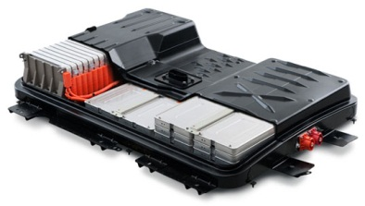
A Rechargeable Energy Storage System (RESS)
What is a RESS used in automotive applications?
Battery pack(s) (cells and modules)
Enclosure and support architecture
Service disconnect (if equipped)
High voltage circuits and connections
Low voltage connectors
Cell/module electronics

Slide 22
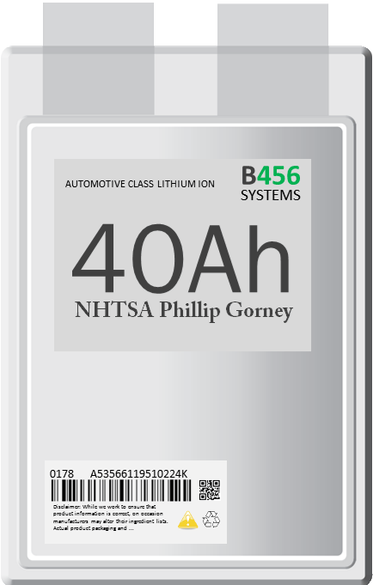


A Rechargeable Energy Storage System (RESS)
What are the Lithium ion batteries used in a RESS?
and . . . what makes them different from other batteries?
When compared to other batteries such as NiMH, Pb-acid, or Ni-Cd that have more commonly defined chemistries and constructions a LiB is a “family of batteries”
The common element of a LiB is the use of a lithium-based salt to carry the charge between the anode and cathode during discharge and back again during charging.
Each LiB has uniquely different properties due to:
Cell chemistry
cathode and anode materials and thicknesses
electrolyte (additives)
separators
Form factor (cylinder, pouch, prismatic)
Size
Energy/power
Performance (including safety)

Slide 23
A Rechargeable Energy Storage System (RESS)
Failure Modes, Mechanisms and Abuse Tolerance
Failure modes generally associated to a LiB RESS are:
Physical decomposition and exothermic release of stored energy
Venting of the LiB electrolyte (releasing flammable and/or toxic fumes)
Some abuse scenarios generally associated to the failure of a LiB include:
Mechanical
crush
penetration
shock
vibration
external thermal exposure
environmental Exposure
chemical Exposure
Control & Monitoring
external Short Circuit
over Charge
under Charge
loss of isolation (internal)
internal thermal control
cell properties (balance)
Manufacturing
internal short circuit

Slide 24
NHTSA Vehicle Safety Research
Physics dictates that all energy storage sources have an inherent risk associated with their use, storage, and handling. This concept applies equally to all petroleum-based fuels, hydraulic storage systems, mechanical or kinetic systems, or electric storage batteries.
Research Question …
How do we identify and quantify risks that are associated with LiB powered EV technology?

Slide 25
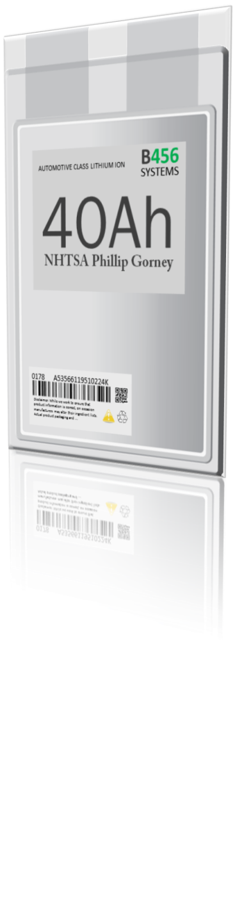
NHTSA Vehicle Safety Research Programs Li-ion based RESS
In 2010 NHTSA initiated research focused on the safety attributes of a Li-ion RESS used in electric vehicle applications. The data from this research may be used by NHTSA to support future regulatory and rulemaking decisions.
NHTSA Safety Research Programs:
Failure Modes and Effects Analysis (FMEA)
Test procedure development
Electronics reliability
Warnings and indicators
Functional Safety
Inoperable RESS stranded energy handling and discharge
Fire extinguishment methods

Slide 26
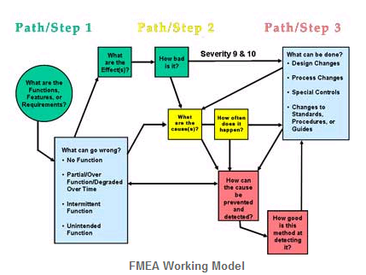
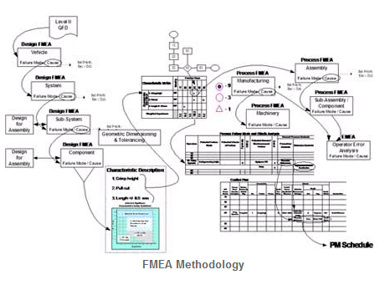
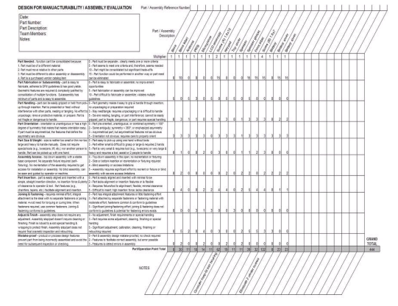
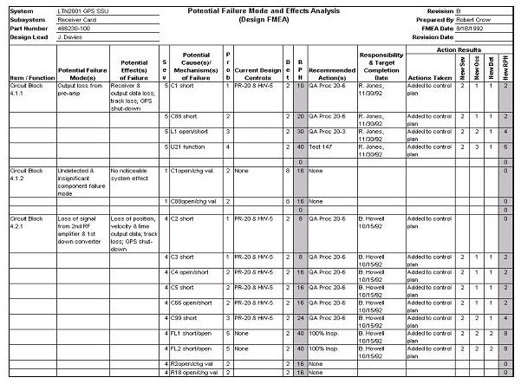
Failure Modes and Effects Analysis
NHTSA is performing a generic system level FMEA
of LiB RESS automotive technology applications
An FMEA is an analytical tool which identifies, lists, and ranks the severity, likelihood, and detectability of all potential failures and their corresponding effects of the product or process under study, in this case Li-ion based RESS safety performance.
The results of this FMEA will be used to perform a gap analysis of existing standards and test procedures for thoroughness.
Battelle Memorial Institute, Columbus, OH
Draft report under NHTSA review
Industry and peer review
This FMEA, as a living document, forms a basis for other safety analysis

Slide 27








Test Procedure Development
The research objective is to develop and document repeatable vehicle-level safety performance test procedures with accurate definition of boundary and test limit conditions to measure the effects of the failure modes created during all operating conditions. Within this process, data generated by these procedures will be used by NHTSA for safety analysis.
Critical potential failure modes (system, component)
All areas of operation Including: charging, normal operation, crash, and post-crash
Building upon the body of existing standards (SAE J2464, SAE J2929, ECE R100, Etc.)
2 contract awards: 24 month performance: October 2011 – October 2013

Slide 28
Electronic Reliability
NHTSA has formed an Electronic Systems Safety Research Group which includes the scope of electrified propulsion in their reliability analysis.
Project 1 – Diagnostics, Warnings and Operator Messages
Scope: Research operator warning indicators for RESS safety critical criteria. Research potential prognostic conditions and warnings for anticipated safety critical events.
Research basic fail-safe conditions, diagnostic codes and indicators, data recording/storage, and safety prognostic requirements
Utilize outputs from FMEA and Discharge projects
Timing (20 months)
Project 2 – Functional Safety Analysis
Scope: Utilize functional safety criteria and analytical techniques to establish minimal performance criteria.
Use a Li-ion RESS technology as an initial case study and method development foundation

Slide 29
Inoperable RESS Stranded Energy Handling and Discharge
Standardized Battery Assessment, and Field Discharge Procedure
Energy may become stranded in a RESS that has become inoperable. This energy must be removed from the RESS to a safe condition as dictated by the circumstances.
The Scope of this project is to identify, develop, and demonstrate methods for the safe management and handling of RESS in post-crash and non-operational environments. These procedures should apply to both damaged and fully functional RESS systems.
Non-operational environments may include: service repair, end of life disassembly, post-crash, post-fire, vehicle crash scene, vehicle tow, and vehicle storage.
Areas of Focus:
Definition of common interface connector and location to support
Diagnostic interface
Diagnostic protocol
Standardized discharge port/terminal
Architectural requirements
Project timing (2 years)

Slide 30
Fire Extinguishment Methods
Standardized Battery Assessment, and Field Discharge Procedure
NHTSA has partnered with DOE through the Idaho National Laboratory to conduct a research project with the NFPA and the automobile industry.
The scope of this research is to establish common procedures in safety focused firefighting techniques.
Establish “when and how” a RESS fire should be extinguished in a vehicle environment.
Project timing (2 years)

Slide 31
THANK YOU!

