Slide 1


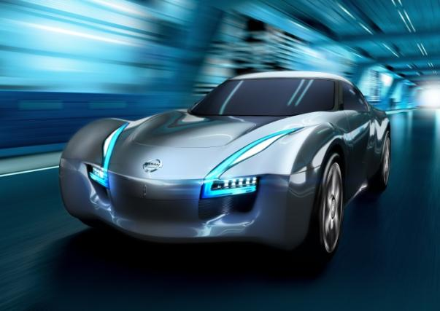
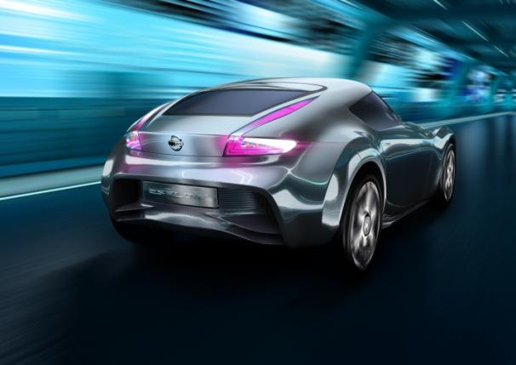
EV / HEV Safety
NISSAN MOTOR CO., LTD

Slide 2
Agenda
1. LEAF Overview
2. Lithium Battery Development at Nissan
3. Lithium Battery System Design and Safety
Notes:
2

Slide 3
Agenda
1. LEAF Overview
2. Lithium Battery Development at Nissan
3. Lithium Battery System Design and Safety
Notes:
3

Slide 4
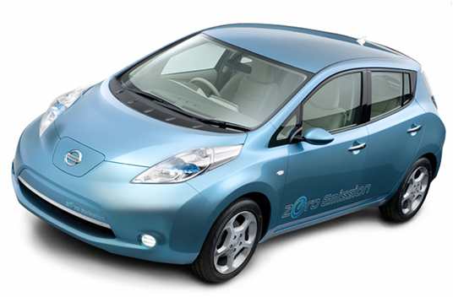
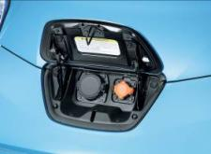
Nissan LEAF
Launched Dec. 2010 in JP, US, EU
Specifications
Dimensions | 4,450mm X 1,770mm X 1,545mm
Seating Capacity | 5 passengers
Powertrain layout | Front motor, front drive
Electric Motor | High response AC synchronizing motor (80kw, 280Nm)
Battery | Laminate-type thin lithium-ion battery (approximately 24kWh)
Brakes | Regenerative braking, mechanical disk brakes
Top speed | Over 140km/h
Cruising range | 160km （@ US LA4 mode）
Charging times | Normal charge: JPN approximately 8 hours(200V) US/EUR approximately 7 hours(240V/230V) Quick charge: Approximately 30minutes (@50kW SOC0% to 80%)

Slide 5
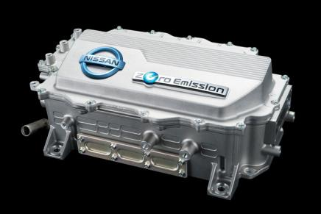
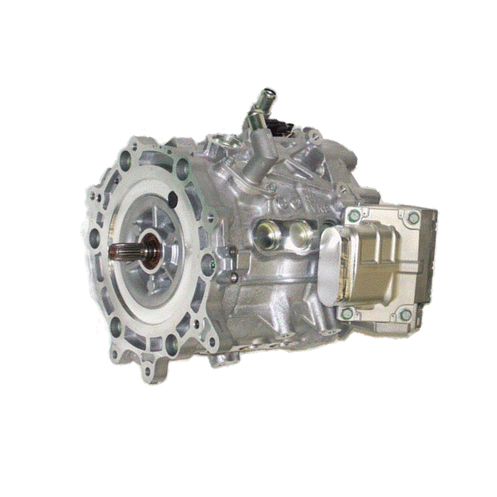
LEAF Powertrain
Inverter Specifications
Dimensions | 304 × 256.5 × 144.5mm
Weight | 16.8kg
Max. AC Current (Coolant temp. : 65℃) | 425 A RMS (4 sec)
 | 340 A RMS
DC Voltage | 240 - 403V
Carrier Frequency | 5kHz
Motor Specifications
Maximum torque | 280 Nm
Maximum power | 80 kW
Top Motor speed | 10,390 rpm
Motor weight | 58 kg

Slide 6
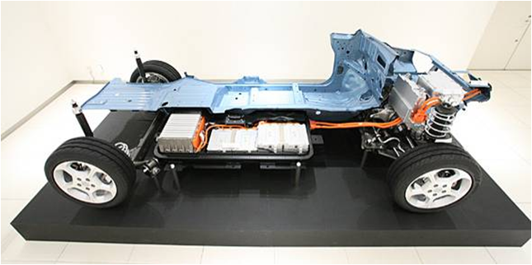
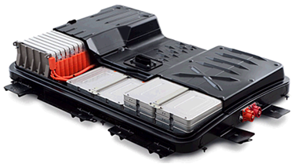
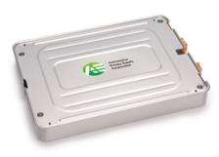

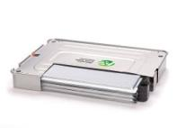
LEAF Vehicle Structure
Chassis
Battery
Battery pack
Module
Cell
Battery Management System
Junction Box
Service Disconnect Switch Etc
192 cells / vehicle
4 cells / module
48 modules / vehicle

Slide 7
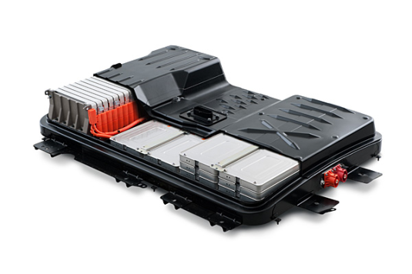

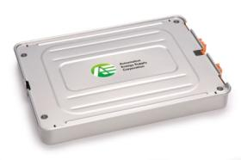
LEAF Battery Specifications
Cell
Module
Pack
Cell | Structure | Laminated type
 | Capacity | 33Ah
 | Cathode | Original blended (LMO based)
 | Anode | Graphite
Module | Consist of Cell numbers | 4 cells
 | Cell connection | 2 parallel-2series
Pack | Consist of Module numbers | 48 Modules (in series)
 | Total Energy | 24 kWh
 | Max. Power | >90kW
 | Power/Energy ratio | ≒4

Slide 8
Agenda
1. LEAF Overview
2. Lithium Battery Development at Nissan
3. Lithium Battery System Design and Safety
Notes:
8

Slide 9






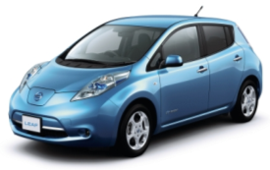






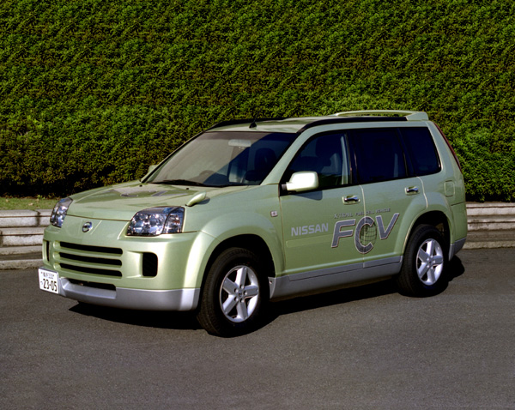
Nissan Li Battery History
In 1992, R&D began on lithium batteries for automobile applications.
1991
2000
2010
‘91 The world’s first LB
(for cellular phone)
’92 Research start
‘07 AESC founded
Co type
Mn type
Lithium
Battery
Cylindrical cell
Laminated cell
EV
Vehicle
LEAF
Prairie EV
Altra EV
Hyper Mini
HEV / FCV
Tino HEV
03 FCV
05 FCV
FUGA Hybrid
Notes:
We started Lithium battery research in 1992, beginning with a cobalt type battery in a cylindrical cell package.
In the late 90’s, we started developing a Mn-type cell and in the early 2000’s developed a laminated cell. This led to the current cell configuration.

Slide 10

Cell Design
Cell designed by AESC
AESC( Automotive Energy Supply Corporation)
High energy performance
(light weight and compact)
Highly balanced total performance
Long life
Low cost
Reliability
The original blended compound cathode (LMO based)
    compatibility of low-cost and durability.
Laminated-type cell structure
    simplifying the terminal design for power-use
    improving the thermal radiation performance.

Slide 11
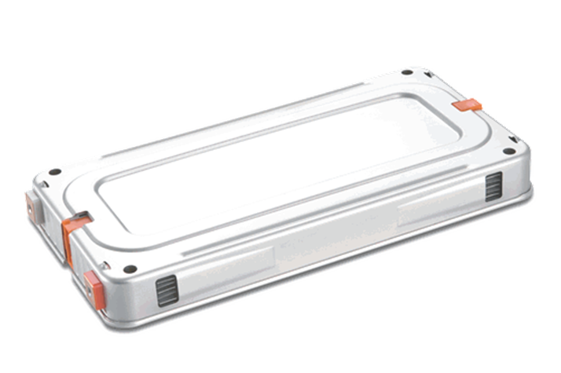

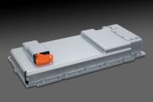
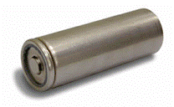

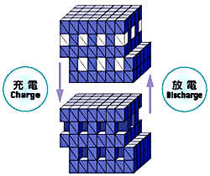



Laminated Li-Ion Battery
Satisfies automotive-level performance with high reliability.
Twice the Power
Twice the Energy
Compact &
Flexible Packaging
> 2.5kW/kg*
140Wh/kg*
½ the Size
Conventional
Laminated
Conventional
Laminated
Cylindrical
Laminated
* after durability test
* after durability test
High Reliability
Charge
Stable Spinal Mn-type crystal structure
Discharge
Laminate structure provides higher cooling efficiency
Stable performance through cell control
Notes:
11

Slide 12
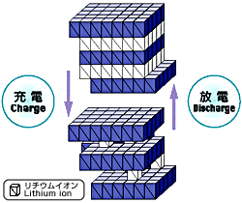
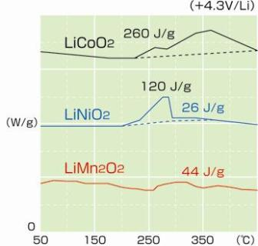
Thermal – Stable Material
How are thermal issues during extreme conditions addressed in the design of the cells and battery packs?
  Currently using Mn type Li-ion battery
  By using stable crystal structure (spinel Mn-type as electrode material) the battery can hold stability even under high heat
Manganese Oxide Lithium
Other Metal Oxide Lithium
Metal Oxide
Mn Oxide
Li-Ion
Li-Ion
Charge
Charge
Discharge
Discharge
Spinel Structure
Layered Structure
Stable
Notes:
12

Slide 13

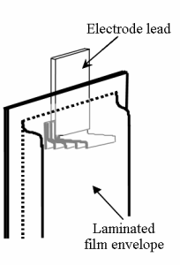
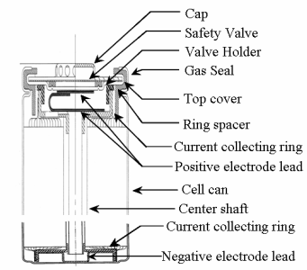
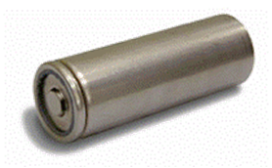

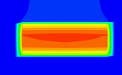


Thermal – Heat Rejection
This cell design provides higher cooling performance
Laminated Cell Battery
Cylindrical Cell Battery
Notes:
13

Slide 14
Agenda
1. LEAF Overview
2. Lithium Battery Development at Nissan
3. Lithium Battery System Design and Safety
Notes:
14

Slide 15
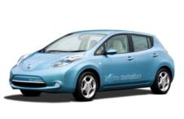
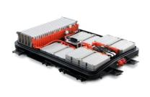


Battery Safety Design Concept
Vehicle, battery pack and modules are designed to act as ‘barriers’ to potentially harmful events
Apply global regulations and standards
Safety Shield Concept
Standards
Regulations
Potential hazardous
events
FMVSS
Vehicle
ECE R100
Mechanical
Pack
UN §38.3
Module
Applied
Electrical
Cell
IEC/ISO
Thermal
Protection design
Resistance design
SAE
JIS C8714
QC/T743

Slide 16
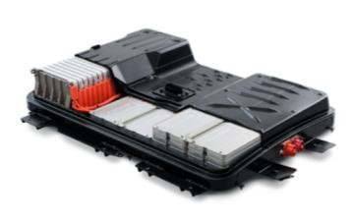
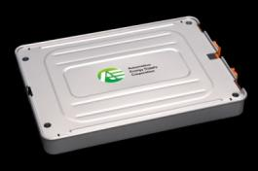
Module/Pack Design
High energy performance
(light weight and compact)
Highly balanced total performance
Long life
Low cost
Safety/Reliability
Mechanical cell support
Thermal management
Waterproof
Insulation
Lay-out versatility etc.

Slide 17
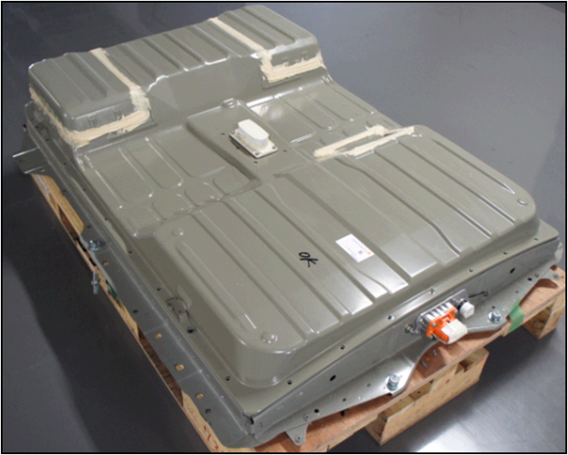
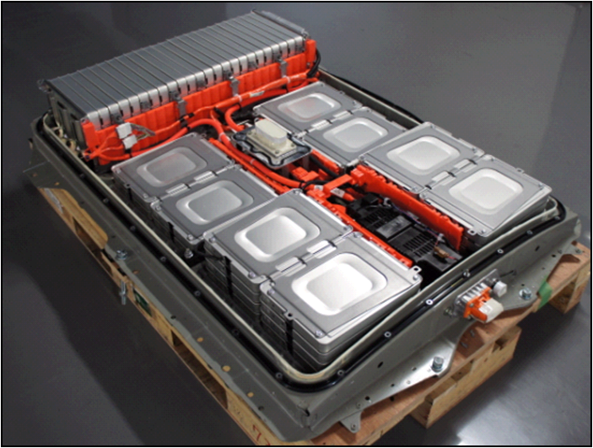
LEAF Battery Structure
Battery case is made from steel to create a sealed structure
Pack uses a robust interior of metal fixtures to secure components; this helps maintain the pack structure in case of accident or fire.

Slide 18
Immersion
test time: 1 hour
No leak into the Pack

Slide 19
Battery Management System
The LEAF battery management system performs continuous self diagnostics by monitoring:
  Individual cell voltage
  State of charge
  Battery temperature
  Battery pack hardware conditions
BMS optimizes conditions to provide power on demand
BMS responds to unexpected conditions by going to failsafe mode or complete shut down depending on the circumstances; examples:
  Overcharging
  Over-temp
  Cell failure
  Crash

Slide 20
High Voltage Circuit Diagram
High voltage circuit is initially open and activated only when control system is correct
Main RLY is cut off when detecting vehicle crash
A/B sensor
Battery pack
Request
RLY CUT
Vehicle control module (VCM)
Request RLY CUT
BMS
Cut off Main RLY
Check each (96 cells) voltage
and total voltage
Bat Main RLY
Motor
Inverter
SD/SW
Charge RLY
Bat Main RLY
On board charger
A
Input
AC
J/B
Q/Charge RLY
Normal Open RLY
Quick charger
Input
AC

Slide 21
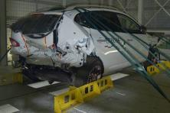
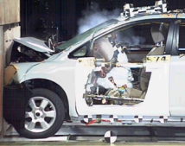
EV Safety
Impact safety concepts
ICE
EV
Passenger Protection
Body deformation control
Optimization of restraint systems
Prevention of secondary accident
Protection of fuel system
Prevention of secondary accident
Protection of high voltage system
Triple Protection Structure
Triple Electric Safety System
Notes:
21

Slide 22
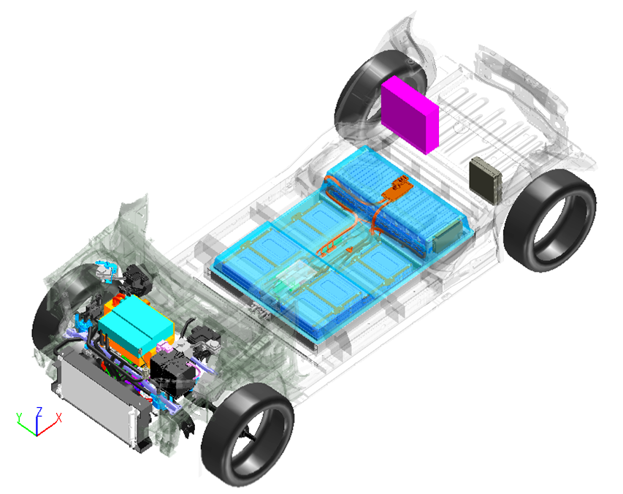
EV Safety
Triple electric safety system
1
Cabin is structurally separated from high-voltage electric system with EV dedicated body and optimized layout
Battery pack
3
Prevent high-voltage electric leakage with fuses in battery
2
Cut off high voltage with impact detection system
Notes:
22

Slide 23
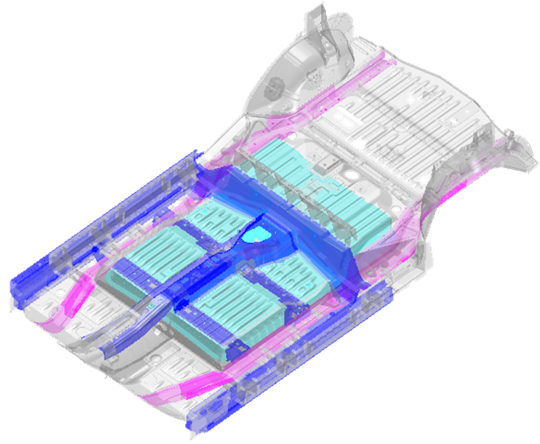
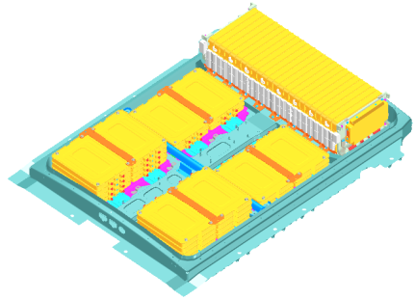
EV Crash Safety
Triple protection structure
2
2nd Protection Structure
Protect battery pack with body skeleton
1
1st Protection Structure
Suppress body deforming with impact energy absorbing vehicle body
1
Battery module
Battery pack
3
3rd Protection Structure
Protect battery modules with
high-strength battery frame
Notes:
23

Slide 24
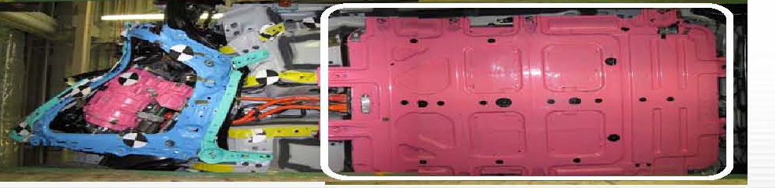
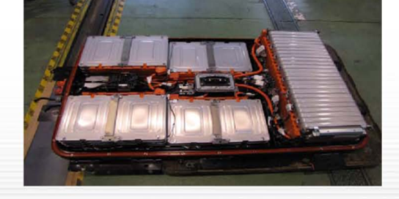
EV Crash Safety
EV is tested according to the regulatory and non-regulatory requirements for all markets where it is sold
  Example: 40 mph offset frontal impact
  No damage to battery pack
Notes:
24

Slide 25




EV Safety
Safety is evaluated by testing under a variety of situations and environments
Cold area Test
Water-covered road Test
Uneven road Test
High pressure washers Test
Notes:
25

Slide 26
Thank You
Notes:
26

