Slide 1

July 18, 2013
Terry Shelton
Associate Administrator, National Center for Statistics and Analysis

Slide 2
Agenda
What is Data Modernization (DataMod)?
NASS History
Data Mod Project Progress
Next Steps

Slide 3
What is Data Mod?
NHTSA’s Project to:
Upgrade the National Automotive Sampling System (NASS)
Modernize and consolidate related information technology systems
Goal: To affirm NHTSA's position as the leader in motor vehicle crash data collection and analysis, by collecting quality data to keep pace with emerging technology and evolving policy needs.

Slide 4
NASS History
Designed in the mid-1970’s
Designed as one system
75+ planned collection sites
20,000+ planned cases
Split NASS in 1988:
  General Estimates System
  Crashworthiness Data System
NHTSA continually reassesses its data needs

Slide 5
Current NASS General Estimates System
Purpose: To monitor large scale trends on the characteristics of the nation’s crash experience.
Probability-based design
60 sites in 26 states
About 50,000 sampled crashes annually
100+ variables coded from police crash reports
All vehicle types and crash severities

Slide 6
Current NASS Crashworthiness
Data System
Purpose: To aid in the development and evaluation of passenger vehicle crashworthiness and occupant protection systems
Probability-based design
24 sites in 17 states (subset of GES sites)
600+ variables coded from investigation-based data
Towed, passenger vehicle crashes only

Slide 7
Number of Cases in NASS CDS
*2012 Estimated ** 2013 Projected

Slide 8
Direction from Congress –
Modernize NASS
Considerations:
Is sample size and design sufficient?
Is scope too limited?
What data needs to be collected?
What data do external stakeholders need?
Congress appropriates $25M in FY 2012 to modernize NASS.
Notes:
The Insurance Institute for Highway Safety states that NASS provides a ‘vital means of understanding injury mechanisms and identifying ways to improve crashworthiness and restraint system performance’.
Safety researchers and automobile manufacturers also recognize the current NASS sample design created in 1977 is outdated, as data needs and demographics have changed significantly.

Slide 9
Data Modernization:
Major Project Components
Survey
Modernization
Information Technology Modernization & Consolidation
Implementation & Operations

Slide 10
Data Modernization:
Major Project Components
Survey
Modernization
Information Technology Modernization & Consolidation
Implementation & Operations

Slide 11
Survey Modernization Progress
Evaluated external and internal data needs
Developed sample conceptual design
Collected data for site selection
Made decisions on sample design, more to come

Slide 12
Solicited Input From Stakeholders on Data Elements for New System
Notes:
About 300 comments from 25 different stakeholders

Slide 13
Comments From Stakeholders on Data Elements for New System
Sample – (expand size, focus on higher severity crashes, newer and older vehicles, improve weights)
Scene (scaled diagrams, physical evidence, environmental items, terrain)
Vehicle (detailed event data recorder data, velocities, photos)
Other (more data in public file, include other vehicles and peds; continue crashworthiness data collection; collect more avoidance data)
Notes:
Most of the comments were related to the NASS CDS System.

Slide 14
“New NASS”
Sample Design
Probability-based
Two sample systems to start
No intentional overlap between “old” and “new” data collection sites
Increased sample scalability (up or down)
Flexible modular design
More precise estimates

Slide 15
Data Modernization:
Major Project Components
Survey
Modernization
Information Technology Modernization & Consolidation
Implementation & Operations

Slide 16
IT Progress
  Completed independent alternative analysis to determine a high-level approach to system design
Began consolidation of system components on a shared environment
Launched standardized approach for management of program variables

Slide 17
Data Modernization:
Major Project Components
Survey
Modernization
Information Technology Modernization & Consolidation
Implementation & Operations

Slide 18
Implementation and Operations Progress
Completed time analysis study
Developed variable repository
Evaluating platforms for field data collection, e.g., laptops, tablets, toughbooks, iPads
Evaluated and field-tested electronic measurement tools – proposing use of Total Station

Slide 19
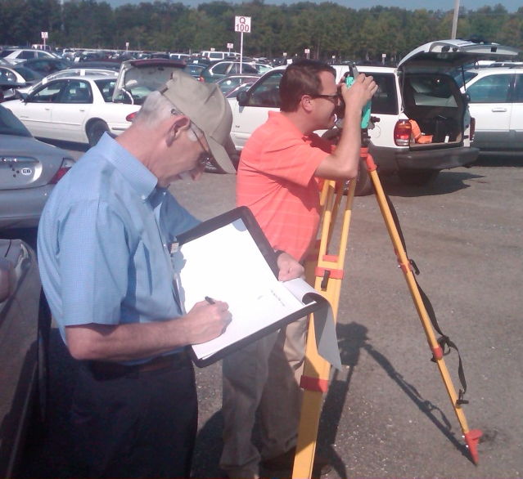
Total Station Data Collection Device
Benefits
  Time savings
  Accuracy
  Improved safety for field
  Produces scalable diagram
How does it work?
  Electronically measures distance and slope to a point
No PII data retained
Produces standard .CSV file
Notes:
CSV File:
Common format

Slide 20

Next Steps
What does the new GES look like?
What does the new CDS look like?
Anticipated outcomes
Timeline

Slide 21
“New” General Estimates System
What’s the Same? | What’s Different?
Probability-based | Newly selected sites (better reflect current population and crashes)
 | Possibly different size sites
All crash severities | Sites with slightly more injury crashes
All vehicle types | Enhanced use of technology to sample and capture data from police reports
Data from police crash reports | Possible use of linked data (e.g., VINs)
 | Increased precision of estimates

Slide 22
“New” Crash Data System
What’s the Same? | What’s Different?
Probability based | Newly selected sites
Crashes involving a towed passenger vehicles | Target sites and crashes with late model year passenger vehicles and injury crashes
Collect crashworthiness and basic precrash data | Enhanced data collection through new technologies and linked data
Investigation-based data collection | Flexibility for transition to special study data collection (e.g. trucks, peds, m/c, crash causation, etc.)

Slide 23
Anticipated Outcomes from DataMod
Fresh sample that better represents the national crash experience
Improved data collection efficiency
Better access and more data available to users
Improved IT efficiency and security
Scalable to add sites and cases
Flexible design to increase scope

Slide 24
Data Modernization Timeline
2012
2013
2014
2015
2016
Congress appropriates funds
Sample design begins
External data needs explored
Sample design complete
IT project plan complete
IT consolidation and development begins
IT architecture built
IT testing and validation
Document information on selected sites
Establish sites
Hire and train collection and coding staff
Pilot test collection
Pilot test quality control
Commence data collection in New NASS system

